Slide 1
بسم الله الرحمن الرحيم
Republic Of Sudan
Ministry of Human Resource Development
and Labour-Sudan
TACKLING Child Labour through Education Project
Brussels-Belgium
July 2013

Slide 2
Introduction
Great progress was made under each of the four TACKLE Project result areas. The progress under the four result areas are as follows:

Slide 3
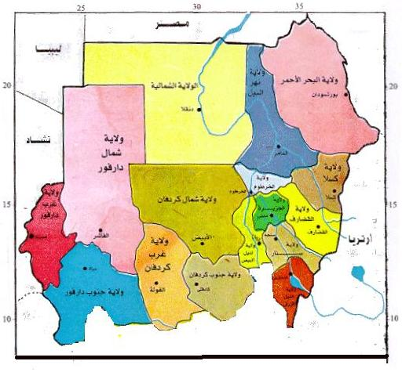
Sudan - Map

Slide 4
Result1
Improved country level child labour and education legal framework exists in Sudan:
Child act was reformed in 2010 where it included a section on child labour and partners are now working on developing bylaws on child labour.
Under TACKLE support, the Ministry of Labour has developed a list of hazardous work, the list was endorsed by the minister and a decree was issued on it.
A comprehensive review of all legislations relevant to child labour was conducted with specific recommendations for strengthening of the laws and draft bills including the draft constitution.

Slide 5
Result 2: Strengthened institutional capacity leading to improved ability to formulate and implement child labour strategies
Establishment of the Child Labour Unit within Ministry of Labour.
Establishment of the National Steering Committee on Child Labour from Ministry of Labour, Ministry of Education, the National Council of Child Welfare, Workers Union, Employers Federation, and three NGOs working on Child Labour.
Study on child labour in Sudan to assist in developing a national policy on elimination of child labor including detailed work plan with budget estimate
Training of labor inspectors from Khartoum and seventeen states of Sudan on Child Labour Inspection.
Organizing a seminar for 40 departmental heads in MoE on mainstreaming child labour in relevant sections of the 5 years education strategic plan.

Slide 6
Cont.
Training on Economic Reintegration of Children Associated with Armed Forces and Groups and Other Vulnerable Children targeting participants from war zones.
Training of officers from Ministries of Labour, Education, Agriculture and National Bureau of Statistics through participation in different workshops held in Kenya, Zambia, Uganda, and ILO training centre in Turin, Italy.

Slide 7
Result Area 3: Implement targeted actions to combat child labour:
Direct actions targeted the withdrawal of children from child labour and placement in school, and support of their families to start alternative sources of income. CDF has been funded to withdraw 150 children from labour and place them at schools at Jabal Awlyia Locality, there was also support to children families.
SABAH Association has been supported to withdraw twenty children and support their families and raise the community awareness about child labour.
Child Right Institute held public forum on children in Domestic Works disseminating study findings.

Slide 8
هيكل السلم التعليمي في السودان
Result Area 4: Improve advocacy and dissemination of good practices to enhance the knowledge base and reinforce networks on child labour and education:
The celebrations of the World Day against Child Labour (WDACL) for the years 2010, 2011, 2012, and 2013 took place successfully. There was active participation of all members of the National Steering Committee (NSC) on child labour, civil society groups and private sector players in Sudan where the observances had also been conducted in different States of Sudan.

Slide 9
The internal political support:
There was great political support where Minster of Labour and undersecretary of Minster of Labour were closely supervising and providing guidance and needed support.
The state presidency showed its utmost interest where the cabinet of ministers asked the Minstry of Labour to report the efforts taken to end child labour. The Minister of Labour submitted the required report to the vice-president of Sudan.

Slide 10
Recommendation:
Sudan strongly recommends a second phase of the project where partners agreed to continue their work in the fields of tackling child labour through education through the following:
Strengthening the institutional mechanisms in both the center and the states of Sudan.
Formulation of states steering committees to carry on activities on the states levels.
Supporting children inspection work all over Sudan.
Continue programs on tackling child labour through education.

Slide 11
Thank You

