Slide 1

Upgrading Informal Apprenticeship
ILO New Initiative on Youth Employment in Jordan
Yasser Ali
Project Manager

Slide 2
“Tripartite Action for Youth Employment” project is part of four SIDA-funded projects on Youth Employment in Jordan, Indonesia, El Salvador and Zambia
Increased productive and decent employment for young women and men in Jordan
Improved signalling of skills, and market value of the TVET certificates to facilitate training to work transition ( through access to a national assessment and certification system established by CAQA)
Increased capacity of MSMEs to contribute to the quality of the skills supply through upgraded apprenticeship
Improved capacity of trade unions to increase their outreach to young women and men to advocate for their rights at work through the manual on youth rights at work including non-gender based discrimination

Slide 3
Stakeholders
MOL
Beneficiaries
Trainees certified through the centres, and employers who will recruit them
ETVET Council
CAQA (Center of Accreditation & Quality Assurance)
VTC
JCI and sectorial associations
GFJTU and other TUs
MSMEs and young women and men who will benefit from improved apprenticeship
Young women and men trained on youth rights at work by the trainers.

Slide 4
Main Expected Deliverables
Outcome 1 – improved testing and certifications
Assessment & Certification system requirements, strategies, methodologies
Outcome 2 – upgraded informal apprenticeship
Assessment and analysis of informal apprenticeship in Jordan
Assessor Guides
Certified Assessors and Assessment Centres
Increased capacities of MSMEs to implement apprenticeships
Implementing & monitoring implementation of action plan
Outcome 3 Youth Rights @ Work
Manual of Youth Rights at Work
Certified Trainers on Youth Rights at Work

Slide 5
Informal Apprenticeship
Transitions from school to productive and decent work in the formal economy are the realistic expectations of young people: those with the opportunity for good basic education that opens pathways to further learning and to employment.
Even for these young people, expectations often go unmet because low rates of job-rich growth in the formal economy result in scarce employment opportunities
Most young people however do not have the chance to attend formal institutions of learning
growing numbers of youth are learning and then working in the informal economy

Slide 6
Formal/Informal
Formal Training
Instruction given in education and training institutions or specially designed training areas, including enterprises in formal apprenticeship systems
Training is structured and systematic, and follows predefined content and precise learning objectives
Formal Apprenticeship
Formal apprenticeship refers to a system by which a learner (the apprentice) acquires the skills for a trade or craft in an enterprise learning and working side by side with an experienced craftsperson, usually complemented by classroom-based instruction
Apprentice, master craftsperson/employer and the training provider conclude a training agreement that is regulated by formal laws and acts
Informal Apprenticeship
System by which a young learner (the apprentice) acquires the skills for a trade or craft in a micro- or small enterprise learning and working side by side with an experienced craftsperson
Apprentice and master craftsperson conclude a training agreement that is embedded in local norms and traditions of a society
Costs of training are shared between apprentice, master craftsperson/ employer and the government
Costs of training are shared between apprentice and master craftsperson

Slide 7
Improving informal apprenticeship
Informal apprenticeship systems have the potential to meet the needs of substantial numbers of youth but they also have serious weaknesses that limit their ability to deliver good quality training.
the slow diffusion of new technologies and skill sets;
limited opportunity for apprentices to acquire theoretical understanding in their field which inhibits continued learning;
the lack of recognition of the skills apprentices acquire outside of the local community which reduces their employment options;
long working hours;
unsafe working conditions;
low or no allowances or wages;
little or no social protection in case of illness or accident;
strong gender imbalances
Well-designed approaches aim to overcome weaknesses in the system step by step.

Slide 8
Upgrading informal apprenticeship
Identifying and Selecting sector/occupation for in-depth analysis
Conducting assessment to understand rules and practices in informal apprenticeship
Analysing the result
Analysing policy context
Identification and prioritization of major issues to upgrade informal apprenticeship in the country
Presenting findings and discussed at partners and stakeholder workshop

Slide 9
Identifying occupations
The way skills are acquired
The status of young people in the business
General idea of the training content
Importance of a training agreement
Duration of the apprenticeship period

Slide 10
Selecting occupations for in-depth analysis
The occupation has a good potential for growth and development helping to increase motivation, supply and demand for apprenticeship as well as returns to apprenticeship training
The occupation should be gender-balanced so that female-dominated occupations are also included

Slide 11
Conducting research
Qualitative :
Interview of master craftperson
Interview of apprentice
Interview of focus group
Quantitative:
Questionnaire for master craftperson
Questionnaire for master apprentice
Questionnaire for master skilled worker
Questionnaire for master business owner

Slide 12
Analyzing results
Economic and social context
Business characteristics ( size, owner,--)
Business opportunities (technology, import/export)
Socio-economic background of staff (gender, age, education & training)
Financing informal apprenticeship
Training investment (fees, tools, apprenticeship period --)
Shared benefits

Slide 13
Analyzing result (Cont.)
Quality of Training
Perception of IA (master, apprentice)
Flow of knowledge and skills
Training content and process
Access to new skills
Training outcome (employment--)
Quality assurance of training

Slide 14
Analyzing results (Cont.)
IA Practices
Recruitment and gender
Decent work (social security, working hours, OSH)
Linkage with formal System
Transition from school to apprenticeship (time lag--)
Recognition of skills (assessment & certification)

Slide 15
Apprenticeship Contracts can include..
What is the content, the process of training and tracking system?
Quality management: who will ensure the quality of the youth production / services?
Can apprentice set up new business in same field? Be hired another business?
How long should apprentice work to allow for cost recovery?
What happens if the contract is breached?
What liability in case of destruction equipment?
What social protection for apprentices?
What are working conditions and working hours?
What assessment and certification?

Slide 16
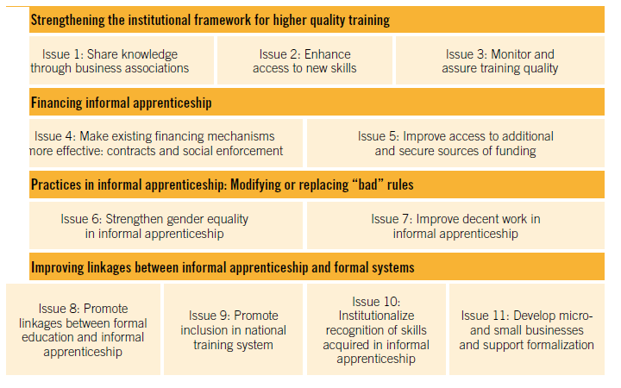
Policy Areas

Slide 17
Key messages
Capitalize on the existing system
Strengthen the apprenticeship contract
Bring new skills into informal apprenticeship
Enhance the quality and reputation of informal apprenticeship
Improve equal access to informal Apprenticeship
Include informal apprenticeship in the national training system
Take a step-by-step approach

Slide 18
Thank you.

