Slide 1

Tripartite Action for Youth Employment in Jordan
Yasser Ali
National Project Coordinator

Slide 2

Jordan Facts

Slide 3
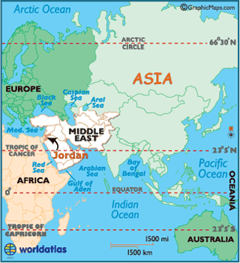

Slide 4
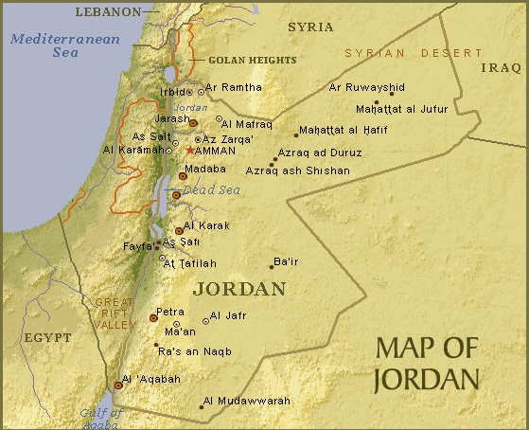

Slide 5
Jordan Facts
Population: 6,249,000
Area: total 89,342 sq km (land 88,802 sq km ,water 540 sq km)
Jordan lies between latitudes 29º and 34º, and longitudes 35º and 40º
The Hashemite Kingdom of Jordan is a constitutional monarchy with an appointed government
Jordan is classified by the World Bank as an "upper middle income country”
Potash and phosphates are among the country’s main economic exports
Total no. of students: 1,822,000 ( F: 49.8 %)
Labour force participation rate: 39 % (F:14.7%, M:62.8 %)
Unemployment rate: 12.9 % (M:F 2:1)
Foreign workers: 280,263
Population below absolute poverty: 13.3 %

Slide 6
Project in Brief

Slide 7
Increased productive and decent employment for young women and men in Jordan
Improved signalling of skills, and market value of the TVET certificates to facilitate training to work transition ( through access to a national assessment and certification system established by CAQA )
Increased capacity of MSMEs to contribute to the quality of the skills supply through upgraded apprenticeship
Improved capacity of trade unions to increase their outreach to young women and men to advocate for their rights at work through the manual on youth rights at work including non-gender based discrimination

Slide 8
Stakeholders
MOL
Beneficiaries
Trainees certified through the centres, and employers who will recruit them
ETVET Council
CAQA (Center of Accreditation & Quality Assurance)
VTC
JCI and sectorial associations
GFJTU and other TUs
MSMES and young women and men who will benefit from improved apprenticeship
Young women and men trained on youth rights at work by the trainers.

Slide 9
Main Expected Deliverables
Outcome 1 – Testing and certifications
Assessment & Certification system requirements
Outcome 2 – upgraded informal apprenticeship
Rapid assessment of informal apprenticeship in Jordan
Certified Assessors
Capacity Building of MSMEs to implement upgraded apprenticeship
Implementing upgraded informal apprenticeship
Outcome 3- Youth Rights @ Work
Manual of Youth Rights at Work
Certified Trainers on Youth Rights at Work
Assessor Guide and Assessment tools
Assessment Centres

Slide 10
Project Logframe

Slide 11
Project Progress

Slide 12
Outcome 1
Assessment and certification system
The tripartite steering committee for the project was established and the TORs for the committees was approved.
The steering committee has representatives for government (MOL,ETVET Council, CAQA,VTC), Social partners (JCI, GFJTU), Private training provider
The project work plan was developed and then approved by the steering committee
Three steering committee meetings were conducted in addition to several individual meetings with governments, social partners and other related institutions.
An inception report was prepared at November 2012 including revision for the project outcomes, outputs, indicators, activities and budget.

Slide 13
(Cont’d/-) Outcome 1
Assessment and certification system
The project work plan was developed and then approved by the steering committee
The criteria for selecting the intervention sectors are set up, that are:
The sector ranking in terms of economic activity
The sector is covered by the law of Certificate for Practice
The sector has a developed competency profile
The sector is gender-balanced
Two sectors were selected based on the agreed criteria, that are: Auto Repair and Printing sectors
Forming the technical team for developing assessment tools and training assessors
Four specialists: leader, Assessment methodology, Two experts : Auto Repair , Printing

Slide 14
(Cont’d/-) Outcome 1
Assessment and certification system
Organizing one consultation day to define assessment and certification system requirements
Participants: curriculum developer and assessment specialists from governmental and private training providers, Tus, Chamber of Industry and worker association, employers
Objectives
Knowledge exchanging on international, regional and national experiences in skill assessment and certification
SWOT analysis for the existing skill testing system
The main requirements for improving the existing skill and certification system in terms of occupational standards, test designing and conducting
Role of different stakeholders

Slide 15
(Cont’d/-) Outcome 1
Assessment and certification system
Skill testing team achievement right now:
Assessor guide contents:
Skill testing in Jordan
Skill testing concepts
Designing skill tests
Conducting skill test
Example's
Assessment tools templates:
Evidence Matrix ( competency mapping)
Assessor checklists
Written exam characteristics
Good part of the assessor guide drafted
Work on Assessment tools in progress

Slide 16
Outcome 2
Upgraded Informal Apprenticeship
A workshop on apprenticeship was conducting for exchanging and identifying the steps to be taken for upgrading apprenticeship and improving youth employment in Jordan
Participation of government, social partners, CSOs , UN and international agencies.
The workshop objectives:
International experiences inside and outside Arab States on upgrading apprenticeship is exchanged
Current initiatives and studies on youth employment in Jordan is discussed ( ALMP, YE Mapping )
Cross cutting issues related to apprenticeship and youth employment is presented ( child Labour )
Steps to upgrade apprenticeship and improve youth employment in Jordan is agreed upon

Slide 17
(Cont’d/-) Outcome 2
Upgraded Informal Apprenticeship
Selecting the sectors to be worked on
Hiring National Consultant for conducting rapid assessment for required improvements for upgrading informal apprenticeship system in the targeted sector(s)
Conducting interview meetings with the key informants
Developing field research tools for interviewing apprentices, craft persons and skilled workers (in Progress)
Conducting the individual interviews and focus groups for apprentices, craft persons and skilled workers (this month)

Slide 18
Outcome 3:
Trade unions better prepared to promote youth rights at work
Recruiting the national consultant for developing and training on the manual of youth rights at work
Selecting the editing board for the manual
GFJTU
Independent TUs
VTC
YE organizations)
Format and table of content (almost finish)
First draft ( in progress)
Manual content validation workshop (this month)

Slide 19
Achievements :
As a Focal Point on skill and YE
Building channels with institutions working on skill development and youth employment in Jordan toward tangible collaborations .
Expanding the ILO profile for skill development and youth employment in Jordan for more visibility of ILO in skill development picture in Jordan compared with other UN and non-profit organizations
Networking was established with several institutions working on the youth employment in Jordan (UNDP,IYF,EFE,ETU ---)
The intervention and other ILO interventions on skill development and youth employment were presented in several meetings (UNDP,UNRWA,GIZ,DVV ---)
Collaboration with EU on skill testing, M&E for ETVET sector
Working with IYF on policy paper on retention assessment
IYF and EFE are members in editing board on YR@W

Slide 20
Achievements
Collaboration with other ILO projects in Jordan
M&E in ETVET Sector project
STED project
Child Labour project:
Expanding the scope of work for national consultant on informal apprenticeship to cover child labour dimensions specially OSH and hazardous work
Hiring OSH specialist to accompany the national consultant on informal apprenticeship and cover the OSH dimension in YE and Child Labour projects
Migrants project:
Supporting the project in organizing a workshop on work permits and the link to qualifications and skill testing

Slide 21
Contribution to Measurement Criteria

Slide 22
Criteria c:
National programmes / decent employment / disadvantaged youth/ government / social partners
Access of young women and men to national assessment and certification system that improves the signaling of skills, and the market value of the TVET certificates and facilitates training to work transition
Disadvantaged young women and men benefiting from Implementing upgraded informal apprenticeship
National manual and certified trainers on youth right at work to enable disadvantaged youth to advocate for key aspects of decent work conditions
The tripartite approach to skills development is central to the projec
Tripartite Project Steering Committee
Decisions related to the implementation of the project for each component, is made based on a tripartite agreement of government and social partners from workers and employers

Slide 23
Criteria d
Information dissemination, awareness-raising, training or outreach
Several consultation meetings and workshops with government, social partners, training providers, employers, youth, key informants, NG youth employment organisations– for knowledge exchange, collaboration and awareness
Awareness raising meetings and documents (leaflets, brochure):
for publicising skill assessment tools and guide,
issuing informal apprenticeship final report,
endorsement of the national manual on YR@W
Training
of trainers on skill assessment tools,
of trainers on youth rights at work manual
and coaching for MSMEs and young women and men participating in implementing upgraded informal apprenticeship
Piloting youth rights at work manual on young women and men

Slide 24
THANK YOU

