Slide 1
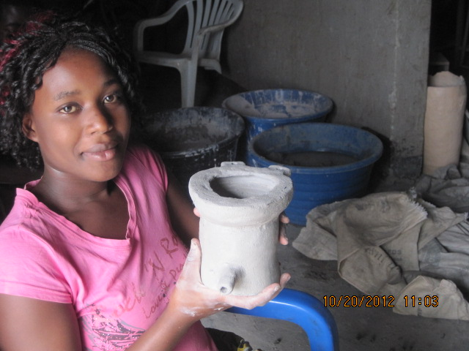
INTERNATIONAL LABOUR ORGANIZATION
YOUTH EMPLOYMENT PROJECT- ZAMBIA

Slide 3
Development Objective
Enhanced employment and self-employment opportunities for young people through access to skills development.

Slide 4
Logframe – word document

Slide 5
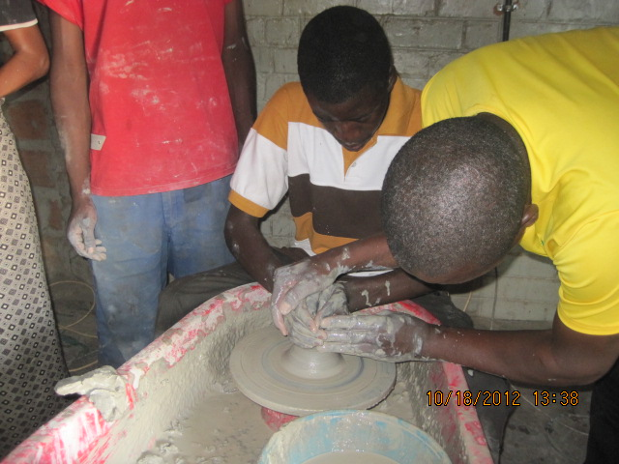
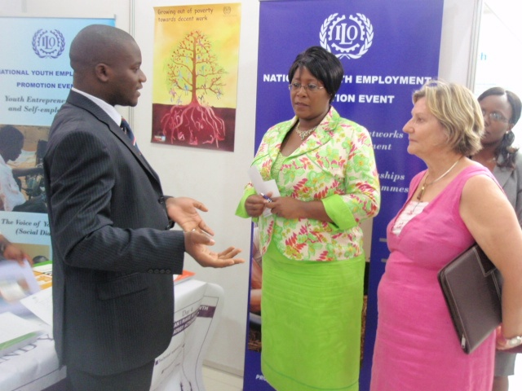

Slide 6
Updates
Youth rights Manual adaptation with ZCTU – action plan in place
Cooperatives formation with ZCTU
Draft NPA in place to be incorporated in SNDP by MoFNP
ZB partnership Get Ahead
Lumwana partnership

Slide 7
Advisory committee of NYRC and a three year Sofia Project
Commonwealth professionalising youth work- promotion of Decent work for youth, recognition of prior learning, curricular for youth work to be developed and careers paths in youth to be identified.
Junior reporters 19 young men and women trained on reporting youth employment issues – skills and awareness

Slide 8
NPA process acknowledged in the Presidential Speech on National Youth Day
Youth Week Exhibitions IYES, Value chain, Entrepreneurship exhibitions etc - Results helped popularise entrepreneurship, - there is more appreciation of youth entrepreneurship, President awarded three best exhibitors on national day (partnership with CYP and ZB)
Impressive media coverage on YE

Slide 9
Organised youths to add a voice to Post 2015 discussion
Newsletters

Slide 10
Upcoming
UNCT signatory issues - Youth employment
Youth Policy Review with UNESCO and ILO taking a lead on Entrepreneurship and employment thematic group
train 500 young women
Mentorship for young women with Stanchart
Famos Training for Bank staff
Partnership with Lumwana Mine on youth empowerment
Cooperating Partners conference on youth employment
PGA for MYS
Support to ZFE and MLSS on internship

Slide 11
Key Success Factors
Cooperation or support from
Country office
YEP, Specialists
Government prioritisation of YE
Interventions at three levels
Partnerships
Project team’s passion on YE
Knowledge sharing with fellow project Managers
ILO’s past and recent reputation to deliver

Slide 12
Challenges
More expectations from government
Many players on YE sometimes duplicating the work

Slide 13
Way forward
What next after this project end
?
?
?
Support to implement NPA
Support to implement IJS
Extra budget for 2013 activities???

Slide 14
Thank You

