Slide 1
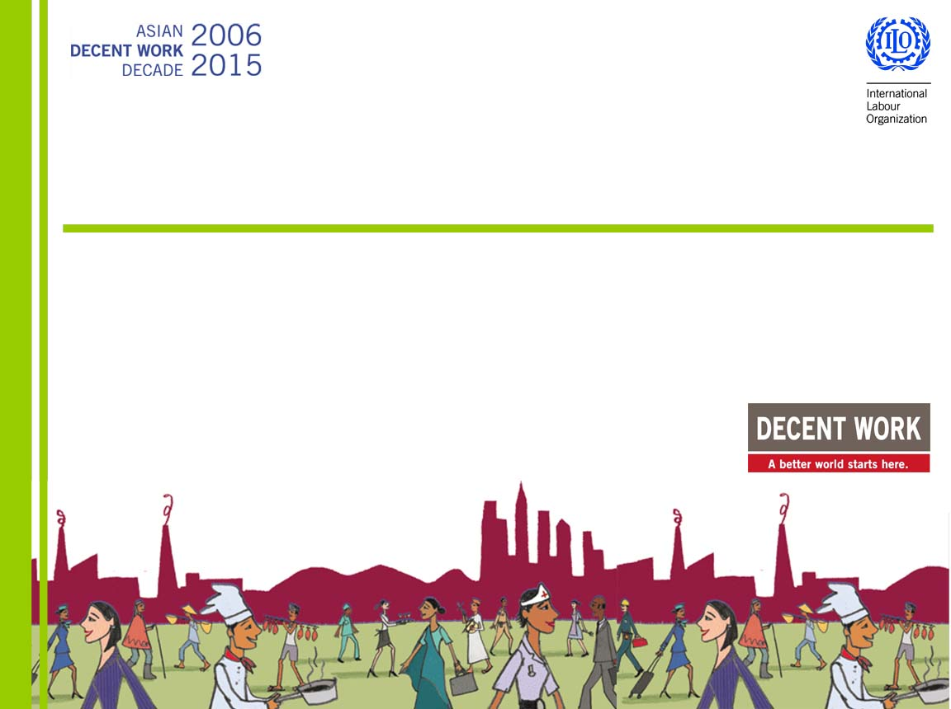
Hiring with a Heart
Director Lawrence Jeff Johnson
International Labour Organization
Country Office for the Philippines

Slide 2
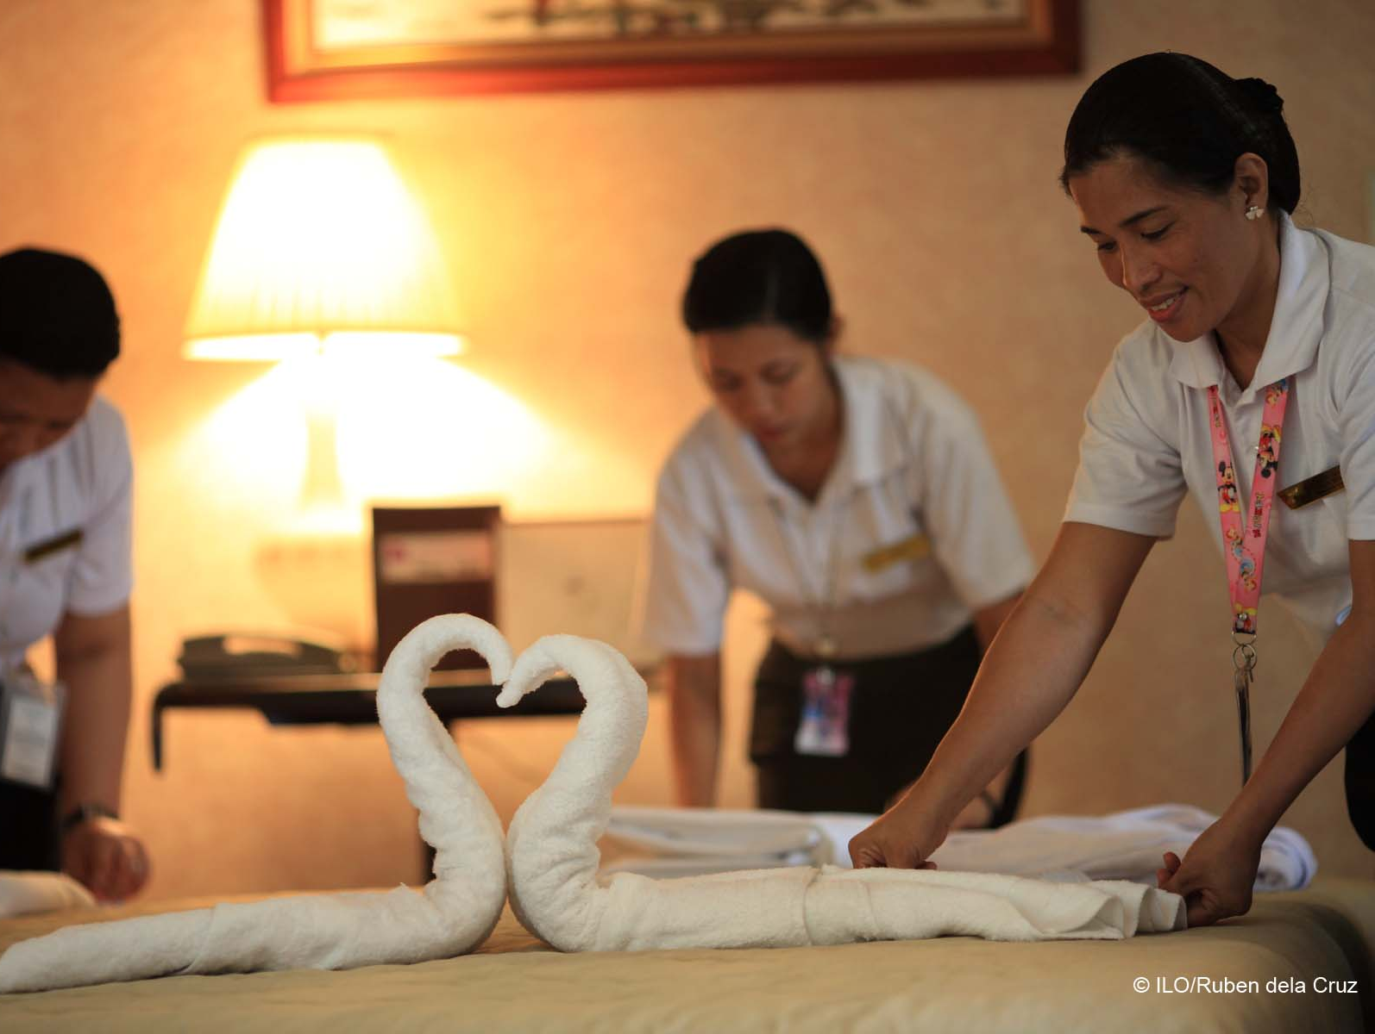
Hiring with a heart
Investing in youth
Persons with disabilities
Women and maternity protection
Indigenous peoples
Persons living with HIV
Ending child labour in supply chains

Slide 3

Investing in youth
Young people are three times more likely to be unemployed than adults
75 million young people are jobless - 4 million more than in 2007.

Slide 4
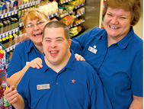
Persons with disabilities
Challenge
470 million are of working age (2006), including 238 million in Asia Pacific
many are living in poverty and
more likely to earn lower wages
Walgreens hired many disabled employees, including those with autism and intellectual disabilities, resulting to 20 per cent production increase , a model being copied by others.
rates are increasing due to population ageing and global increase in chronic health conditions

Slide 5

Persons with disabilities
What companies and researchers have found
Good dependable employees
Better job retention
Improved company image
Disabled people as a market
Dupont Study (1958-1990) Disabled workers performed comparable to or better than
non-disabled peers with regard to: SAFETY, ATTENDANCE and JOB PERFORMANCE.

Slide 6
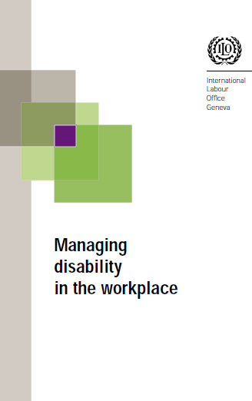
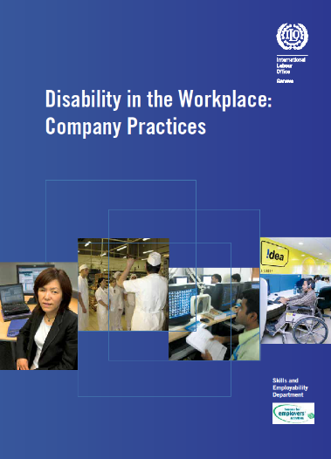
Persons with disabilities
ILO Discrimination (Employment and Occupation ) Convention (No. 111), 1958
ILO Vocational Rehabilitation and Employment (Disabled Persons) Convention (No.159), 1983 and Recommendation No. 168
Voluntary ILO Code of Practice for Managing Disability in the Workplace, 2002.
“What can and should be done practically, for instance on a corporate level?
My answer is quite plain.
Why don’t we just try?
- Marc Suter, Lawyer and
advocate for persons with disabilities
UN Convention on the Rights of Persons with Disabilities

Slide 7
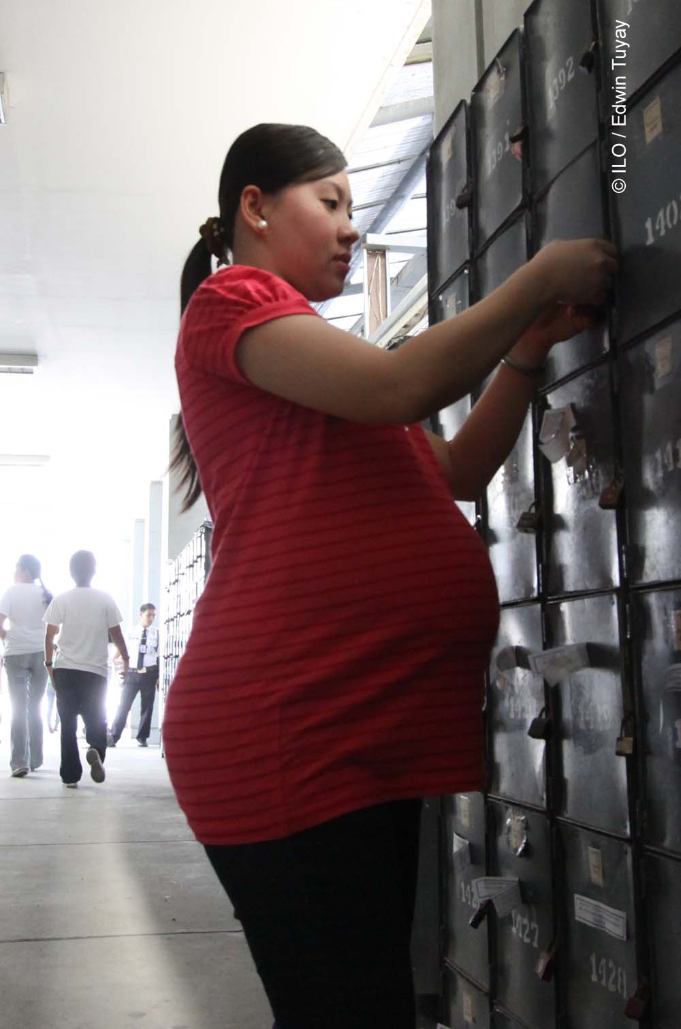
Women and maternity protection
Pregnant women are often not recruited, or not even encouraged to apply since hiring them will immediately incur maternity protection costs and benefits.
Many women are forced to return to work too early, before they have recovered for fear of losing their jobs or returning to work with lower pay or position.

Slide 8
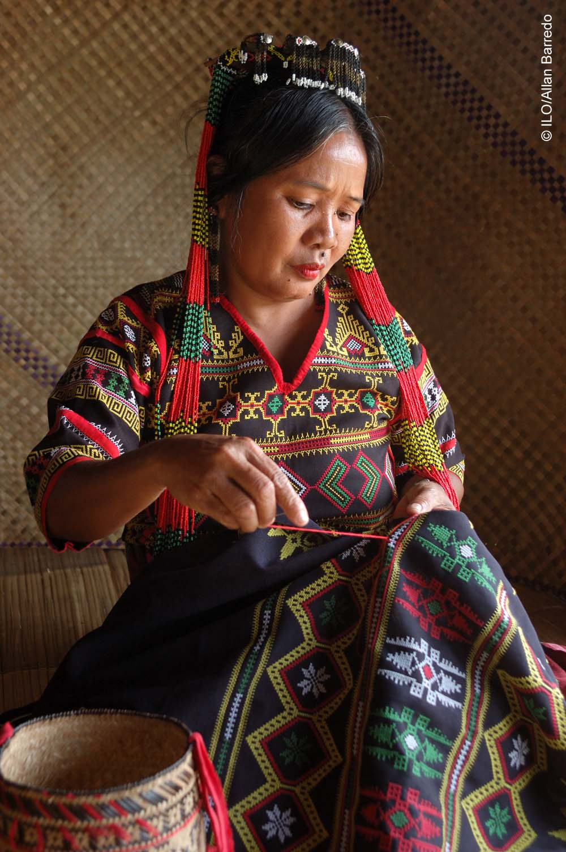
Indigenous peoples
Indigenous and tribal peoples are often forced to seek work outside traditional communities in order to survive
Indigenous and tribal workers should not be discriminated against when looking and applying for work (ILO Convention on Indigenous and Tribal Peoples, No. 169)

Slide 9

Persons living with HIV
Nine of every ten people living with HIV will get up today and go to work.
Workplace can facilitate access for all workers to HIV prevention, treatment, care and support.
People living with HIV can work and lead a long productive life, important to keep them in employment.
“If you take away our jobs, you will kill us faster than the HIV virus.” - Person living with HIV

Slide 10

Persons living with HIV
Workers should not be subjected to HIV-related stigma and discrimination in any aspect of the employment, including selection and recruitment.
Workers should not be required to undergo compulsory testing and disclosure of their HIV status for purposes of recruitment and employment.

Slide 11
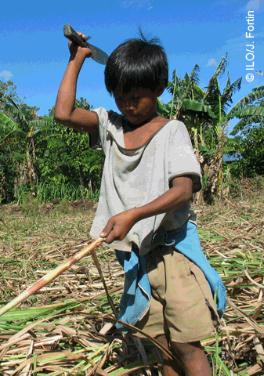
Ending child labour in supply chains
Child labour in the Philippines
5.49 million working children, of which 2.99 million in hazardous child labour (NSO, 2011).
Keeping children in school
Improvements in global supply chains (corporate codes of labour practice, CSR and ethical trade approaches)
Coca-cola “Sugar is sweeter without child labour”

Slide 12

Ending child labour in supply chains
Damage company reputation. Child labour scandal hits a popular sports brand - footballs being made by children as young as 7.
Loss of revenue. Young boys sold into slave to cocoa farms to make chocolates.

Slide 13
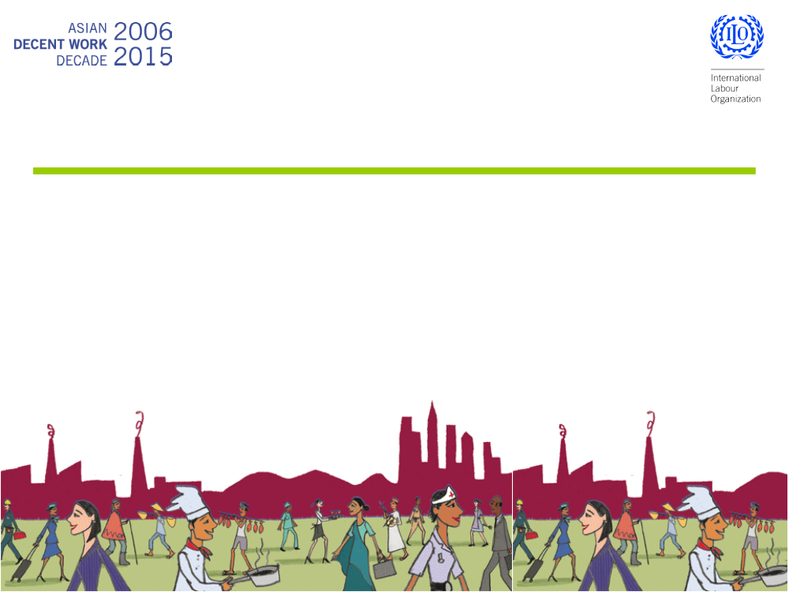
Thank you
For more information, please contact:
Director Lawrence Jeff Johnson
ILO Country Office for the Philippines
Tel: 63 2 580 9900, Fax: 63 2 856 7597
E-mail: manila@ilo.org
www.ilo.org/manila

