Slide 1
ICAO: Driving and supporting States, building resilience to ensure sustainable safe travel
TITLE / HEADING
JAG, 6 September 2022

Slide 2

Achieving resilience based on a trio of critical considerations
Policies
Assure
feasibility
Align and
Harmonise
Implementation
Resources
Leverage tools
and infrastructure

Slide 3

Policies
ICAO General Assembly
• 27 September – 7 October 2022
• Facilitation Programmes (Agenda Item 12 and 13)
• Wide variety of topics:
Annex 9, innovation, future of pax processes and innovation, human trafficking, framework for future outbreaks, wildlife trafficking, crew treatment, etc.

Slide 4
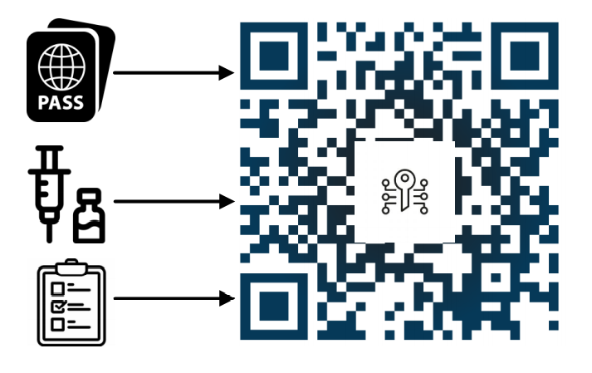



Resources
ICAO VDS-NC
The ICAO Health Master List
Allows re-use of existing document issuance infrastructure and capabilities
Verifiable at borders based on existing capabilities for travel documents
Re-uses existing capabilities and resources associated with the ICAO PKD
Leverages ICAO’s positioning as a global nexus for trustworthy certificate sharing

Slide 5
On-going collaboration to support global implementation of health-related infrastructure for travel
Implementation
WHO
G20
States
NGOs
Industry
Supporting pilot project on mutual recognition of health proofs
Providing expertise and input to support advancement of planning for future infrastructure
Ensuring the needs of aviation and border management are properly considered

Slide 6
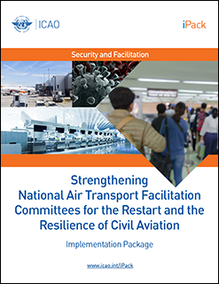
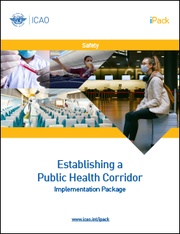

Implementation

Slide 7

TRIP symposium?

Slide 8
Notes:
Thank you.

