Slide 1
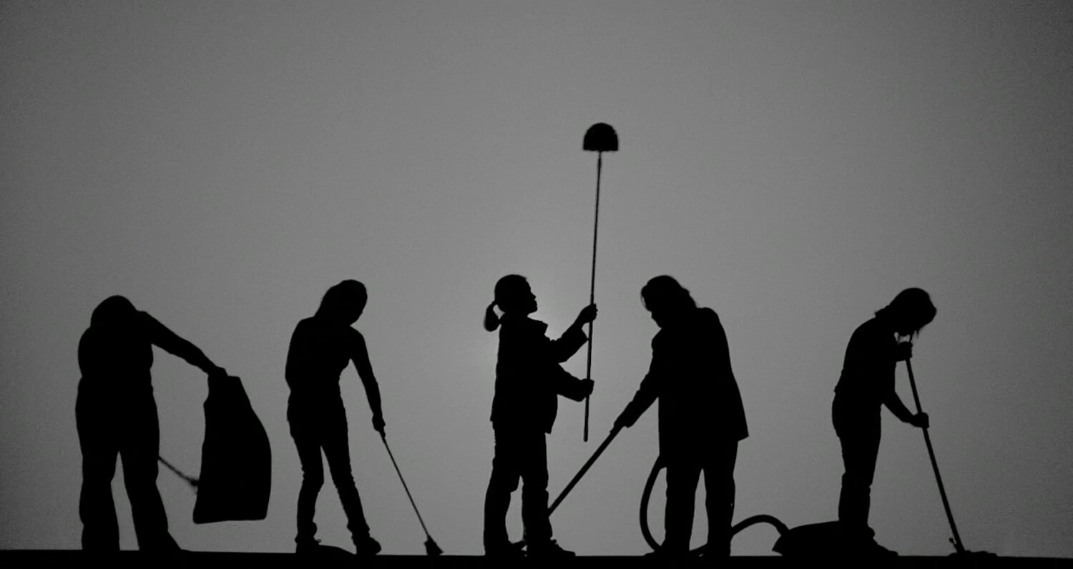
Domestic Workers in Sri Lanka
Centre for Women’s Research (CENWOR)
7th January 2020

Slide 2
Methodology
Overall Methodology
  Survey of domestic workers and employers
  In-depth interviews with domestic workers
  Documentary analysis: policies, laws, international instruments;
  Desk review : national and international literature
Survey - Colombo, Gampaha, Kandy
  300 domestic workers: 138 live-in DWs; 162 live-out DWs
  242 women and 58 men
  60 employers: 57 individual employers; 3 recruitment agencies
15 in-depth interviews
Sampling method- Convenience and snowballing

Slide 3
Distinct category of worker in
Sri Lanka’s informal Labour Force
Different types of domestic workers
Majority are women
Duties vary according to type of work

Slide 4

Domestic Workers:
Vulnerable group in informal sector

Slide 5
Vulnerable Group
Reasons for choosing domestic work
Family income < LKR 20,000 35% of live-in and 26% live-out

Slide 6
Vulnerable Group – Age Structure
A majority of the domestic workers are above the age of 50.

Slide 7
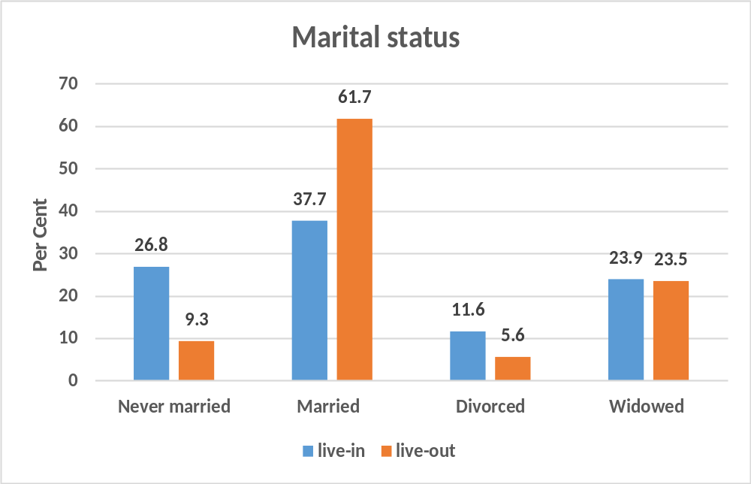
Vulnerable Group – Marital Status
Age - elderly persons – mostly women have to work for their survival due to lack of social support
Marital Status

Slide 8
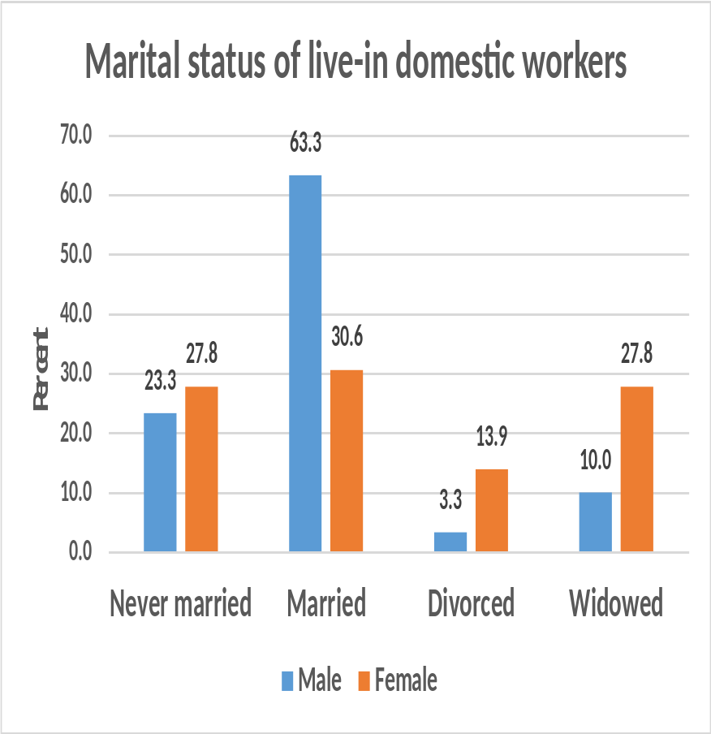
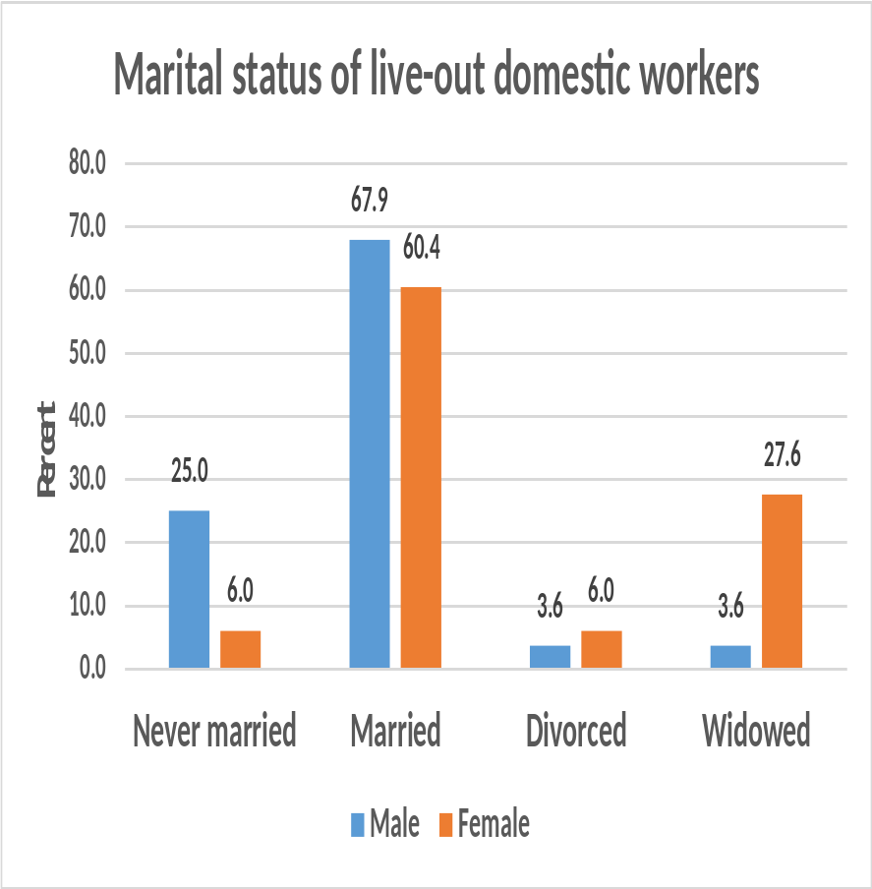
Vulnerable Group
Gender Differences in Marital Status

Slide 9
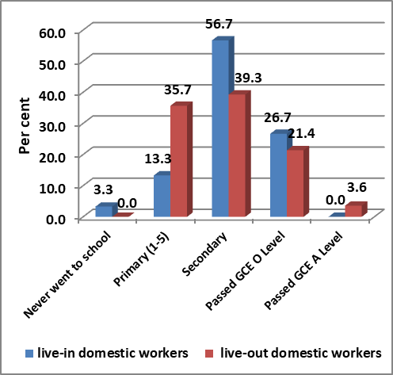
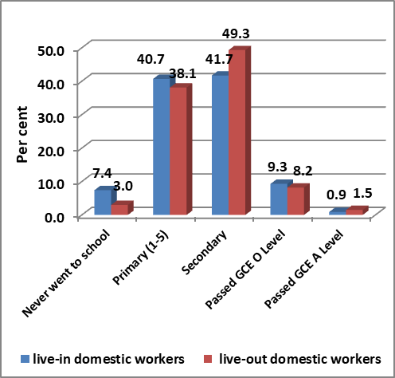
Vulnerable Group
Low-level of Education

Slide 10
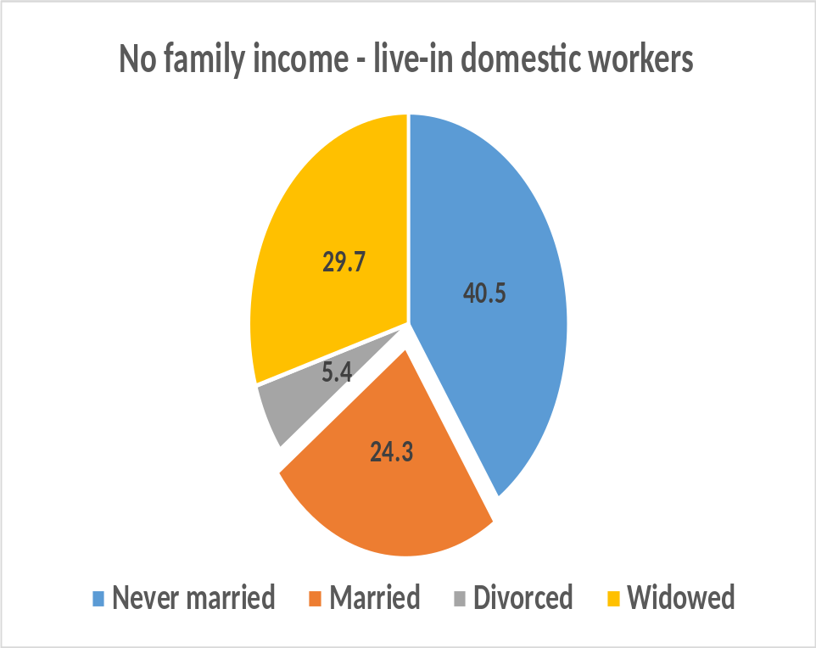
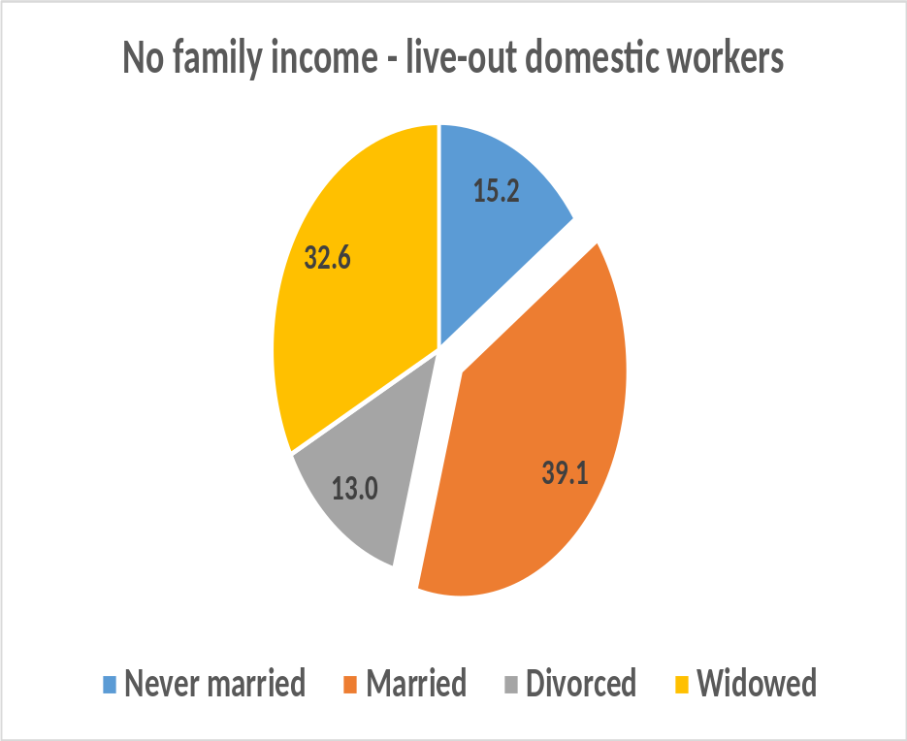
Vulnerable Group
Economic Status and Family Income
  26.8% of live-in and 28.4% of live-out domestic workers had no other family income, or a family.

Slide 11
Terms and Conditions of Work

Slide 12
Terms of Work - Working Hours

Slide 13
Working Hours
According to daily routine of DWs:
  For 46.7% wake-up time was 4.00am or before
  73.3% went to bed at 10.00pm or later
  13.3% do not get any leisure time
  53.3% had less than or equal to 2 hours of leisure time.

Slide 14
Work Agreements
Informality
More than 90% had not received a written agreement.
However, most were aware of the terms and conditions of the job they were undertaking.
All 57 employers had given verbal agreements irrespective of their educational levels.
Only 1 live-in and 3 live-out DWs reported that EPF/ETF was discussed at the time of employment

Slide 15
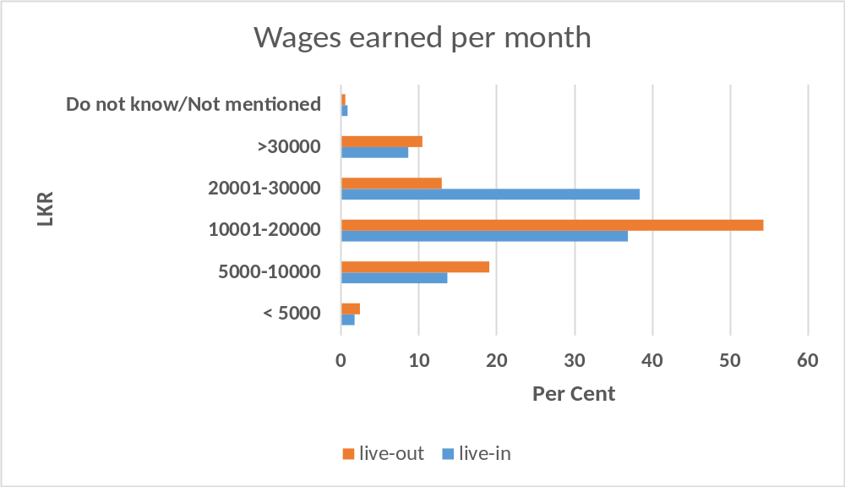
Terms of Work – Salaries and Wages

Slide 16
Terms of Work - Leave
Paid leave - More than 70%
Paid sick leave – More than 80%

Slide 17
Working Conditions - Facilities
Room - The majority had a separate room allocated to them, were given meals, toiletries, and were provided with medicines when unwell
Rest - The majority stated that they were given time to rest
Communication - Nearly three quarters mentioned that mobile phone use was not restricted.
Mobility - 80.4% of live-in domestic workers were permitted to leave the house for short periods of time for various reasons and this was not counted as paid leave. However,
  17.4% reported they were not permitted to leave the house, while two said they were not allowed to venture out on their own.

Slide 18
Working Conditions
Discrimination, Harassment, Abuse
22.5% of live-in DWs had faced problems mainly too much work or psychological harassment
A majority did not complaint due to fear of the employer, due to fear of losing the job, due to lack of knowledge of an agency to make a complaint
5 Live-in DWs had experienced unacceptable/unpleasant behaviour. 2 were asked for sexual favours, 2 workers had experienced touching in an uncomfortable way and one worker had been raped.

Slide 19
Formalising Domestic Work

Slide 20
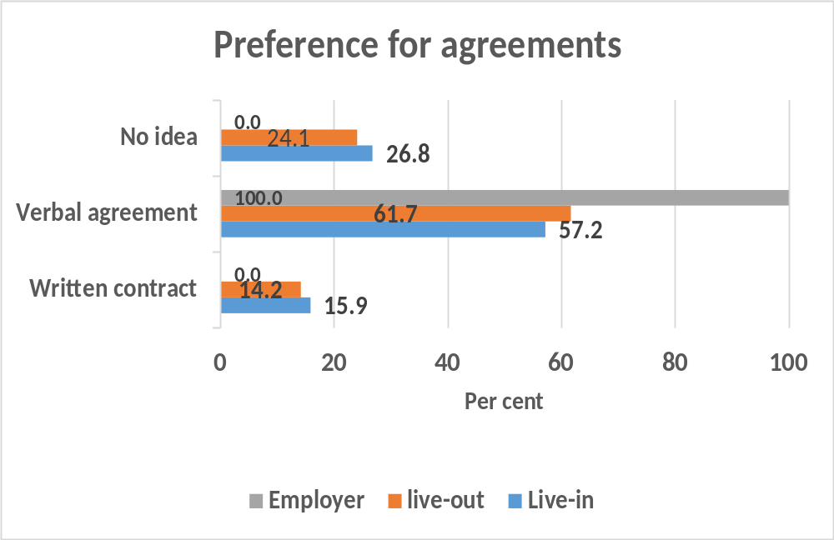
Preference for Contracts

Slide 21
Preference for Contracts
Main reasons for preferring a verbal agreement | Live-in DW (%)
Easy to negotiate | 31.1
Easy to understand working conditions | 29.4
Flexibility | 20.0
Not familiar with written contracts | 18.3
Main reasons for preferring a verbal agreement | Live- out DW (%)
Easy to understand working conditions | 42.5
Flexibility | 27.0
Not familiar with written contracts | 26.5
On trust | 3.0
Cannot understand written documents | 0.5

Slide 22
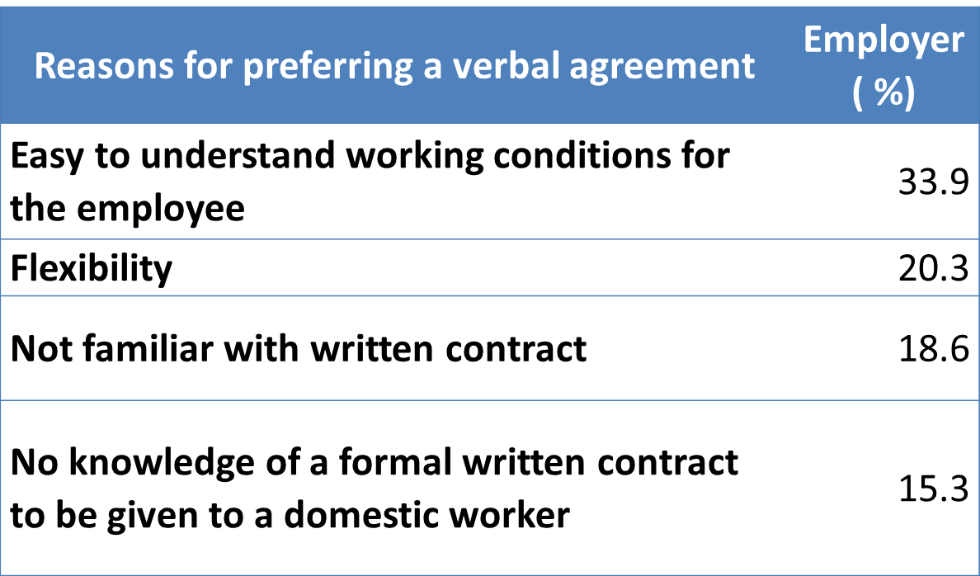
Preference for Contracts

Slide 23
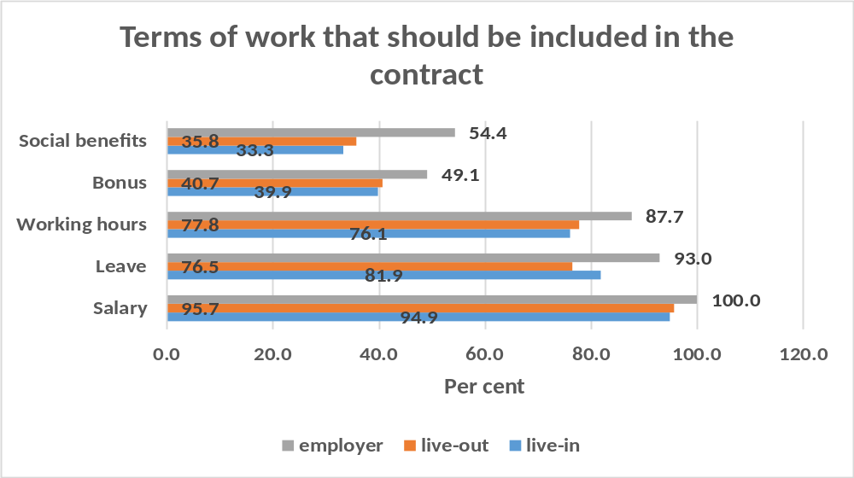
Contracts – critical elements
salary, leave and working hours

Slide 24
Domestic workers organisations /networks
Domestic Workers’ Union
Formed in 2012 succeeding the Red Flag Movement
3000 members
Head office in Kandy
Branches in other districts
Only 5 DWs,
2 live-in and
3 live-out were aware of DWU

Slide 25
Formalizing domestic work and recommendations for ratification of C189
National Consultation on the Road Map to Ratification of Domestic Workers Convention No. 189

Slide 26
There is no specific law in Sri Lanka that relates to domestic workers.
Enabling provisions in existing employment laws require extensive interpretation to include domestic workers
In terms of legal recognition,
Domestic Work remains virtually an invisible form of employment in the informal sector

Slide 27
Formalizing domestic work
Legislation
Regulation
Processes

Slide 28
Views on formalizing domestic workers
Enact a separate and distinct law governing domestic workers in Sri Lanka
Ensure legal recognition by integrate domestic workers into existing labour laws.
Introduce a Standard Agreement between employers and employees.

Slide 29
Views on formalizing domestic workers
4. Create a Government led formal system of registration of domestic workers and ensure, by Circular, the terms and conditions governing such domestic workers. This can be done at two levels:
  Registration at Labour Department by creating a separate unit under the Ministry of Labour with responsibility conferred on district and divisional level Labour Officers
  Registration at Divisional Secretariats with responsibilities conferred on dedicated Development Officers working under the Divisional Secretary

Slide 30
A ROADMAP for formalizing domestic workers
The lead government institution
Classifying of domestic workers
Ensuring competency
Awareness raising
Accountability mechanisms
Documentation
Ratifying C189
Notes:
The lead government institution: This should be the Ministry of Labour as the lead Ministry on worker rights with the mandate to ensure worker rights and employee responsibilities.
Classify domestic workers: All domestic workers should be classified according to duties, qualifications and working categories thus establishing recognised categories of workers. This enables the full description of each category.
Ensure competency: In order to ensure domestic worker competency, a link with the National Vocational Qualification (NVQ) level of competence should be established. This should be followed by a comprehensive training and skills recognition framework.
Awareness raising: In order to ensure that domestic workers are aware of their rights, responsibilities, and the need for legal recognition of domestic workers as a legal category of workers, a plan for strategic and systematic awareness raising should be made. This plan should include awareness raising programmes, use of print, audio and social media, create awareness raising material and identify resource persons. The plan should also be adequately resourced.
Accountability mechanisms: The Road Map should set in place mechanisms to ensure stipulation and monitoring of payment of minimum wage, stipulation and monitoring of working hours and the stipulation and monitoring of working conditions, leave including annual, sick and maternity leave, and all social security benefits. This should further set in place a complaints mechanism and a grievance redressal mechanism.
Documentation: The Road Map should ensure documentation of all issues pertaining to domestic workers, including the maintenance of a database of workers and employers/employment agencies.
Ratifying C189: Finally, the road map should include the process of ratifying C189 and the enjoyment of its protection and guidance. ?

Slide 31
Some issues for consideration
Inclusion of workers based on age (inclusion of workers beyond the legal age of retirement)
Mechanisms for social security including payment of legal dues (EPF, ETF and gratuity payments) and insurance
A sound monitoring framework reflecting the monitoring framework for other workers led by the Department of Labour
Grievance Redressal System including alternative dispute resolution systems, government led systems, and access to the formal justice system.

Slide 32
Some issues for consideration
Reporting and documentation including databases on domestic workers
Recruitment regulations to govern employers and recruitment agencies
A mechanism to unify recruitment agencies with an exploration of the possibility of establishing an umbrella organisation
Training of domestic workers

Slide 33
Some issues for consideration
The crucial changes that will come about in the relationship between domestic worker and employer which is extensively informal and temporary at present.
The creation of different layers of domestic workers from a broad housemaid and houseboy category to specialized work including child care workers, aged care workers, drivers etc.
The ethics of monitoring considering it will involve entering private spaces (homes) and of gathering employer information

Slide 34
Recommendation:
Enact a separate and distinct law governing domestic workers in Sri Lanka.

Slide 35
A separate and distinct law on domestic workers in Sri Lanka
Explicit recognition of rights
Scope and exclusions
General obligations
Minimum Age
Minimum wages and protection of wages
Recruitment of domestic workers
Registration
Contracts and Agreements
Social security, health insurance coverage, and other benefits
Rest periods and leave
Termination of employment relationship
Complaint mechanisms
Rescue of abused domestic workers
Legal counsel and legal aid
Association

Slide 36
Ratification of C189
FORMAL RECOGNITION
C189 RATIFICATION

Slide 37
Research Team
  Dr. Ramanie Jayatilaka
  Dr. Ramani Jayasundere
  Dr. Asha L. Abeyasekera
  Ms. Girty Gamage
  Ms. Leelangi Wanasundera
  Mr. Namal Weerasena

