Slide 1

International Labour Migration Statistics Database (ILMS) in ASEAN
Marina Andrade, ASEAN TRIANGLE Project
*
Fourth technical meeting of focal specialists on international
labour migration statistics in ASEAN
22-23 March 2018
Pullman Bangkok Kingpower Hotel, Bangkok, Thailand

Slide 2
Outline
  Introduction & Key examples of 5-year statistical trends taken from the ILMS Database in ASEAN
  Scope of the ILMS Database in ASEAN
    Scope and review of the ILMS Process in ASEAN
    Current data collection: quality and gaps
  ILMS - Phase VI: the next round of data collection in 2018

Slide 3
There is widespread recognition of the need for improved data collection and sharing among the ASEAN community…
“Facilitate data-sharing on matters related to migrant workers, for the purpose of enhancing policies and programmes concerning migrant workers in both sending and receiving states.”
- Cebu Declaration (2007, Article 18)
ASEAN Socio-Cultural Community Blueprint (2009, Article 28.v)
“… Labour migration will not diminish in the medium term and will probably continue to rise. The ASEAN region can look ahead by developing robust institutions to support labour mobility. This includes […] improvements to labour market information systems that can produce reliable and detailed data to better enumerate, profile and understand migrant stocks and flows.”
ILO and Asian Development Bank (ADB) (2014, p.83)
“… The ILO will need to reinforce its statistics and knowledge base in respect of migration. That base can then be used as a foundation for improved research and analytical work, which in turn should contribute to improved, evidence-based policy advice.”
Guy Ryder, ILO Director-General, 2014

Slide 4
  Key 5-year statistical trends taken from the ILMS Database in ASEAN

Slide 5
Total migrant workers in ASEAN destination countries (in thousands), 2012-2016*
ASEAN labour receiving countries had increasing numbers of migrant workers from 2012 to 2016.
Note: *For Brunei, data points used were 2011 and 2014.
Data source: ILMS in ASEAN Database (Brunei: Population and Housing Census 2011, Labour Force Survey 2014; Malaysia: Labour Force surveys 2012-2016; Singapore: Administrative records of the Ministry of Manpower; Thailand: Administrative records of the Office of Foreign Workers Administration).

Slide 6
Labour force in selected ASEAN destination countries by share of migrant status, 2012 and 2016
2011/12
2014/16
Brunei Darussalam
In 2014/16, Brunei Darussalam and Singapore remain as the ASEAN countries receiving the most migrant workers in terms of shares of their total populations.
Singapore
Malaysia
Note: *For Brunei, data points used were 2011 and 2014.
Data source: ILMS in ASEAN Database (Brunei: Population and Housing Census 2011, Labour Force Survey 2014; Malaysia: Labour Force surveys 2012-2016; Singapore: Administrative records of the Ministry of Manpower;

Slide 7
  Share of migrant labour force in the top ASEAN labour receiving country by gender and youth status, 2012 and 2016
In Malaysia, the number of female migrant workers has increased 1.4 times in the past five years, and 1.2 times for males.
In 2016, women represented 31 percent of the youth migrant labour force in Malaysia, as compared to 28 percent in 2012.
Data source: ILMS in ASEAN Database (Malaysia: Labour Force surveys 2012, 2016)

Slide 8
Share of migrant workers in Malaysia by gender and level of education, 2007-2016
Over the last ten years, female migrant workers’ educational attainment in Malaysia has improved little, but still more than males’.
From 2012 to 2016, the share of male migrant workers with basic educational attainment in Malaysia stayed roughly constant, while the one for females decreased more prominently
Notes: Basic education is defined as International Standard Classification of Education (ISCED 2011) groups 0 (less than primary education), 1 (primary education), and 2 (lower secondary education). Medium education is defined as ISCED groups 3 (upper secondary education), and 4 (post-secondary non-tertiary education). Advanced education is defined as ISCED groups 5 (short-cycle tertiary education), 6 (bachelor’s or equivalents levels), 7 (master’s or equivalents level), and 8 (doctoral or equivalents levels). Data source: Labour force survey

Slide 9
Share of migrant workers in Thailand by gender and level of education, 2007-2016
For Thailand, the annual data series for the inflow of migrant workers shows that educational attainment has worsened in the last 10 years, and especially so for women;
In 2016, the share of female and male migrant workers with higher (intermediate or advanced) educational levels was 8 and 27 percent, respectively, as compared to 12 and 26 percent in 2012, and to 23 and 30 per cent in 2007.
Notes: Basic education is defined as International Standard Classification of Education (ISCED 2011) groups 0 (less than primary education), 1 (primary education), and 2 (lower secondary education). Medium education is defined as ISCED groups 3 (upper secondary education), and 4 (post-secondary non-tertiary education). Advanced education is defined as ISCED groups 5 (short-cycle tertiary education), 6 (bachelor’s or equivalents levels), 7 (master’s or equivalents level), and 8 (doctoral or equivalents levels). Data source: Labour force survey.

Slide 10
Women’s share in total outflow of nationals for employment in ASEAN origin countries, 2012 and 2016
Women’s share in the outflow of nationals for employment increased for all ASEAN labour sending countries;
For half of the ASEAN labour sending countries, namely, the Philippines, Indonesia and Lao PDR, women were the majority of the outflow of nationals in 2016. In 2012, men were still majority for 5 out of these six countries.
Data source: ILMS in ASEAN Database (Cambodia: Administrative records of the Department of Employment and Manpower; Indonesia: Administrative records of the Directorate of Controlling of Foreign Employment; Lao PDR: Statistical Yearbook; Myanmar: Administrative records of the Ministry of Labour, Employment and Social Security; Philippines: Survey on Overseas Filipinos, PSA; Viet Nam: Administrative records of the Department of Overseas Labour).

Slide 11
Mean and median wage in Malaysia by migrant status and gender (in current terms), 2016
In 2016, migrant workers’ wages in Malaysia were targeted by a new minimum wage policy. Recent data shows that the median wage for female migrant workers in 2016 was 910 RM (Malaysian Ringgit), level just above the new minimum set: 900 RM.
Both mean and median wage levels in 2016 show a larger gender pay gap among migrant workers in Malaysia than among nationals. Also, in total, migrant workers received on average 38 percent less than nationals in Malaysia in 2016.
Data source: Labour force survey.

Slide 12
  Scope and review of the ILMS Process in ASEAN

Slide 13

The International Labour Migration Statistics (ILMS) Database in ASEAN was launched in order to:
    Provide an openly-available, relevant, comprehensive and tractable information source to enable evidence-based policymaking on international labour migration in ASEAN.
    Map the existing data sources countries collect, including their quality, scope, completeness, comparability and possible weaknesses that can be filled through capacity building.
    To define a set of tables of relevance on international labour migration as a standard reference-point for future data collection and reporting in ASEAN and beyond.
    Currently the data are published as a ‘special collection’ on ILOSTAT as well as on AP-Migration:
    www.ilo.org/ilostat/faces/home/statisticaldata
    http://apmigration.ilo.org/asean-labour-migration-statistics

Slide 14
Scope of the 2017 Round
10 countries
All available annual data up to 2017
Seeking and collecting exclusively official sources
Labour Force Surveys, Population Censuses, Administrative records (e.g. Civil registers, records from Ministries, border agencies…), Other surveys (e.g. Economic Censuses, Socio-Economic Surveys, Migration Surveys…), + Official estimates (where they exist…)

Slide 15
Scope of the 2017 Round
  MODULE A. International migrant stock
  Table 1. Resident population by sex, age and labour market status, total & migrants
  Table 2. Working age population by sex and education, total & migrants
  Table 3. Migrants by country of origin
  Table 4. Employed migrants by country of origin
  Table 5. Employed persons by economic activity, total & migrants
  Table 6. Employed persons by occupation, total & migrants
  Table 7. Employed persons by sex and by status in employment, total & migrants
  Table 8. Average monthly employment-related income of employed persons by sex, total & migrants
  MODULE B. International migrant flow
  Table 9. Inflows of migrants by sex and by country of origin
  Table 10. Inflows of migrants by sex and education
  Table 11. Inflows of employed migrants by economic activity
  Table 12. Inflows of employed migrants by occupation
  MODULE C. Nationals abroad
  Table 13. Stock of nationals abroad by sex and country of residence
  Table 14. Outflows of nationals by sex and country of destination
  Table 15. Outflows of nationals for employment by sex and country of destination
  Table 16. Outflows of nationals for employment by sex and education
  Table 17. Outflows of nationals for employment by economic activity
  Table 18. Outflows of nationals for employment by occupation
  Table 19. Inflows of return migrants by sex and previous country of residence

Slide 16
Scope of the 2017 Round
  The ILMS Database currently has 19 tables divided into three separate modules:
  MODULE A. International migrant stock – 8 tables
  MODULE B. International migrant flow – 4 tables
  MODULE C. Nationals abroad – 7 tables
Figure: Current ILMS data collection, by module and status of tables

Slide 17
Current data collection:
quality and gaps
TABLE / MODULE | Brunei | Cambodia | Indonesia | Lao PDR | Malaysia | Myanmar | Philippines | Singapore | Thailand | Viet Nam |  | TOTAL (●) | TOTAL (○) | TOTAL (–OR +)
MODULE A.
Table 1 | ● | ● | ● | ● | ● | ● | ● | ● | ● | ● |  | 10 | 0 | 0
Table 2 | ● | ● | ● | + | ● | + | ● | + | ○ | + |  | 5 | 1 | 4
Table 3 | ● | ● | ● | ● | ○ | ● | ● | ○ | ● | - |  | 7 | 2 | 1
Table 4 | ● | ● | ● | ● | ○ | ○ | ○ | ○ | ● | - |  | 5 | 4 | 1
Table 5 | ● | ● | ● | ● | ● | ○ | + | ● | ● | + |  | 7 | 1 | 2
Table 6 | ● | ● | + | + | ● | ○ | + | ○ | ● | + |  | 4 | 2 | 4
Table 7 | ● | ● | ● | + | ● | ○ | + | ○ | + | + |  | 4 | 2 | 4
Table 8 | ● | ● | + | ○ | ● | ○ | + | ○ | + | + |  | 3 | 3 | 4
MODULE B.
Table 9 | - | ● | ● | ○ | ● | ○ | ● | ○ | ● | - |  | 5 | 3 | 2
Table 10 | - | ● | - | ○ | ● | ○ | ● | - | ● | - |  | 4 | 2 | 4
Table 11 | - | ● | ● | ○ | ● | ○ | ● | - | ● | ● |  | 6 | 2 | 2
Table 12 | - | ● | - | ○ | ● | ○ | ● | - | ● | ● |  | 5 | 2 | 3
MODULE C.
Table 13 | - | ● | - | - | - | ● | ● | ● | ● | - |  | 5 | 0 | 5
Table 14 | - | - | - | ○ | - | - | ● | - | - | - |  | 1 | 1 | 8
Table 15 | - | ● | ● | ● | - | ● | ● | - | ● | ● |  | 7 | 0 | 3
Table16 | - | - | ● | ○ | - | - | - | - | ● | - |  | 2 | 1 | 7
Table 17 | - | - | ● | - | - | - | - | - | - | - |  | 1 | 0 | 9
Table 18 | - | - | ● | - | - | - | ● | - | ● | - |  | 3 | 0 | 7
Table 19 | - | ○ | ● | ○ | ○ | ○ | - | ○ | ○ | - |  | 1 | 6 | 2
TOTAL NUMBER OF TABLES COLLECTED BY 2017 (●): | 8 | 14 | 13 | 5 | 10 | 4 | 11 | 3 | 13 | 4
TOTAL POTENTIAL TABLES STILL TO BE COLLECTED (○): | 0 | 1 | 0 | 8 | 3 | 10 | 1 | 7 | 2 | 0
Total Tables for which there appear to be no existing data (– OR +): | 11 | 4 | 6 | 6 | 6 | 5 | 7 | 9 | 4 | 15
● indicates at least one observation (i.e. one year) has been collected for a given table.
+ indicates at least one observation has been partially collected, but the data for the missing part does not appear to exist (i.e. for tables with “total and migrants” parts, namely tables 1,2,5-8)
○ indicates that the relevant data appear to exist but were not able to be collected so far.
– indicates that the relevant data appear not to exist (to the best of our knowledge).

Slide 18
DATA COLLECTED
Labour Force Surveys and other surveys
TABLE / MODULE | Brunei | Cambodia | Indonesia | Lao PDR | Malaysia | Myanmar | Philippines | Singapore | Thailand | Viet Nam
MODULE A. International migrant stock
1. Resident population by sex, age and by labour market status
2. Working-age population by sex and education
3. Migrants by country of origin
4. Employed migrants by country of origin
5. Employed persons by economic activity
6. Employed persons by occupation
7. Employed persons by sex and status in employment
8. Average monthly wages by sex, total and migrants
MODULE B. International migrant flow
9. Inflows of migrants by sex and country of origin
10. Inflows of working-age migrants by sex and education
11. Inflows of employed migrants by economic activity
12. Inflows of employed migrants by occupation
MODULE C. Nationals abroad
13. Nationals abroad by sex and by country of residence
14. Outflows of nationals by sex and by country of destination
15. Outflows of nationals for empl. by sex and country of destination
16. Outflows of nationals for employment by sex and education
17. Outflows of nationals for employment by economic activity
18. Outflows of nationals for employment by occupation
19. Inflows of return migrants by sex & previous country of residence
NOTES: GREEN indicates at least one observation (i.e. one year) has been collected for a given table.
YELLOW indicates that the relevant data exist but could not be collected during the previous round.
‘WHITE’ indicates that the relevant data do not exist/has not been mapped.

Slide 19
DATA COLLECTED
Population and Housing Censuses
TABLE / MODULE | Brunei | Cambodia | Indonesia | Lao PDR | Malaysia | Myanmar | Philippines | Singapore | Thailand | Viet Nam
MODULE A. International migrant stock
1. Resident population by sex, age and by labour market status
2. Working-age population by sex and education
3. Migrants by country of origin
4. Employed migrants by country of origin
5. Employed persons by economic activity
6. Employed persons by occupation
7. Employed persons by sex and status in employment
8. Average monthly wages by sex, total and migrants
MODULE B. International migrant flow
9. Inflows of migrants by sex and country of origin
10. Inflows of working-age migrants by sex and education
11. Inflows of employed migrants by economic activity
12. Inflows of employed migrants by occupation
MODULE C. Nationals abroad
13. Nationals abroad by sex and by country of residence
14. Outflows of nationals by sex and by country of destination
15. Outflows of nationals for empl. by sex and country of destination
16. Outflows of nationals for employment by sex and education
17. Outflows of nationals for employment by economic activity
18. Outflows of nationals for employment by occupation
19. Inflows of return migrants by sex & previous country of residence
NOTES: GREEN indicates at least one observation (i.e. one year) has been collected for a given table.
YELLOW indicates that the relevant data exist but could not be collected during the previous round.
‘WHITE’ indicates that the relevant data do not exist/has not been mapped.

Slide 20
DATA COLLECTED
Administrative Records Data
TABLE / MODULE | Brunei | Cambodia | Indonesia | Lao PDR | Malaysia | Myanmar | Philippines | Singapore | Thailand | Viet Nam
MODULE A. International migrant stock
1. Resident population by sex, age and by labour market status
2. Working-age population by sex and education
3. Migrants by country of origin
4. Employed migrants by country of origin
5. Employed persons by economic activity
6. Employed persons by occupation
7. Employed persons by sex and status in employment
8. Average monthly wages by sex, total and migrants
MODULE B. International migrant flow
9. Inflows of migrants by sex and country of origin
10. Inflows of working-age migrants by sex and education
11. Inflows of employed migrants by economic activity
12. Inflows of employed migrants by occupation
MODULE C. Nationals abroad
13. Nationals abroad by sex and by country of residence
14. Outflows of nationals by sex and by country of destination
15. Outflows of nationals for empl. by sex and country of destination
16. Outflows of nationals for employment by sex and education
17. Outflows of nationals for employment by economic activity
18. Outflows of nationals for employment by occupation
19. Inflows of return migrants by sex & previous country of residence
NOTES: GREEN indicates at least one observation (i.e. one year) has been collected for a given table.
YELLOW indicates that the relevant data exist but could not be collected during the previous round.
‘WHITE’ indicates that the relevant data do not exist/has not been mapped.

Slide 21
Current data collection:
quality and gaps
Considering…
Gaps that have been mapped: Tables can potentially be filled
Gaps that have not been mapped yet: Tables for which data does not appear to exist
In the next rounds of data collection efforts should go into:
Updating the tables and filling gaps that can potentially be filled with existing, mapped data
Identifying and sharing information on sources not yet included in this mapping

Slide 22
  ILMS - Phase VI: the next round of data collection in 2018

Slide 23
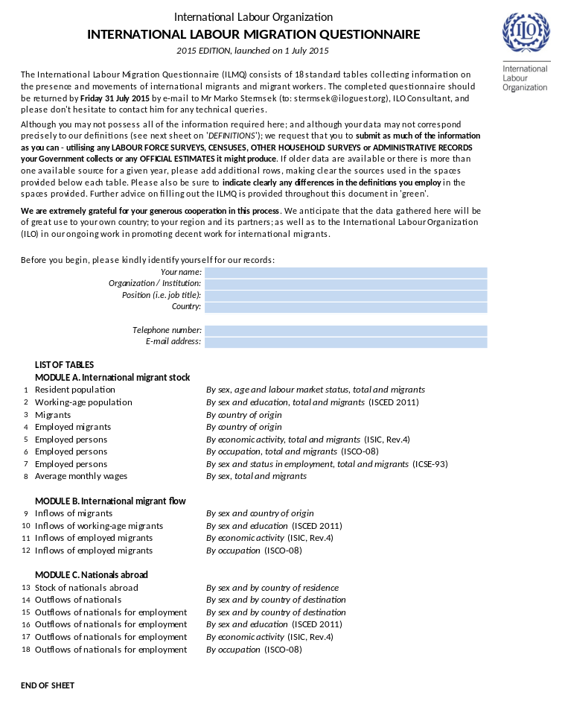
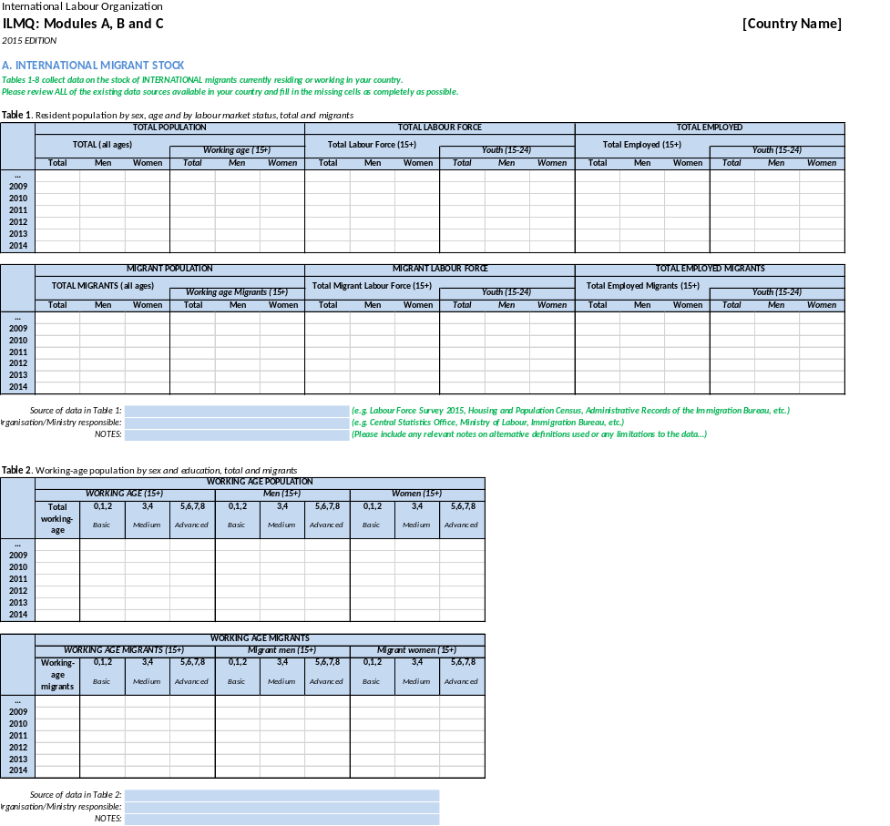
The 2018 questionnaire
The standard International Labour Migration Questionnaire (ILMQ) is once more partially filled out and will be sent to focal specialists this year.

Slide 24
The 2018 round of data collection
The ILMQ 2018 will be sent out along with a few questions to be answered by the focal specialist on the data gaps identified and discussed today and tomorrow.
The 2018 data collection round, or ILMS Phase VI, will be launched on the 6th of April, 2018.
THANK YOU
…Additional questions:
andrade@iloguest.org
marinacandrade@gmail.com

