Slide 1


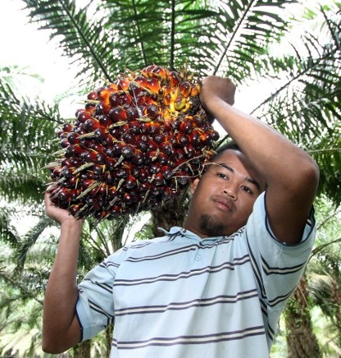
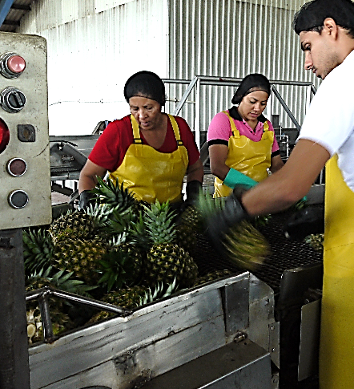
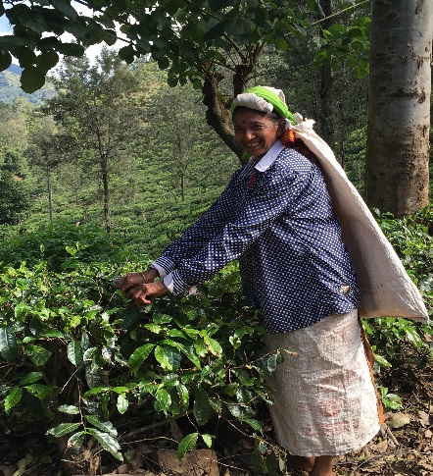
Decent work on plantations
Sri Lanka’s TEA sector
Alette van Leur
Director, ILO Sectoral Policies Department
Colombo, 14 June 2018

Slide 2
Why focusing on plantations?
Critical role of the sector in developing and emerging economies
  Provides jobs for some 450 million workers and serves as a source of indirect employment
  Links national economies to global supply chains
  Generates export earnings
  Contributes to feeding the world

Slide 3
Why focusing on plantations?
Common decent work challenges:
  Prevalence of working poverty among those engaged in agriculture
  Poor working conditions - 170,000 agricultural workers killed each year
  Low skills and productivity
  Ineffective law enforcement, labour inspection and compliance
  Violations of fundamental rights at work (child labour, forced labour, discrimination, freedom of association)
Notes:
Poor working conditions
170,000 agricultural workers killed each year
Violations of fundamental rights at work (child labour, forced labour, discrimination)

Slide 4





Our objective
Introducing plantations programme
  Mobilise governments, companies, plantation owners and workers to improve working conditions and productivity, drive competitiveness and create a world in which “no one is left behind”

Slide 5
  At the international and country levels we
Conduct pioneering research and develop innovative tools
Develop policy recommendations and influence policy change
Facilitate debate with governments, industry and workers’ organizations

Slide 6
  What we DO in countries
A 5-step model: From a diagnostic process to project implementation and review
Discover
Collecting data through focus group discussions with government, employers and unions as well as direct interviews with plantation workers and smallholders
Report
Plan
Review
Providing insights into the situation in the sector and outlining areas where progress is needed
Implement
Developing a national plan of action, setting goals for the way forward
Bringing the national plan of action to life through a sector-specific programme
Ensuring that programme meet the needs of all constituents

Slide 7
A TWO-PRONGED PROGRAMME STRATEGY
Institutional development
Strengthen governance institutions and capacity of government, employers and workers to address key issues through improved knowledge, legislation and information dissemination
Direct support
Improve the capacity of governments, workers and employers to engage in dialogue
Implement interventions to promote decent and productive employment, including training and advice on key issues (e.g. OSH, management skills, workers rights and responsibilities; workplace cooperation; negotiation skills; grievance procedures)
Notes:
Institutional development
Strengthening governance institutions and capacity of employers and workers through improved legislation and information dissemination
Improving the capacity of governments, workers and employers to engage in dialogue
Direct support
Implementation of interventions to promote decent and productive employment at plantation level including training and advice on key issues (e.g. occupational safety and health, workers rights and responsibilities; workplace cooperation; negotiation skills; grievance procedures, worker life skills, supervisory skills, and preventing sexual harassment).

Slide 8
  In brief: at country level we
Establish a multi-stakeholder steering committee
Work with national constituents
Help improve productivity and working conditions, competitiveness and image of the industry

Slide 9
PROMOTING DW ON SRI LANKA’s TEA PLANTATIONS
Key areas of focus
Employment
focus on youth, Skills, career guidance, Wages, innovation for improved productivity
Housing & infrastructure
EIIP housing, water, roads.., youth to participate, inter-ministerial collaboration
OSH
Raise awareness (PPE), access to weighing stations, alcohol (prevention & remedial), address new osh risks
Labour Inspection
Strengthen services (skills, resources...), compliance culture combining inspection, enforcement, education
Social Dialogue
Capacity building, women empowerment, Improved collective bargaining, explore further avenues of social dialogue

Slide 10
THE FUTURE OF WORK IN TEA PLANTATIONS
  Policy coherence and coordination at national and international levels: Macroeconomic, trade and social policies
  Access to services (public and private) and rural infrastructure
  Investing in youth and skills development
  Empowering women
  Exploring alternative models (outgrower schemes) without circumventing labour laws
  Economic diversification: “tea tourism”; production of cash and food crops to supplement incomes and improve food security
  Harnessing technology and climate change considerations in tea sector policy

Slide 11
ILO’S COMPARATIVE ADVANTAGE
Solid knowledge on the rural economy
A wide range of tools and approaches on promoting decent work in rural areas
Technical projects on rural development
Authority on employment and labour issues
Notes:
Solid knowledge base (e.g. report on employment trends and developments in the plantations sector, robust labour statistics, sector-specific studies)
A wide range of approaches and tools on rural development (described in the Portfolio of Policy Guidance Notes)
Technical projects on rural development, including the plantations sector in different part of the world;
Global authority on employment and labour issues (development and application of labour standards, promotion of decent work in global supply chains, etc.)

