Slide 1
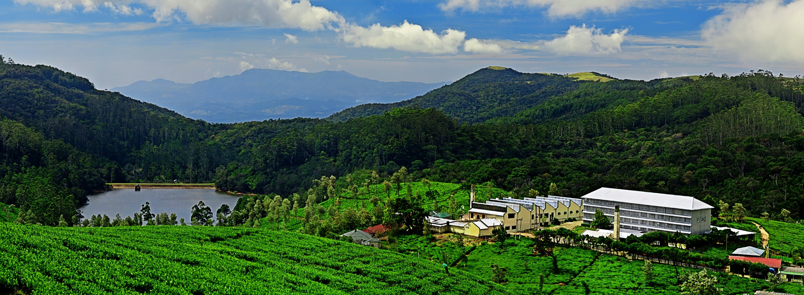


SRI LANKAN tea INDUSTRY supply chain
ROSHAN RAJADURAI
MANAGING DIRECTOR
KELANI VALLEY , TALAWAKELLE & HORANA PLANTATIONS

Slide 2


WORLD TEA SCENARIO - 2016
Country | Total Land Area (Hect.) | Tea Land Area (Hect.) | Production Mn/kgs | % Share of World Production | Exports Mn/kgs | % Share of World Exports | Auction Price US $/kg | Total Export Value US $ '000 | YPH | Per Capita Consumption kgs/Tea
China | 932,641,000 | 2,920,000 | 2,350 | 42.7% | 329 | 18% | 4.52 | 1,484,913 | 801 | 1.31
India | 297,319,300 | 577,480 | 1,267 | 23.0% | 218 | 12% | 2.91 | 634,822 | 2153 | 0.78
Kenya | 56,914,000 | 218,538 | 473 | 8.6% | 480 | 27% | 2.48 | 1,189,741 | 2088 | 0.69
Sri Lanka | 6,590,134 | 202,839 | 293 | 5.3% | 281 | 16% | 4.31 | 1,210,536 | 1658 | 1.34
Turkey | 76,963,200 | 77,000 | 253 | 4.6% | 6 | 0.3% | 4.67 | 28,585 | 3270 | 3.2
Vietnam | 31,007,000 | 134,000 | 180 | 3.3% | 142 | 8% | 1.66 | 236,325 | 1316 | -
Indonesia | 181,156,900 | 118,100 | 126 | 2.3% | 51 | 3% | 2.2 | 113,368 | 1089 | 0.34
Argentina | 273,669,000 | 41,000 | 84 | 1.5% | 78 | 4% | 1.24 | 97,032 | 2027 | -
Bangladesh | 13,017,000 | 59,000 | 83 | 1.5% | 1 | 0.03% | 3.42 | 1,843 | 1243 | 0.49
Japan | 36,448,500 | 43,100 | 77 | 1.4% | 4 | 0.2% | 25.58 | 10,827 | 1846 | 0.84
Source : ITC Report, London

Slide 3
WORLD TEA INDUSTRY
 | 2007 | 2008 | 2009 | 2010 | 2011 | 2012 | 2013 | 2014 | 2015 | 2016 | 2017
GLOBAL PRODUCTION | 3,854 | 3,965 | 4,019 | 4,281 | 4,561 | 4,693 | 4,990 | 5,174 | 5,281 | 5,561 | 5,686
(Mn.Kgs)
PRODUCTION GROWTH | 5.13 | 2.88 | 1.36 | 6.52 | 6.54 | 2.89 | 6.33 | 3.69 | 2.07 | 5.3 | 2.25
(%)
GLOBAL EXPORTS | 1,579 | 1,652 | 1,615 | 1,786 | 1,761 | 1,775 | 1,861 | 1,827 | 1,796 | 1,797 | 1,778
(Mn.Kgs)
EXPORT GROWTH | 0.02 | 4.62 | -2.24 | 10.58 | -1.4 | 0.79 | 4.85 | -1.83 | -1.69 | 0.06 | -1.06
(%)
EXPORTABLE WORLD CROP | 40.9 | 41.8 | 40 | 41.7 | 38.6 | 37.8 | 37.2 | 35.1 | 34 | 32.3 | 31.3
(%)
GLOBAL CONSUMPTION | 3,716 | 3,821 | 3,897 | 4,137 | 4,409 | 4,513 | 4,685 | 4,850 | 5,015 | 5,242 | 5,438
(Mn.Kgs)

Slide 4
WORLD TEA PRODUCTION (Mn / kgs)
Country | 2007 | 2008 | 2009 | 2010 | 2011 | 2012 | 2013 | 2014 | 2015 | 2016 | 2017
Sri Lanka | 305 | 319 | 290 | 331 | 329 | 328 | 340 | 338 | 329 | 292 | 307
China | 1140 | 1258 | 1359 | 1475 | 1623 | 1790 | 1924 | 2096 | 2278 | 2350 | 2550
India | 986 | 981 | 979 | 966 | 1116 | 1126 | 1200 | 1207 | 1209 | 1239 | 1279
Kenya | 370 | 346 | 314 | 399 | 378 | 370 | 432 | 445 | 399 | 475 | 440
Vietnam | 148 | 166 | 180 | 175 | 178 | 174 | 180 | 175 | 170 | 165 | 172
Turkey | 224 | 229 | 221 | 231 | 246 | 231 | 235 | 246 | 259 | 253 | 255
Others | 681 | 667 | 676 | 703 | 692 | 672 | 678 | 689 | 661 | 688 | 683
World | 3854 | 3965 | 4019 | 4281 | 4561 | 4691 | 4991 | 5196 | 5305 | 5463 | 5686
YOY % | 5.15 | 2.88 | 1.34 | 6.53 | 6.55 | 2.84 | 6.39 | 4.12 | 6.29 | 5.13 | 7.19
Source : ITC Report, London

Slide 5

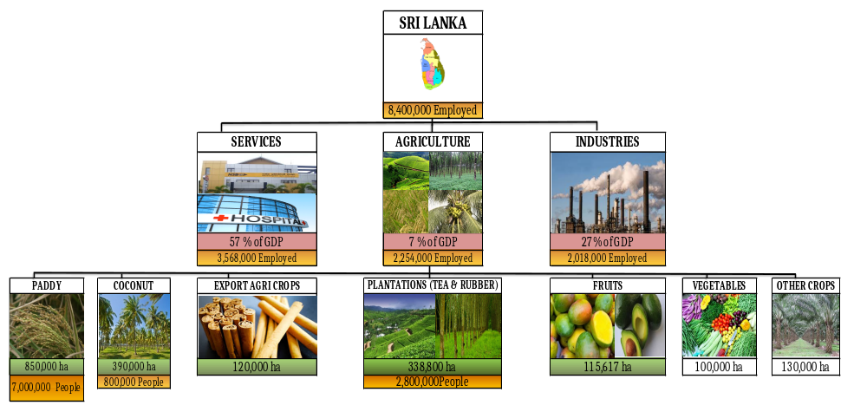
AGRICULTURAL SECTOR OF SRI LANKA

Slide 6
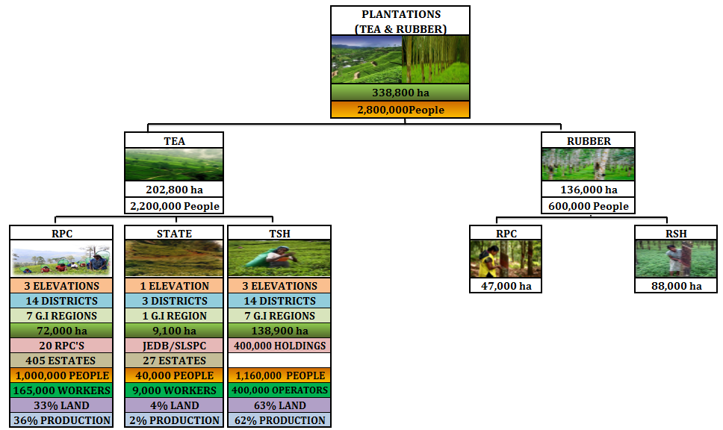
PLANTATION SECTOR OF SRI LANKA

Slide 7

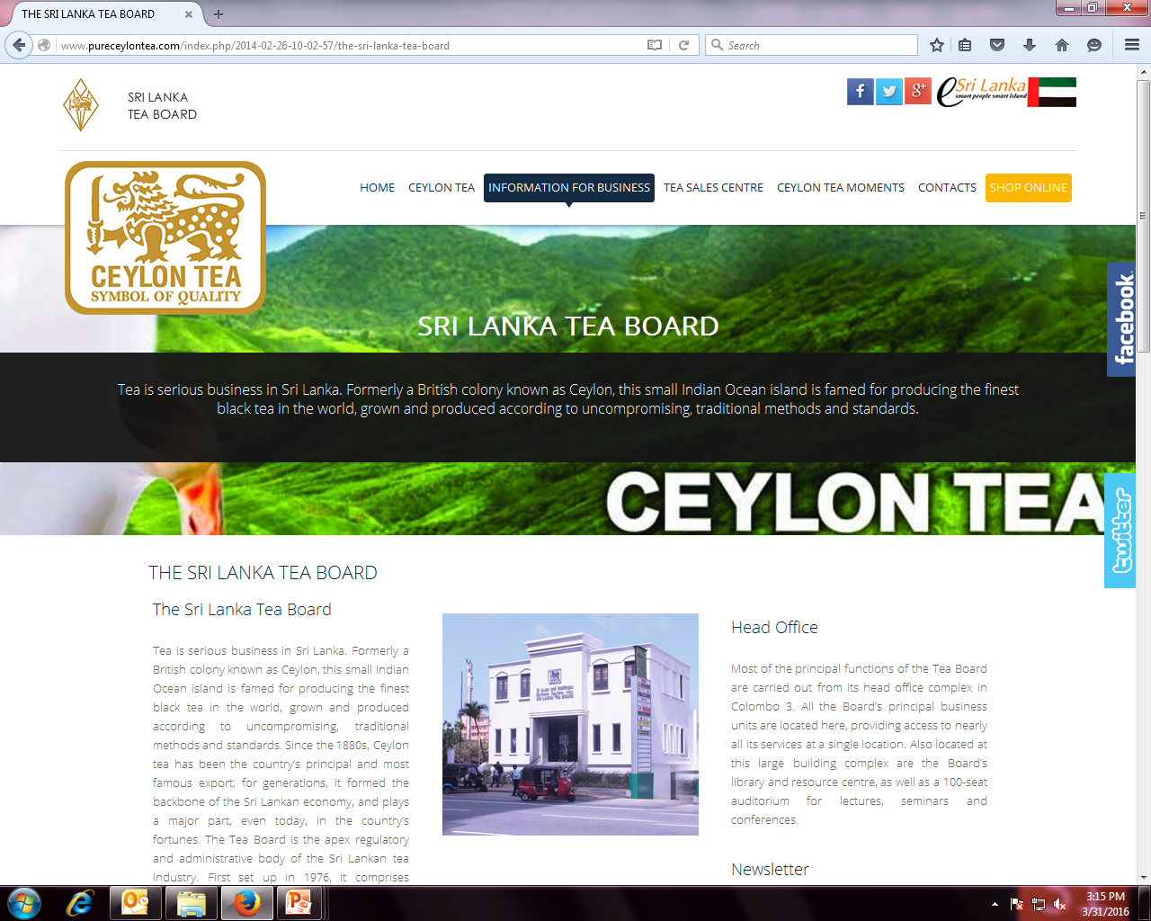









INSTITUTIONAL STRUCTURE
Ministry of Plantation Industries(MPI)
Sri Lanka Tea Board(SLTB)
Tea Research Institute(TRI)
Tea Smallholders Development Authority(TSHDA)
National Institute of Plantation Management(NIPM)
1971
1976
1925
1975
1979
Colombo Tea Traders Association(CTTA)
Planters’ Association of Ceylon
(PA)
Colombo Brokers’ Association (CBA)
Sri Lanka Tea Factory Owners Association(SLTFOA)
Tea Exporters’ Association(TEA)
Federation of Tea Small Holders Societies(FTSHS)
1894
1854
1896
1990
1989
1999
PRODUCER SECTOR
Planters’ Association of Ceylon(PA)
Sri Lanka Tea Factory Owners Association(SLTFOA)
Federation of Tea Small Holders Societies(FTSHS)
1854
1990
1969

Slide 8
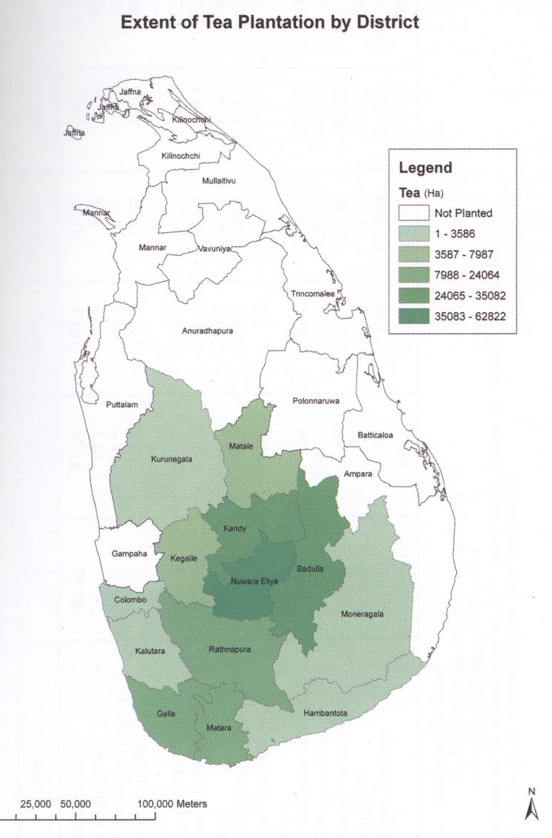
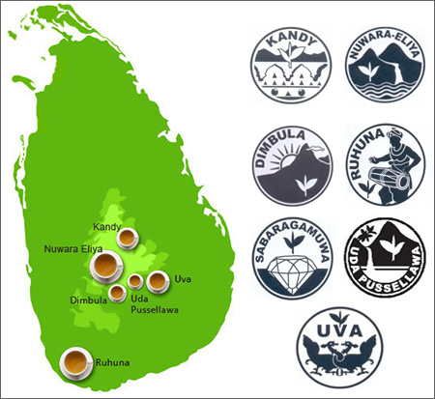
SRI LANKA TEA INDUSTRY
14 DISTRICTS IN 3 ELEVATIONS
Low Grown : 0 – 600M AMSL
Mid Grown : 600M and 1,200M AMSL.
High Grown: Above 1,200M AMSL.
7 GEOGRAPHICAL INDICATORS
Nuwara-Eliya
Uda Pussellawa
Dimbula
Uva
Kandy
Sabaragamuwa
Ruhuna
3 PRODUCER SECTORS
1975 Estates nationalized – 1992 Privatized
State Management – 27 Estates
Tea Small Holders (TSH) – 400,000 Operators
Regional Plantation Companies 20 (RPCs) – 450 Estates

Slide 9
REGISTERED TEA LAND - 2016
 | TSH | RPC | STATE | Total
Hectares | 121,967 | 70,891 | 9,164 | 202,022
% | 60 | 35 | 5 | 100
Source : Ministry of Plantations Industries-2015

Slide 10
MADE TEA PRODUCTION - 2016
 | TSH | RPC | STATE | Total
Made Tea Production (Mn.kg) | 218.1 | 72.9 | 1.6 | 292.6
% | 74% | 25% | 1% | 100%
Source : Ministry of Plantations Industries-2015

Slide 11
SRI LANKA TEA PRODUCTION – ELEVATION - 2016
ELEVATION WISE | High Grown | Medium Grown | Low Grown | National
SL Production (Mn.kg) | 64.4 | 44.5 | 183.6 | 292.6
% | 22% | 15% | 63% | 100%

Slide 12
TEA FACTORIES
 | PRIVATE | RPC | STATE | Total
Number | 429 | 259 | 26 | 714

Slide 13
GROSS SALE AVERAGE- COLOMBO AUCTIONS- Rs/Kilo - 2017
ELEVATION | Medium Grown | High Grown | Low Grown | National
GSA Rs/Kilo | 563.54 | 600.93 | 637.40 | 618.14
% of NATIONAL | 91% | 97% | 103% | 100%

Slide 14
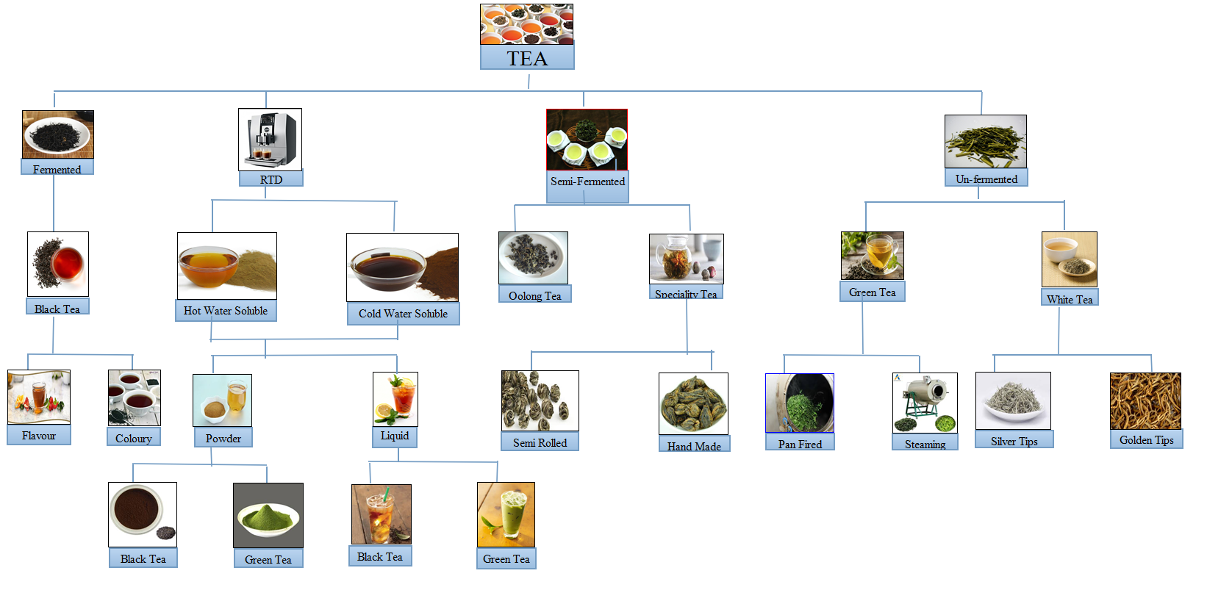
CEYLON TEA PRODUCT MIX

Slide 15
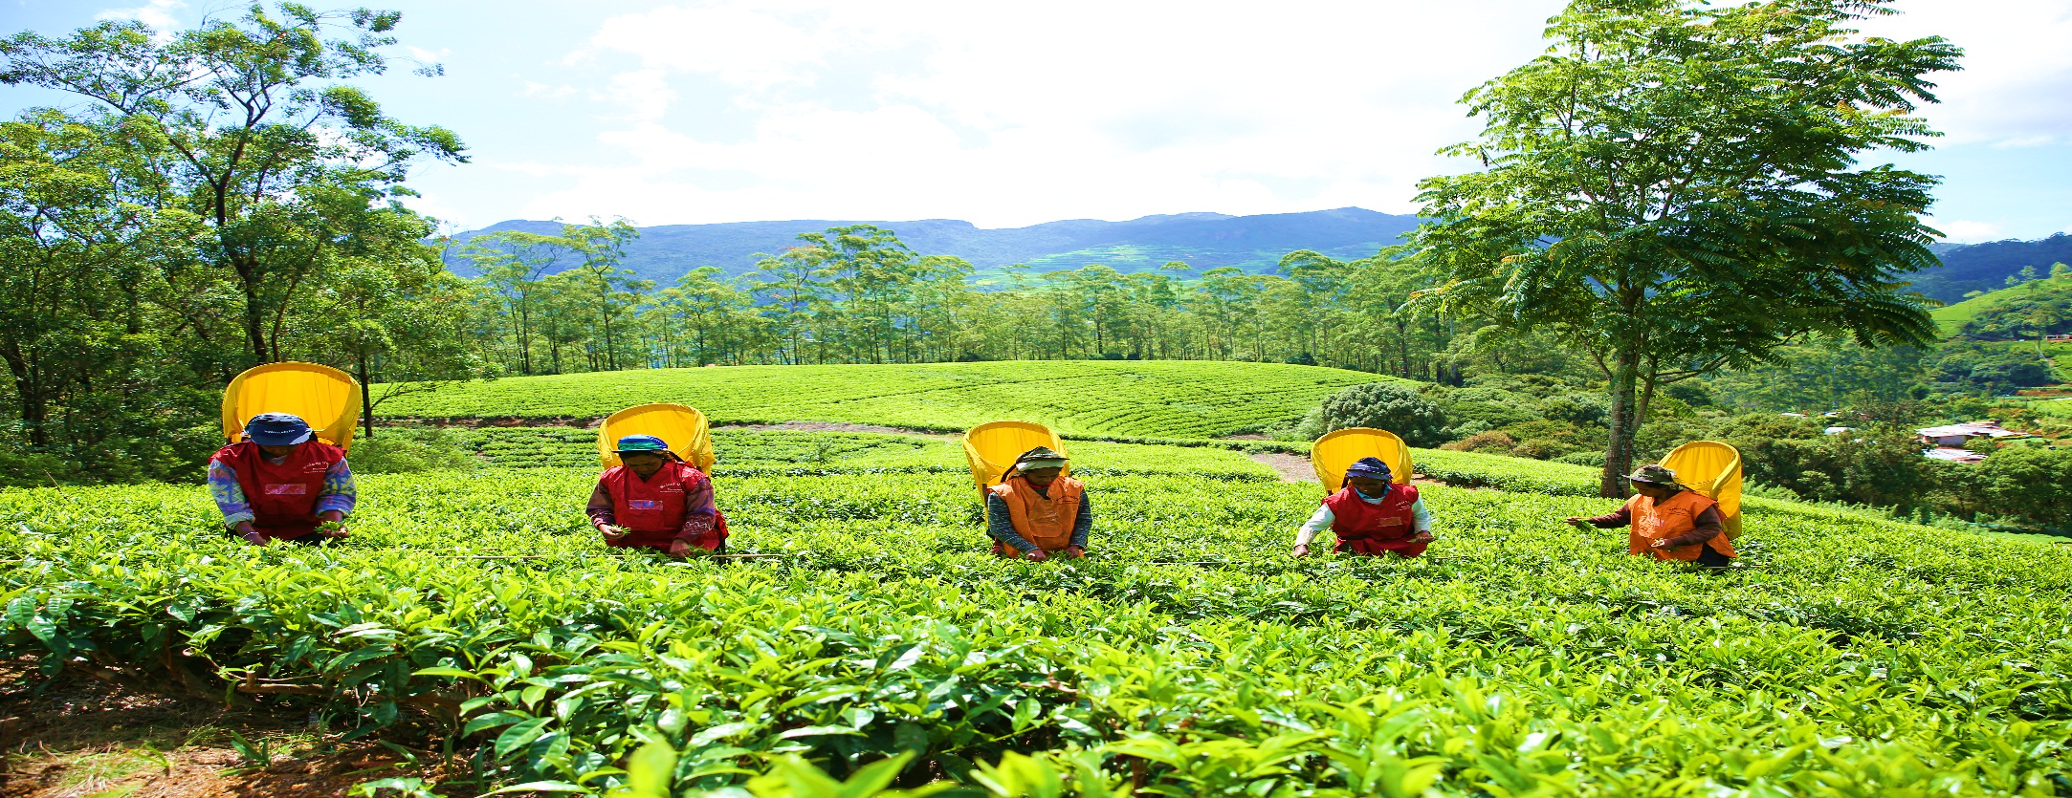
EMPLOYMENT DISTRIBUTION
Total Employees in Sri Lanka | 8,424,000
Agriculture Sector Employees | 2,400,000 (28.5% of National)
Own Account & Family Workers | 1,233,921- (49 %) + 520,826 (21%)
Total Family & Own Account Workers | 1,754,747 (70% of Agricultural Employees)
* No guarantee of regular employment ,wages, statutory dues, benefits, & facilities
Plantations Sector in Sri Lanka | 822,412 (34% of Agricultural Employees)
- Tea Small Holders | 400,000 (50% of the Total Plantation Workers)
- Rubber Small Holders | 200,000 (25% of the Total Plantation Workers)
- Regional Plantation Companies | 196,412 (25 % of the Total Plantation Workers)
AGRICULTURE SECTOR - RPCs = 8% & TEA SMALL HOLDERS = 16%
PLANTATIONS (TEA +RUBBER) RPCs = 25 % TEA & RUBBER SMALL HOLDERS = 75%
SOURCE: CENTRAL BANK ANNUAL REPORT 2014, HOUSEHOLD INCOME & EXPENDITURE SURVEY 2012/2013

Slide 16
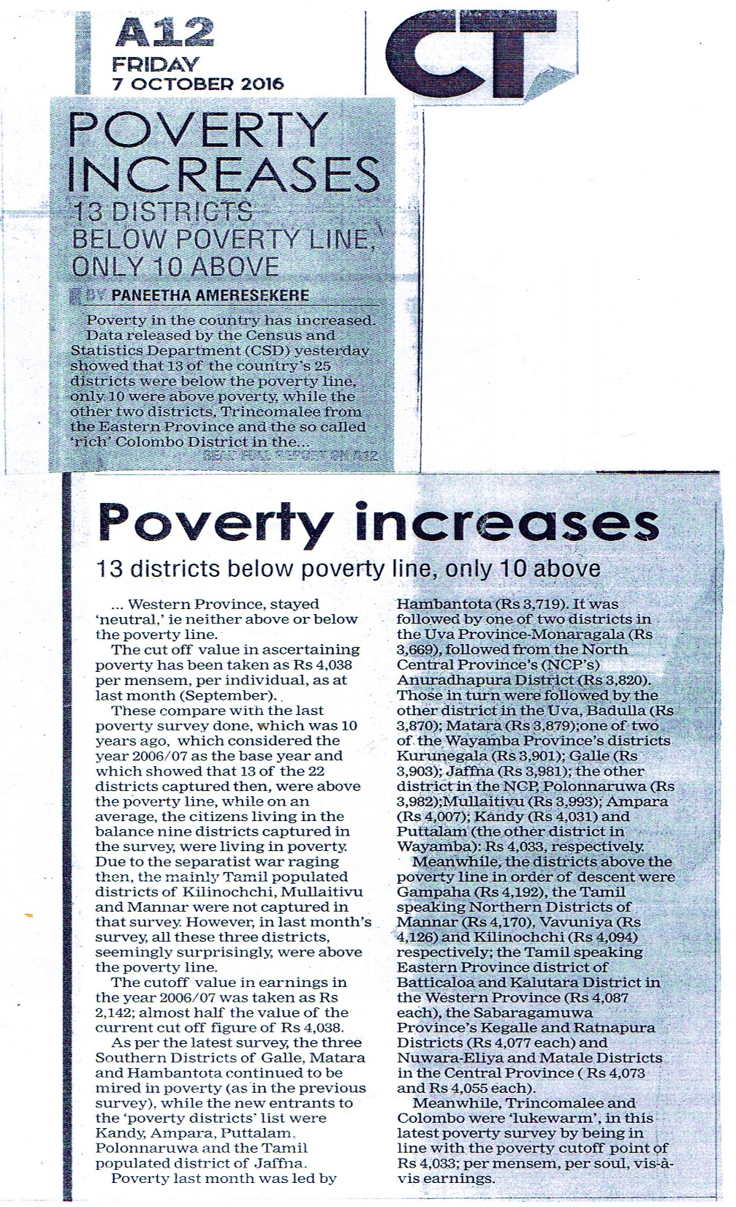
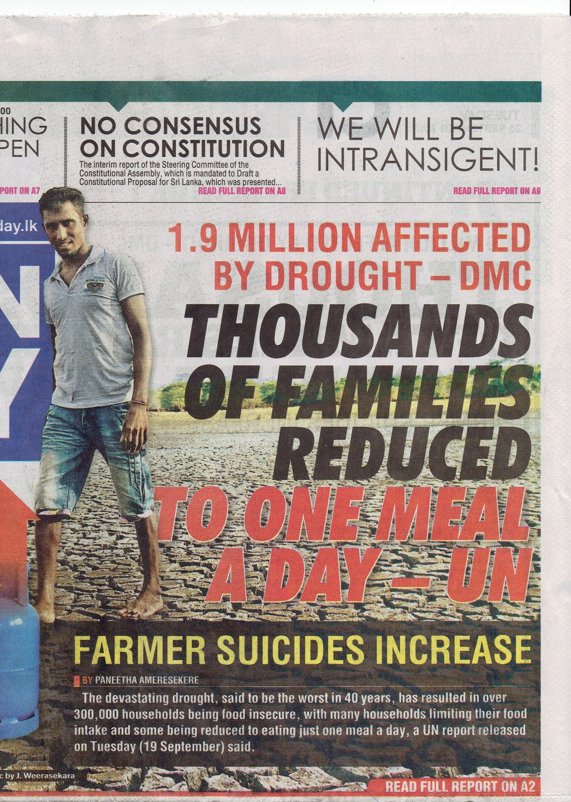

Slide 17
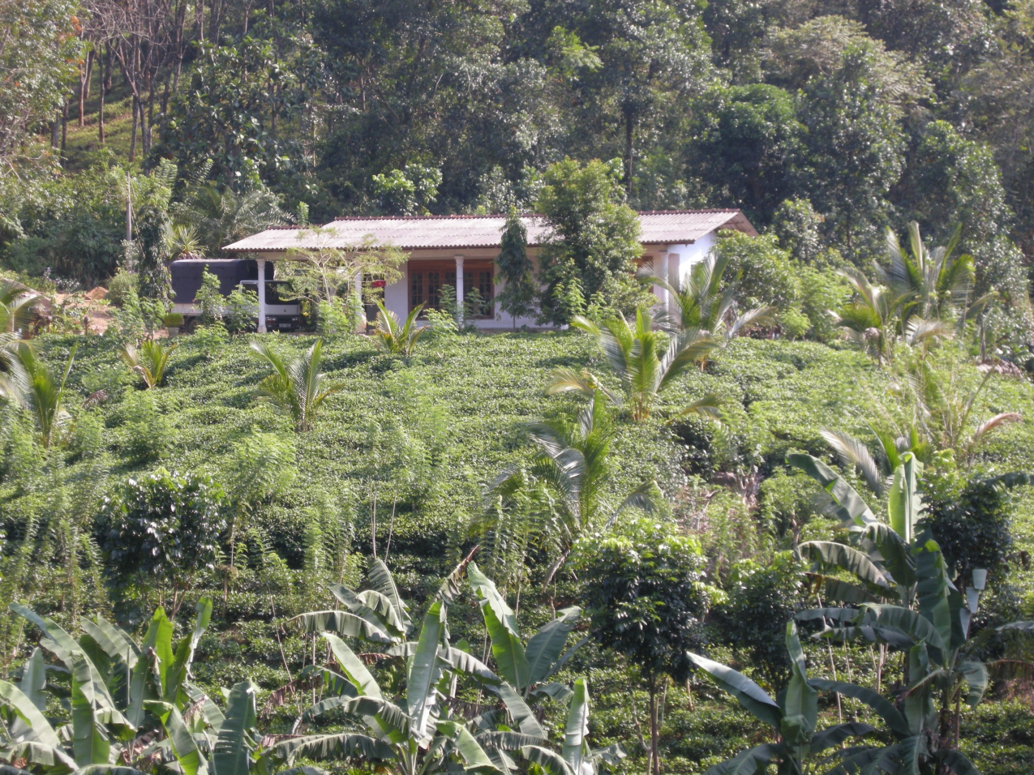
SMALL HOLDINGS
Lands less than 10Acres (4 Ha) – In 1920s in Low & Mid elevations
Number of Small Holders – 370,842 (2016)
Number of Small Holdings - 393,420 (2016)
Hectares under cultivation -121,967 Ha (60%)
Yield per hectare = 1,872 Kilos / Ha – In 1958, New Clearing Subsidy
66% Single Ownership - own 76% of the land (2005)
Number of plots – more than 20 perches = 370,842
Number of plots - with less than 20 perches = 417,617
61% less than 1 hectare = 94% of the TSH plots.
Extent (Ha) | <1/2 | <1-2 | <2-3 | <3-5 | <5-10 | >10
Number of holdings | 45,806 | 34,607 | 12,902 | 7,451 | 7,386 | 24,172
% | 35 | 26 | 10 | 6 | 5 | 18
Number of plots | 120,330 | 30,074 | 6,111 | 2,114 | 1,188 | 902
% | 75 | 19 | 4 | 1 | 0.5 | 0.5
Census 1994
Holdings 206,652
Extent Ha 82,918
Census 2005
Holdings 350,982
% Increase
120 %
54.5%
Extent Ha 116,492
Census 1980
Holdings 159,865
Extent Ha 75,769

Slide 18
NUMBER OF SMALL HOLDINGS

Slide 19
EXTENT OF SMALL HOLDINGS

Slide 20
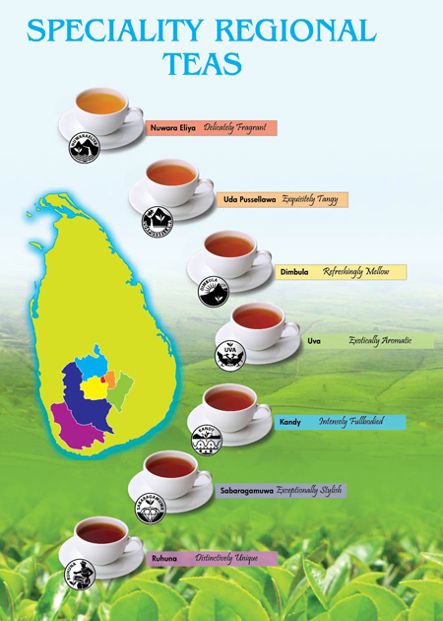


REGIONAL PLANTATION COMPANIES - RPCs
DELICATELY FRAGRANT
INTENSELY FULL BODIED
EXQUSITELY TANGY
EXOTICALLY AROMATIC
KANDY
NUWARA-ELIYA
20 Regional Plantation Companies (RPCs)
RPCs : Only Stakeholder in Producing, Processing & Marketing of Tea and other crops.
453 Estates & 300 Tea & 112 Rubber Factories
Cares for a resident population of 1 Mn (5% of SL)
Cultivates : 35% of Land
Produces : 25% of Green Leaf
Processes : 41% of Made Tea
REFRESHING MELLOW
UDA PUSSELLAWA
DIMBULA
UVA

Slide 21
PLANTATION POPULATION IN RPCs
SOURCE: HOUSEHOLD INCOME & EXPENDITURE SURVEY 2012/2013

Slide 22
AREA OF RESIDENCE- PLANTATION POPULATION
 | Nuwara - Eliya | Badulla | Kandy | Ratnapura | Galle | Kegalle | Total
Total Population ('000) | 706.6 | 811.8 | 1,369.9 | 1,082.3 | 1,058.8 | 836.6 | 20,263.7
District as a % of National | 3% | 4% | 7% | 5% | 5% | 4% | 100%
Plantation Population ('000) | 441.0 | 173.8 | 127.6 | 113.0 | 64.5 | 57.8 | 977.8
% in the District | 62% | 21% | 9% | 10% | 6% | 7%
SOURCE: PLANTATION HUMAN DEVELOPMENT TRUST

Slide 23
AGE DISTRIBUTION
Age Group | 18-24 | 25-29 | 30-50 | 51-60 | Over 60
Resident Workers | 25,524 | 41,106 | 80,496 | 31,842 | 3,050
% | 14% | 23% | 44% | 17% | 2%

Slide 24
REGIONAL PLANTATION COMPANY (RPC) EMPLOYMENT
RPC plantation workers get fully secured, guaranteed, life time family employment with mandatory minimum 300 days work per year from 18 years to 60 years.
Workers are completely free agents and there is no compulsion of any sort for them to report for work although they reside in the estates and enjoy all the benefits and facilities.
EPF/ETF, Gratuity, 20 days Paid Holidays, 14 days Paid Sick Leave, Attendance Bonus, Profit Bonus, Profit Share, Maternity Benefits, 3 Months Paid Maternity Leave, Free Maternal & Child Care on estate itself, Allowances of Milk powder, Flour & Rice, Free issue of Medicines, Drugs, Vaccinations and Vitamins, Total Custodial Child Care on estate account from 0 – 5 years, All vaccinations from birth up to 5 years for children on estate itself with paid leave for mothers and Funeral aid, Maintenance of places of Worship , Elders Home for retirees etc.
Health, Sanitation, Housing, Water, Social Services, Welfare, Community & Support Services, Facilities and Amenities free of charge on estate account from birth to death.
61 Hospitals, 323 Dispensaries, 1474 Child Development Centres caring for 250,000 families with a total population of 1Mn in 453 estates in 13 districts.

Slide 25



SOCIO-ECONOMIC & INDUSTRY CONTRIBUTION
Total revenue Tea sector add to the local economy is around Rs. 190 billion only from Tea at Estate level.
A resident plantation community of 1 million is dependent on the RPCs for their sustenance.
A further 1.2 million Small Holder community is dependent on the Tea growing industry.
Across the High, Mid and Low elevations, hundreds of villages, local bazaars, small enterprises and ancillary services are totally dependent on the local plantation economy for their survival.
Significant contributor to the tourism sector in the Up Country.
The “Ceylon Tea” Brand – The Ethical Tea, Food Factory , Chemical Free Tea, Cleanest Tea in the World, Ethical Management, Zero Child Employment, Ozone Friendly Tea, Sustainable Agriculture, Environmental Management, Product Traceability to Source, Single Origin Estate Marks, Global Certifications as GAP, RA,FSC, ETP, Global Conformances, Management systems, Services and Facilities provided to employees are mainly associated with the Company sector.
300 RPC Factories - more than 700 Global & International Certifications.
Minimum use of chemicals - no Paraquat, no Glyphosate used for weed control, conform to Global MRLs.

Slide 26
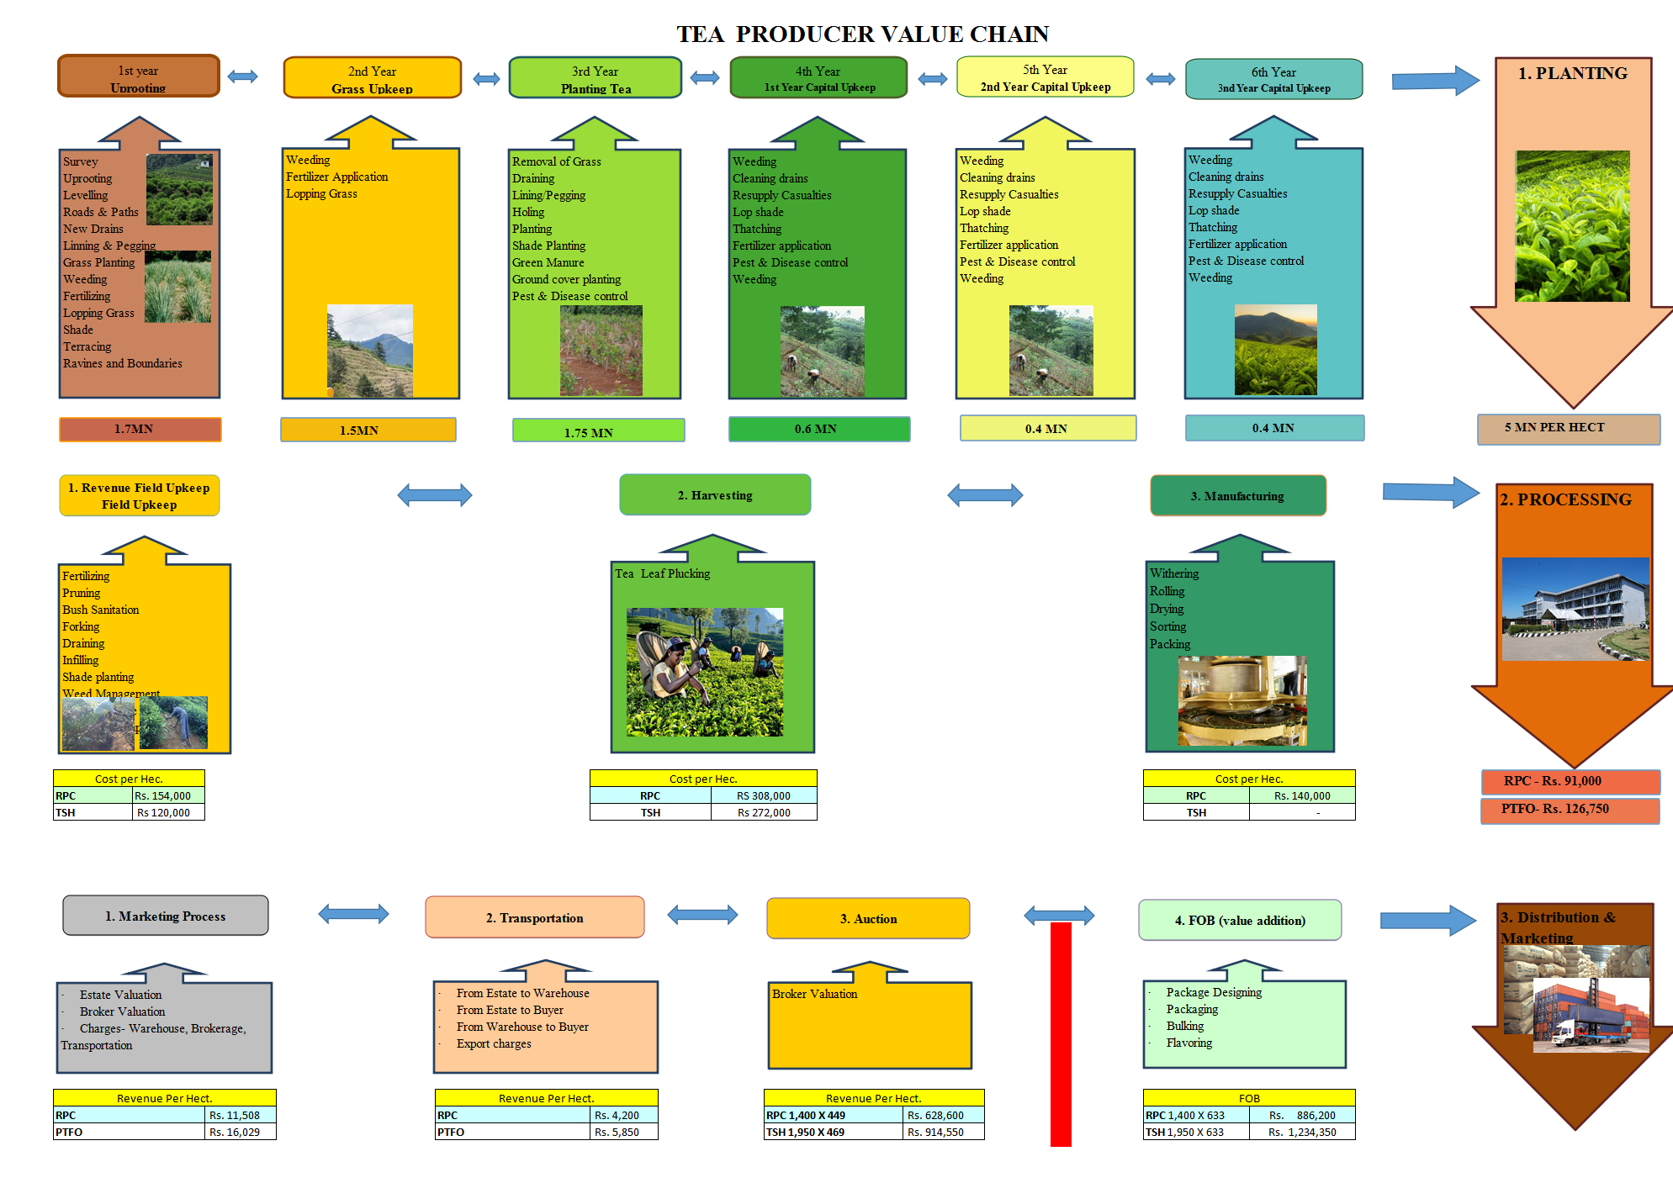
TEA PRODUCER supply CHAIN

Slide 27
COST & REVENUE VIABILITY
 | RPC | Small Holders
Yield per Hect/Year – YPH Kilos/Made Tea | 1,400 | 1,950
WHG & National GSA- Rs/ Kilo/ Made Tea | 449.00 | 469.00
GSA (High Grown - 2016) Rs/Kg (TSH- 68% of GSA)Rs/Kilo | 449.00 | 318.92
Revenue Per Hect. Rs/ Hectare | 628,600 | 621,894
Cost per Hect. Rs/ Hectare
Revenue Field Work Cost. Rs/ hectare | 154,000 | 120,000
Harvesting Cost, Rs/ Hectare | 308,000 | 272,000
Manufacturing Cost. Rs/ Hectare | 140,000 | -
Over Head Cost. Rs/ Hectare | 154,000 | -
Planting Cost. Rs/ Hectare- For 30 Years. | 170,000 | 120,000
Total Cost. Rs/. Hectare | 926,000 | 512,000
Surplus/(Deficit) /Hect | (297,400) | 109,894

Slide 28
BREAKDOWN OF COP - Rs./kg. MADE TEA – (2016)
LABOUR (67%)
Wages and Benefits
MATERIAL (15%)
Firewood, Fuel, Fertilizer, Chemicals, Packing Materials and other physical goods
STAFF & MANAGEMENT (9%)
Estate & Head Office Managers, Executives & Staff (Field, Factory, Office and Welfare) Salaries, Benefits & Perquisites
SERVICES (5%)
Medical, Welfare, Insurances, Electricity , Legal and Taxes
MISCELLANEOUS (4%)

Slide 29
COST PER KG % TEA – 2016 @ 1400 kgs YPH
1400 YPH | Plucking | Manufacture | General Charges | Field Upkeep | Staff | Fertilizing | Worker Welfare | Weeding | Fin & Mgt | Power | Total
2016 | 250.00 | 69.94 | 31.54 | 39.29 | 33.45 | 44.61 | 25.06 | 21.86 | 32.20 | 13.00 | 560.95
% | 45% | 12% | 7% | 7% | 6% | 8% | 5% | 4% | 6% | 2%

Slide 30
RPC LABOUR WAGE INCREASE
Year | 77 | 78 | 79 | 82 | 83 | 84 | 85 | 86 | 87 | 88 | 89 | 90 | 92 | 93 | 96 | 98 | 00 | 02 | 04 | 06 | 07 | 09 | 11 | 13 | 16
Labour Wage Rs./Day | 7.4 | 7.9 | 12 | 14 | 15 | 24 | 25 | 26 | 28 | 37 | 41 | 48 | 62 | 72 | 95 | 115 | 115 | 147 | 180 | 260 | 290 | 405 | 515 | 620 | 730
PRE PRIVATIZATION |  |  |  |  |  |  |  |  |  |  |  |  | POST PRIVATIZATION

Slide 31
SRI LANKA WAGE PRICE AND CCPI (2007=100)
Source : Department of Census and Statistics , Central Bank of Sri Lanka

Slide 32
LABOUR WAGE Vs. HIGH GROWN GSA
Year | 1980 | 1983 | 1985 | 1988 | 1990 | 1992 | 1993 | 1994 | 1995 | 1996 | 1997 | 1998 | 1999 | 2000 | 2001 | 2002 | 2003 | 2004 | 2005 | 2006 | 2007 | 2008 | 2009 | 2010 | 2011 | 2012 | 2013 | 2014 | 2015 | 2016
Labour Wage(Rs.) | 12 | 15 | 25 | 36 | 48 | 62 | 72 | 83 | 83 | 95 | 95 | 115 | 115 | 115 | 121 | 147 | 147 | 180 | 180 | 260 | 290 | 290 | 405 | 405 | 515 | 515 | 620 | 620 | 620 | 730
High Grown GSA | 18 | 42 | 40 | 45 | 68 | 64 | 68 | 66 | 70 | 93 | 109 | 127 | 106 | 128 | 135 | 136 | 138 | 172 | 172 | 204 | 252 | 273 | 320 | 338 | 330 | 376 | 403 | 420 | 388 | 450
% | 67% | 36% | 63% | 80% | 71% | 96% | 106% | 125% | 119% | 102% | 87% | 90% | 109% | 90% | 89% | 108% | 106% | 105% | 105% | 127% | 115% | 106% | 127% | 120% | 156% | 137% | 154% | 147% | 160% | 162%
SOURCE: MINISTRY OF PLANTATION INDUSTRIES

Slide 33
Year | 77 | 78 | 79 | 82 | 83 | 84 | 85 | 86 | 87 | 88 | 89 | 90 | 91 | 92 | 93 | 96 | 98 | 00 | 01 | 02 | 03 | 04 | 06 | 07 | 09 | 10 | 11 | 13 | 14 | 15 | 16
Labour Wages Rs./Day | 7.4 | 7.9 | 11.7 | 14 | 15 | 24 | 25 | 26 | 28 | 37 | 41 | 48 | 52 | 62 | 72 | 95 | 115 | 115 | 121 | 147 | 147 | 180 | 260 | 290 | 405 | 405 | 515 | 620 | 620 | 620 | 730
Gross Sale Avg Rs./Kg | 17 | 14 | 18 | 24 | 42 | 63 | 40 | 32 | 39 | 45 | 56 | 68 | 57 | 66 | 68 | 93 | 128 | 128 | 136 | 142 | 138 | 172 | 205 | 253 | 321 | 338 | 330 | 403 | 420 | 389 | 450
% Wage/GSA | 45% | 58% | 63% | 58% | 36% | 38% | 63% | 81% | 72% | 82% | 73% | 71% | 91% | 94% | 106% | 102% | 90% | 90% | 89% | 104% | 107% | 105% | 127% | 115% | 126% | 120% | 156% | 154% | 148% | 159% | 162%
% GSA/Wage | 223% | 173% | 158% | 171% | 280% | 263% | 160% | 123% | 139% | 122% | 137% | 142% | 110% | 106% | 94% | 98% | 111% | 111% | 112% | 97% | 94% | 96% | 79% | 87% | 79% | 83% | 64% | 65% | 68% | 63% | 62%

Slide 34
LABOUR WAGE VS AUCTION PRICES - 2017
Year | 80 | 81 | 82 | 83 | 84 | 85 | 86 | 87 | 88 | 89 | 90 | 91 | 92 | 93 | 94 | 95 | 96 | 97 | 98 | 99 | 00 | 01 | 02 | 03 | 04 | 05 | 06 | 07 | 08 | 09 | 10 | 11 | 12 | 13 | 14 | 15 | 16 | 17
Labour Wages Rs./Day | 12 | 12 | 14 | 15 | 24 | 25 | 26 | 28 | 37 | 41 | 48 | 52 | 62 | 72 | 83 | 83 | 95 | 95 | 115 | 115 | 115 | 121 | 147 | 147 | 180 | 180 | 260 | 290 | 290 | 405 | 405 | 515 | 515 | 620 | 620 | 620 | 730 | 730
Auction Price US $ | 1.11 | 0.94 | 1.13 | 1.84 | 2.47 | 1.44 | 1.09 | 1.33 | 1.34 | 1.51 | 1.77 | 1.41 | 1.41 | 1.43 | 1.32 | 1.42 | 1.88 | 2.02 | 2.07 | 1.64 | 1.79 | 1.61 | 1.56 | 1.54 | 1.79 | 1.85 | 1.92 | 2.53 | 2.87 | 3.14 | 3.28 | 3.25 | 3.07 | 3.45 | 3.54 | 2.96 | 3.27 | 4.11
Exchange Rates | 17 | 19 | 21 | 23 | 25 | 27 | 28 | 29 | 32 | 36 | 40 | 41 | 44 | 48 | 49 | 53 | 55 | 58 | 64 | 70 | 77 | 89 | 95 | 96 | 101 | 100 | 104 | 110 | 108 | 115 | 113 | 110 | 128 | 131 | 131 | 144 | 148 | 154

Slide 35
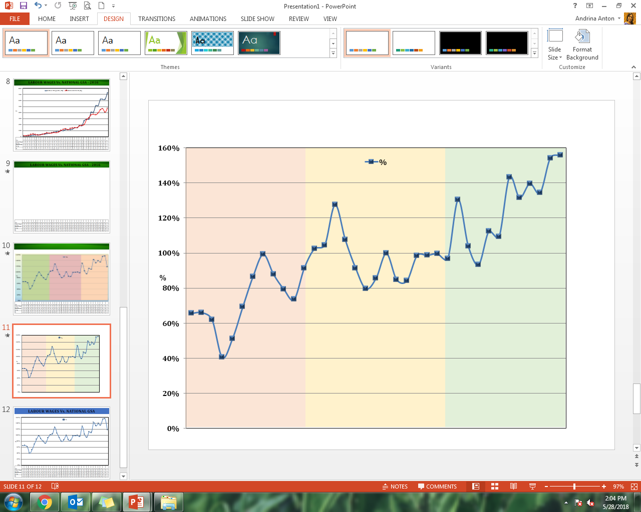
LABOUR WAGES Vs. NATIONAL GSA % - 2016
Year | 80 | 81 | 82 | 83 | 84 | 85 | 86 | 87 | 88 | 89 | 90 | 91 | 92 | 93 | 94 | 95 | 96 | 97 | 98 | 99 | 00 | 01 | 02 | 03 | 04 | 05 | 06 | 07 | 08 | 09 | 10 | 11 | 12 | 13 | 14 | 15 | 16
Labour Wages Rs./Day | 12 | 12 | 14 | 15 | 24 | 25 | 26 | 28 | 37 | 41 | 48 | 52 | 62 | 72 | 83 | 83 | 95 | 95 | 115 | 115 | 115 | 121 | 147 | 147 | 180 | 180 | 260 | 290 | 290 | 405 | 405 | 515 | 515 | 620 | 620 | 620 | 730
National GSA Rs./kg | 18 | 18 | 23 | 37 | 46 | 35 | 30 | 28 | 42 | 51 | 66 | 57 | 61 | 69 | 65 | 77 | 104 | 119 | 134 | 115 | 136 | 144 | 149 | 149 | 181 | 186 | 200 | 279 | 311 | 360 | 371 | 360 | 392 | 444 | 462 | 402 | 467
% | 66 | 66 | 62 | 40 | 51 | 69 | 87 | 99 | 88 | 79 | 74 | 91 | 102 | 105 | 127 | 107 | 91 | 80 | 86 | 100 | 85 | 84 | 98 | 99 | 100 | 97 | 130 | 104 | 93 | 112 | 109 | 143 | 131 | 140 | 134 | 154 | 156

Slide 36
LABOUR COST- % OF REVENUE -2016
Revenue @ Kg of MT = Rs. 450/-
Labour Cost = 80% of Revenue
Labour Cost = 67% of COP
Labour Cost = Rs.355/- @Kg of MT

Slide 37
WAGES Vs HIGH GROWN GSA
Year | 1990 | 1992 | 1998 | 2002 | 2004 | 2006 | 2009 | 2011 | 2012 | 2013 | 2015 | 2016
Rs / kg COP | 59 | 82 | 101 | 124 | 136 | 188 | 334 | 399 | 400 | 440 | 460 | 530
COP % (Rs./kg) Vs. Base | 100 | 139 | 171 | 211 | 230 | 320 | 568 | 678 | 681 | 748 | 782 | 901
Worker wage | 48.32 | 61.84 | 115 | 147 | 205 | 260 | 405 | 515 | 515 | 620 | 620 | 730
Worker wage % Vs. Base | 100% | 128% | 238% | 304% | 424% | 538% | 838% | 1066% | 1066% | 1283% | 1283% | 1511%
GSA - High | 64.05 | 64.22 | 106.71 | 136.65 | 171.78 | 204.31 | 319.73 | 329.95 | 375.53 | 402.98 | 388.38 | 449.85
Wage/GSA | 75% | 96% | 108% | 108% | 119% | 127% | 127% | 156% | 137% | 154% | 160% | 162%
Source: Tea Board Statistical Bulletin – 2011, MPI

Slide 38
SUB SECTOR DAILY WAGE (Rs/Day) – 2016
TEA-US $ 1.628 Bn
RPCs = 28% of work force & 25% of Production
18,250/ Min Wage
SOURCE: WAGES & FRINGE BENEFITS SYRVEY , EFC -2014

Slide 39
RPC WAGES vs. COMPETING COUNTRIES (SL/Rs) - 2016

Slide 40
PLUCKING AVERAGE (GREEN LEAF /DAY/WORKER) - 2016
 | Kenya | South India | Assam | Sri Lanka
Plucking Average (kilos/worker) | 60 | 50 | 36 | 18
Norm | 40 | 34 | 24 | 16-18
Green Leaf Cost (Rs/kilo) | 11.08 | 14.33 | 14.27 | 40.56

Slide 41
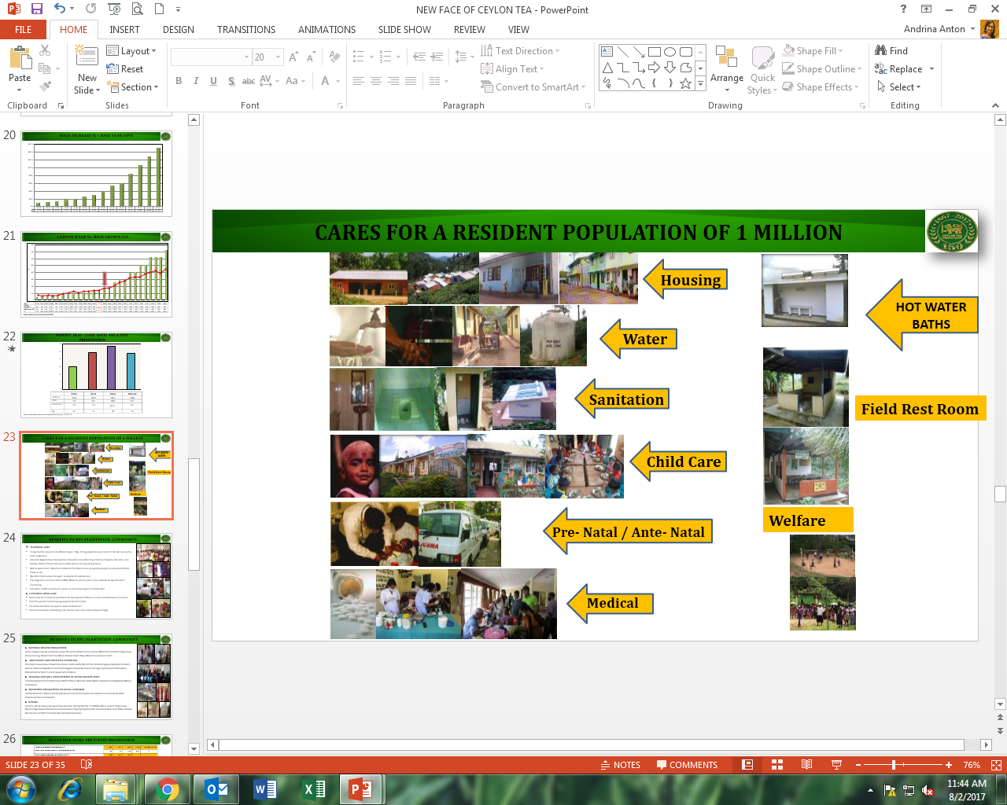
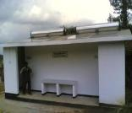
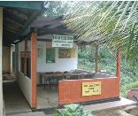
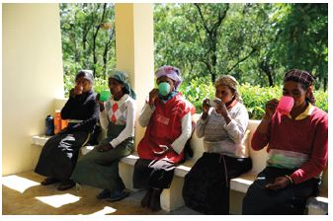
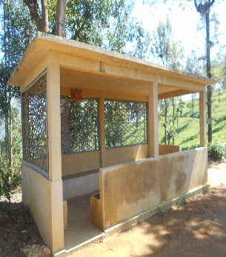
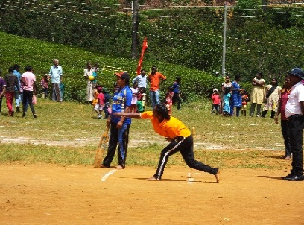

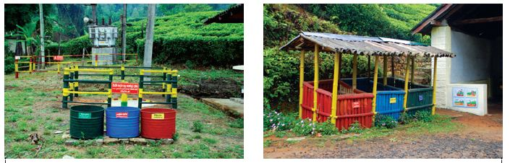
RPCs CARE FOR A RESIDENT POPULATION OF 1 MILLION
Hot Water Bath
Field Rest Room
Welfare
Waste Mgt

Slide 42
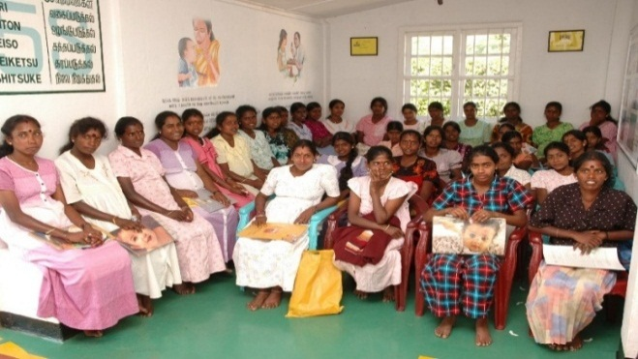

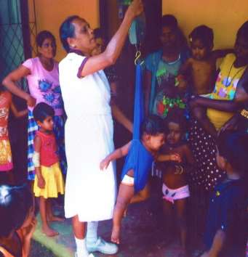
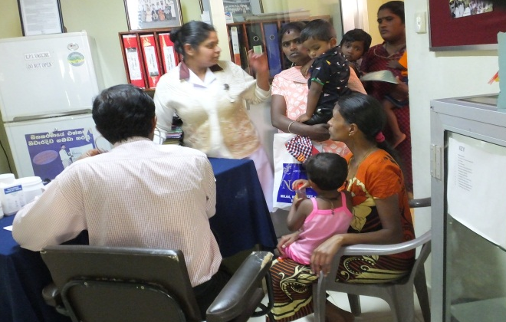
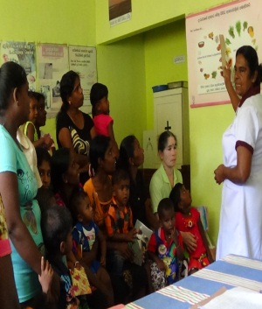
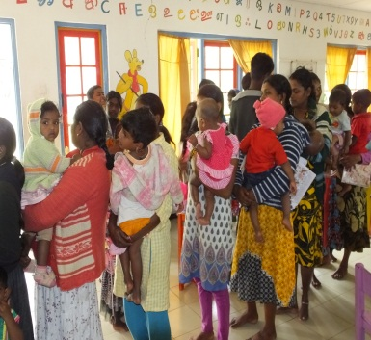
BENEFITS TO RPC PLANTATION COMMUNITY
MATERNAL CARE 2.5 Kg. Healthy baby at birth, Mother to gain 750g – 01 Kg weight for every month in the last 5-6 months of her pregnancy. Antenatal Registration, Paid leave for Antenatal Clinics, Worming, Vitamins, Triposha, Folic Acid , Iron Tablets, Tetanus Toxide Vaccine on estate account during working hours. MOH & Government Midwife on Estate for Pre-Natal Clinics and paid leave given to workers to attend these clinics. Mid-Wife visits homes. Transport to hospital for safe delivery. Pre-pregnancy nutritional status (BMI), Maternal Anemia (Serum Hb), Gestational age estimation monitoring. From BCG to D&T and Polio at 5 years- all vaccinations given on Estate itself CUSTODIAL CHILD CARE Health care for children by qualified Child Development Officers in 1,544 Child Development Centres Nutrition, growth monitoring, age appropriate stimulation Pre-school education and psycho -social development Parental awareness, free feeding, free mid day meal, milk, school books and bags

Slide 43
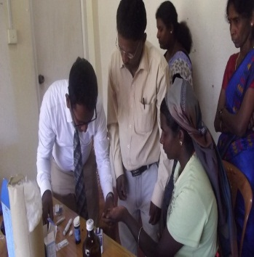
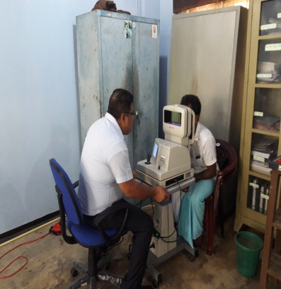
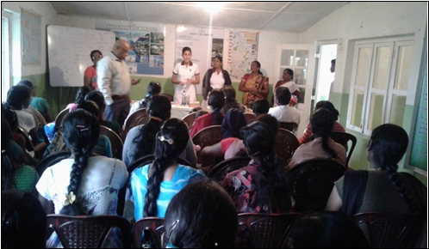
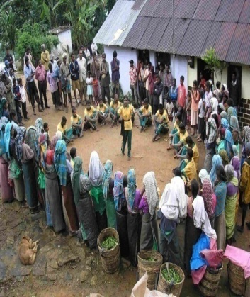


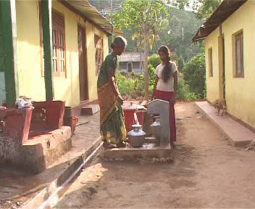
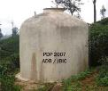
BENEFITS TO RPC PLANTATION COMMUNITY
NATIONAL HEALTH PROGRAMMES
Cancer Programmes, Eye and Dental Camps, TB Control, Rabies Control, Anemia, Mental & Child Health Programmes, Family Planning, National Nutrition Month, National Health Week, Mobile films shows on health
ADOLESCENT GIRLS HEALTH & NUTRITION
Training and Awareness on Food Consumption, Habits, Safety, Malnutrition, Personal Hygiene, Reproductive Health, Anemia, Infectious Diseases, Environmental Hygiene, Awareness of early marriage, Improvement of Self-esteem, Establishment of Youth Clubs, Empowerment of Women
TRAINING AND SKILL DEVELOPMENT OF ESTATE HEALTH STAFF
Child Development Centre Staff, Family Welfare Officers, Midwives, Estate Medical Assistants and Registered Medical Practitioners
AWARENESS PROGRAMMES ON SOCIAL CONCERNS
Combat Alcoholism, Tobacco and Drug Abuse, Community Participation, Awareness on Child abuse, Domestic Violence and Sexual Harassment.
OTHERS
Libraries , Barber Salons, Sewing Centres, Hot water bathing facilities, “E” KIOSKS, Mahila Shakthi Programmes, Maintain Base Hospital Wards, Insurance Policies for Housing Projects, Water Schemes & Water Committees, National Identity Card and Birth Certificate Documentation Facilitation.

Slide 44
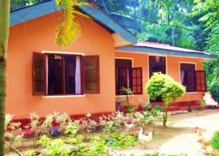
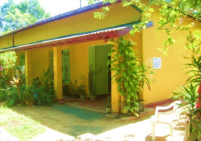
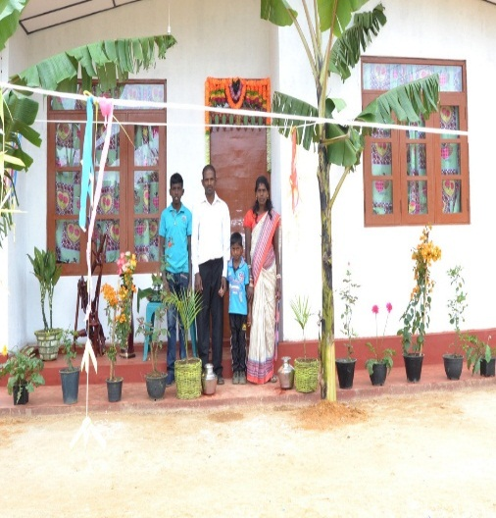
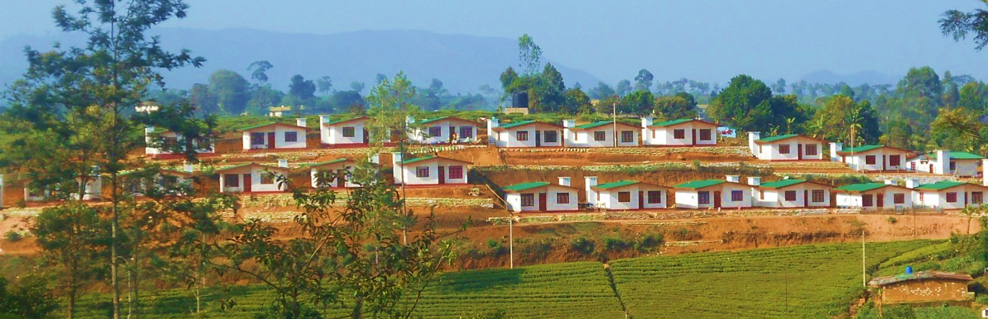
WORKER HOUSING
At the privatization 1992 itself as a precondition, the RPCs absolved of any responsibility related to Worker Housing.
Worker housing and vegetable gardens to be released “free of any consideration” clause.
At Government Level – Ministry of Estate Infrastructure from 1992 – Cabinet level portfolio held by Plantation Sector political party leaders.
At Institutional Level – Plantation Housing Development Trust (PHDT) – Tripartite – Unions, Government and RPCs.
At Estate Level - Estate Worker Housing Cooperative Society-(EWHCS).
7 perches of land for core house given absolutely free by the RPCs.
Free Housing Grant up to Rs. 125,000/- (1997) + Technical, Material, Logistical and Managerial input and assistance from PHDT, RPCs, State and Non State Organizations, NGOs & INGOs.
Community Centers, roads, water supply and other social amenities provided free to Housing Schemes.
By 2014,- 28,000 New Houses & 110,000 Upgraded housing- 60% of workers live in upgraded houses.

Slide 45
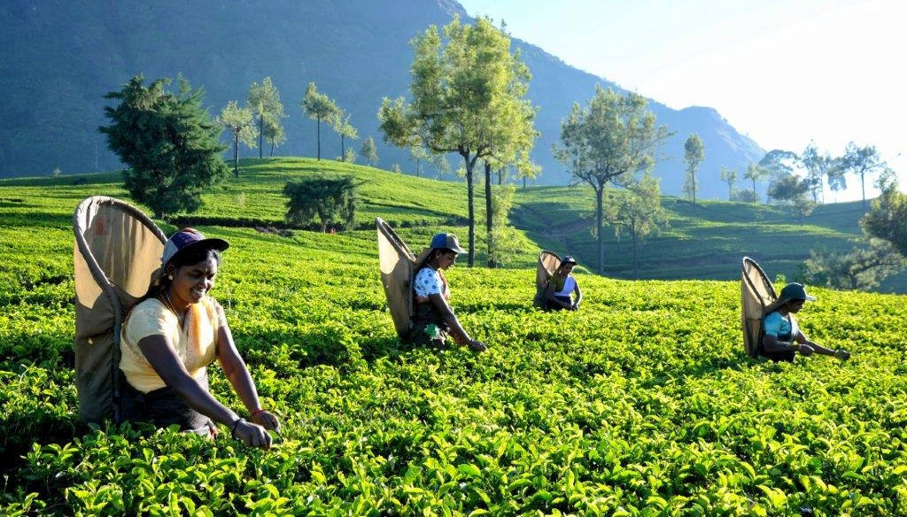
CHALLENGES FACING THE INDUSTRY
Outmigration of workers.
Climate change and the erratic extreme weather conditions.
Low labor and land Productivity
Very high Cost of Production
Low Profit margin
Economies of Scale
Unsustainable Tea prices.
Loss of brand value and identity in global markets.
Very high social cost borne by RPCs for services & amenities.
Politics and policy framework
Adoption of Technology
Reducing “Pull” of agriculture

Slide 46
LABOUR OUT-MIGRATION
1980 – 1991 214,848 = -40%
1992 - 2016 172,607 = -53%
1980 | 11 years = -40% | 1991
541,971 |  | 327,123
1992 | 25 years = -53% | 2016
327,123 |  | 154,516

Slide 47
RPC POPULATION Vs WORKFORCE
Year | 1992 | 1995 | 2000 | 2001 | 2002 | 2003 | 2004 | 2005 | 2006 | 2007 | 2008 | 2009 | 2010 | 2011 | 2012 | 2015 | 2016
Total Workers | 327,123 | 280,783 | 261,417 | 255,226 | 249,807 | 239,902 | 236,527 | 233,046 | 231,845 | 218,130 | 217,035 | 200,439 | 202,204 | 196,861 | 193,412 | 163,068 | 154,516
Total Population | 838,518 | 849,646 | 887,028 | 895,446 | 904,882 | 892,979 | 917,103 | 917,103 | 934,807 | 939,283 | 939,283 | 952,135 | 970,000 | 983,433 | 987,074 | 987,074 | 987,074
% | 39 | 33 | 29 | 29 | 28 | 27 | 26 | 25 | 25 | 23 | 23 | 21 | 21 | 20 | 20 | 17 | 15
SOURCE: MINISTRY OF PLANTATION INDUSTRIES 2006,2011 (141),PHDT

Slide 48
% OF WORKERS OF THE ESTATE POPULATION
Year | 1992 | 1995 | 2000 | 2001 | 2002 | 2003 | 2004 | 2005 | 2006 | 2007 | 2008 | 2009 | 2010 | 2011 | 2012 | 2015 | 2016
Total Workers | 327,123 | 280,783 | 261,417 | 255,226 | 249,807 | 239,902 | 236,527 | 233,046 | 231,845 | 218,130 | 217,035 | 200,439 | 202,204 | 196,861 | 193,412 | 163,068 | 154,516
Total Population | 838,518 | 849,646 | 887,028 | 895,446 | 904,882 | 892,979 | 917,103 | 917,103 | 934,807 | 939,283 | 939,283 | 952,135 | 970,000 | 983,433 | 987,074 | 987,074 | 987,074
% | 39 | 33 | 29 | 29 | 28 | 27 | 26 | 25 | 25 | 23 | 23 | 21 | 21 | 20 | 20 | 17 | 15
SOURCE: MINISTRY OF PLANTATION INDUSTRIES 2006,2011 (141),PHDT

Slide 49

PLANTATION WORKERS
PLUCKER ATTENDANCE
Socio Infrastructure
Political
Social
Economic
Cultural
Work life / Lifestyle

Slide 50
FACTORS FOR WORKER SHORTAGE
Availability of jobs for 1st time job seekers
Better cash wages outside
Remittances from Colombo
Availability of alternate employment
ECONOMIC
Accent on education
Access to education
Improvement to literacy and education levels
Language barriers broken
Lower social image for plantation work
Change in aspirations and expectations
SOCIAL
Unwillingness of parents (71%)
Low dignity attached to plantation jobs –(35% prefer another job)
Role of women in family, society, work place
Inferiority mind set
More off days (festivals)
WORKER SHORTAGE
CULTURAL
Better political representations leverage
Empowerment and emancipation
Better integration with outside
Access to government/state resources & institutions
POLITICAL
Drudgery of plantation work
Weed infestation – unsafe work conditions
Work related health issues
WORK LIFE
Housing
Water
Sanitation
Other facilities
SOCIO INFRASTRUCTURE

Slide 51

WORKER SHORTAGE
OUT-MIGRATION IS AN IRREVERSIBLE PROCESS
Change the model of employment – Revenue share
“De-Estating “process – Clustering of houses & village concept
Provide better housing facilities
Improve knowledge, skills & perceptions
Change the payment system to weekly
Improve status & dignity of workers
Concentrate on health, well-being & safety at work
Improve facilities – Quality of life
Develop infrastructure for SME

Slide 52

MARKET AND VIABILTY CHALLENGE
Tea price in 2016 (HG) @ Rs. 450/- per Kilo below COP of Rs. 530/- .
Labour wages 71% of the High Grown GSA prior to privatization(1992)- 162% by 2016.
1991 Auction price USD 1.41 per Kilo, by 2016 USD 2.96 - 2 fold increase.
1991 Labour wage from Rs. 48/- per day to Rs. 730/- by 2016 – 15 fold increase.
Protect the “Producer Sustainability” by giving a higher share of the value .
Strengthen the marketing of the product and leverage on the advantages of Ceylon Tea.

Slide 53
WHO MAKES MONEY FROM A CUP?
UK – 10% OF WORLD TEA IMPORTS
16% OF INDIA & 19% OF KENYA
SOURCE: WAR ON WANT

Slide 54
TOTAL PROFIT/LOSSES – TEA (1993-2016)
Year | 1993 | 1994 | 1995 | 1996 | 1997 | 1998 | 1999 | 2000 | 2001 | 2002 | 2003 | 2004 | 2005 | 2006 | 2007 | 2008 | 2009 | 2010 | 2011 | 2012 | 2013 | 2014 | 2015 | 2016
Labour Wage (Rs/day) | 72 | 72 | 72 | 83 | 83 | 95 | 95 | 121 | 121 | 147 | 147 | 180 | 180 | 260 | 290 | 290 | 405 | 405 | 515 | 515 | 620 | 620 | 620 | 730
Total. Profit (Mn) | (1,243) | (1086) | (376) | 873 | 2,307 | 1,107 | 327 | 1,487 | 1,082 | 107 | (235) | 509 | (242) | (204) | 1,409 | (10) | (436) | 327 | (5,175) | 635 | (651) | (1,695) | (3,094) | (2,134)

Slide 55
CUMULATIVE PROFIT/LOSSES – TEA (1993-2016)
Year | 1993 | 1994 | 1995 | 1996 | 1997 | 1998 | 1999 | 2000 | 2001 | 2002 | 2003 | 2004 | 2005 | 2006 | 2007 | 2008 | 2009 | 2010 | 2011 | 2012 | 2013 | 2014 | 2015 | 2016
Labour Wage (Rs/day) | 72 | 72 | 72 | 83 | 83 | 95 | 95 | 121 | 121 | 147 | 147 | 180 | 180 | 260 | 290 | 290 | 405 | 405 | 515 | 515 | 620 | 620 | 620 | 730
Cumulative. Profit (Mn) | (1,243) | (2,330) | (2,706) | (1,832) | 475 | 1,582 | 1,910 | 3,397 | 4,480 | 4,587 | 4,351 | 4,860 | 4,617 | 4,413 | 5,823 | 5,812 | 5,376 | 5,048 | (126) | 508 | (142) | (1,837) | (4,931) | (5,822)

Slide 56
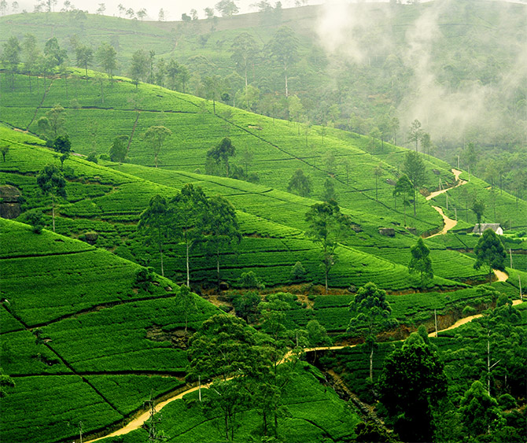
REVENUE SHARING WAGE MODEL
The present model of daily wage based emolument irrespective of output of the worker is not sustainable and will not be sustainable in the future even. The current crisis is a result of this system.
With the existing wages itself, the industry is in a state of collapse as the Colombo Auction average was (2016) at Rs. 450/- per Kg whilst the Cost of Production is over Rs. 530/- per Kg.
Over 75% of the pluckers bring in more than 18 Kg per day on an annual basis, absorbing the seasonal variances.
Therefore, a scheme to encourage and reward the 75% of the productive workers should be in place to support them.
The existing model prevents the benefits of productivity going to the more productive workers and it encourages under performing workers as they too get the same emoluments. There is no surplus left to reward productive workers.

Slide 57

REVENUE SHARING WAGE MODEL
Current thinking sweeping across the globe is to empower the growers and make them directly responsible for their capacity to earn while the management providing the suitable environment, technical and managerial inputs.
Empowered with entrepreneurial skills in an environment where the workers will have a proprietary interest and an opportunity to earn.
Opportunities to earn is maximized to the limit of their effort and initiative.
From the models that are in existence, it is clearly evident that Revenue Sharing Model has increased the income for the workers and have contributed to
- Increased earnings,
- Enhancing their job security
- Improving Quality of Life.
The flexibility of their times of work has contributed to the increase in productivity & ability to be an entrepreneur.

Slide 58
THE WAY FORWARD - REVENUE SHARING FOR RPCs
150 year old traditional model - resident, daily wage based, employer dependent workers who still look up to the estate management to determine their income earning capacity and potential.
Change the management dependent, entitlement minded, welfare oriented, low factor productivity, daily wage based system for the sustainability of the plantation community.
Current thinking is to empower the growers and make them directly responsible for their capacity to earn while the management provides the suitable environment, technical and managerial inputs.
Revenue Sharing” Model to move away from employer dependent to self managed model.
Workers to be empowered with entrepreneurial skills in an environment where they will have a proprietary interest and an opportunity to maximize earnings to the limit of their effort and initiative.
The willingness on the part of the workers to increase their productivity where they see an apparent direct gain to themselves have also contributed to the success.
The flexibility of their times of work has contributed to the increase in productivity & ability to be an entrepreneur.
Revenue Sharing” Model has contributed to Increased earnings and giving dignity to the operators ,enhancing their job security and improving the overall Quality of Life

Slide 59

REVENUE SHARING WAGE MODEL
It is proposed to share 50% of the bought leaf rate with the RPC harvesters while retaining 50% for taxes and rates, general charges, manufacture, field supervision, field upkeep, agronomic and agricultural practices and fertilizer.
The proposed Revenue Sharing Model will pay 50% of the bought leaf rate for the harvesters.
This will facilitate the RPC workers to achieve an even better standard of living and earnings as all the other facilities such as health, welfare and sanitation will be looked after by the estate as at present.
Currently, more than 400,000 Tea Smallholders are harvesting over 76% of the National Crop and are being paid on a very sustainable “Bought Leaf” formula, for the last 60 years. (68% of the factory NSA)
This has resulted in the Smallholders increasing the share from less than 25% of the National Crop in the 1950s to the current level of 76% of the National Crop.
The Smallholders and their families have benefitted from receiving 68% share of the natural increase of Tea prices over the years as a result of this formula. Their life style and quality of life has improved tremendously because of their entrepreneurship and ability to determine their earning capacity based on their productivity.

Slide 60

REVENUE SHARING WAGE MODEL
The new model proposes only a change in the way the workers are going to be paid for their work. Instead of merely paying a fixed daily wage, their capacity to earn will increase exponentially with the level of their output.
Land will be assigned and the workers will go to their allotted sections and work under the overview of staff and Kanganies as done presently.
Only the basis of payment will change – instead of daily fixed wage to enhanced earnings through productivity based.
Estate will offer 3 days of work in the current model and the rest of the week, the “Revenue Sharing Model” will operate.
35% of the Gross Sale Average of the Tea will be paid after converting for each Kilo of Green Leaf plucked by the harvesters and their earnings will depend directly on their individual output.
The more productive pluckers can earn as much as over Rs. 1,300/ per day and this will encourage entrepreneurship amongst workers.
A sense of control of how much they can earn will be instilled in them instead of depending on other external factors and a daily fixed wage.

Slide 61
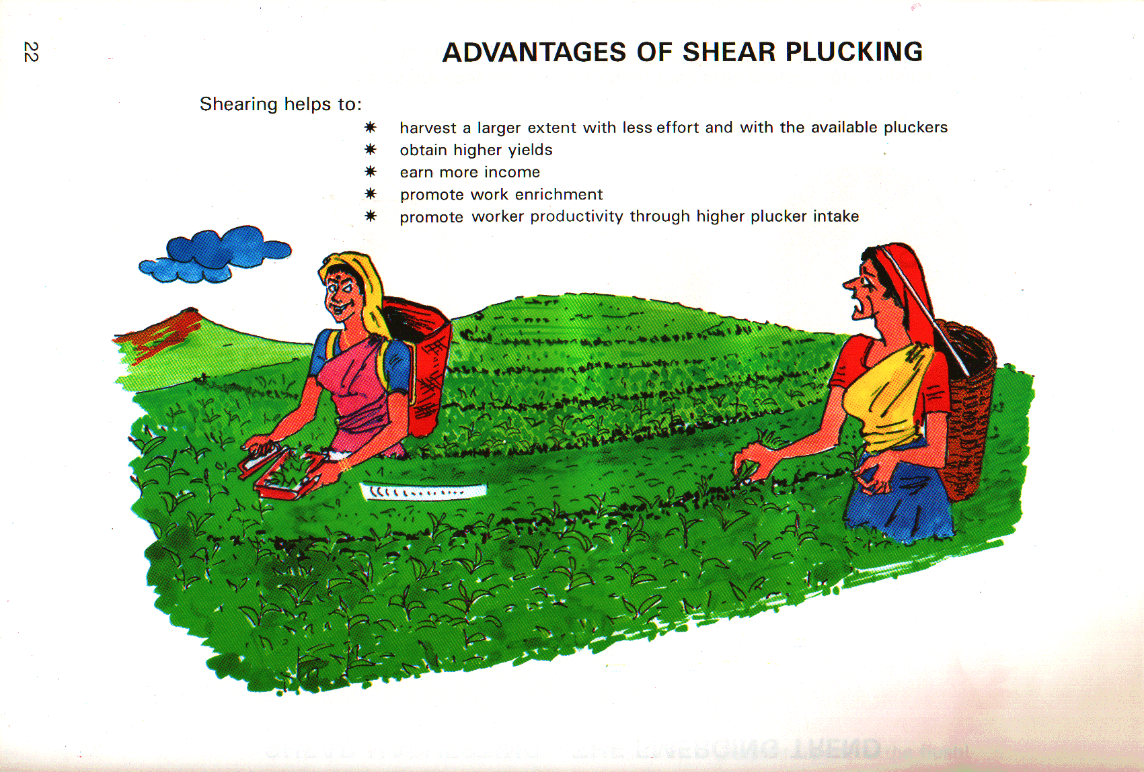
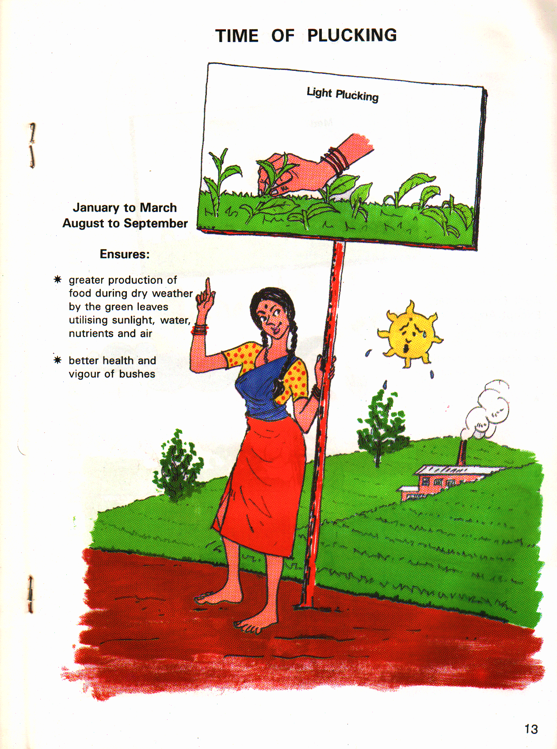

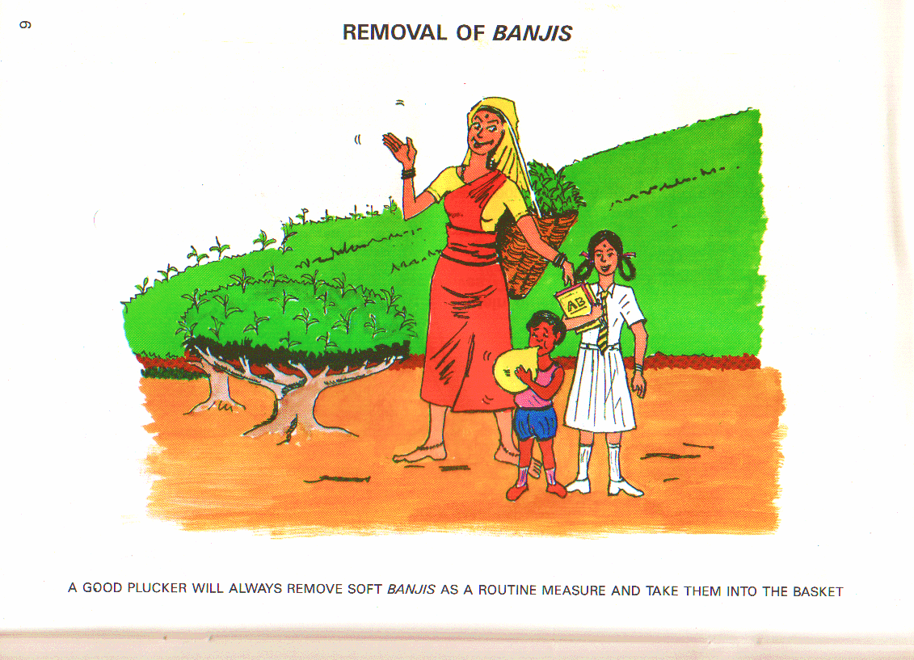
A SUSTAINABLE FUTURE FOR OUR WORKERS
Productivity/Revenue Share based earning model.
Productivity based rather than Attendance based wages.
Gain sharing entrepreneurs instead of “Daily Wage” based worker.
Archaic daily wage based worker to commercial worker.
Autonomous “Social Business Enterprise” instead of paternalistic & management dependent culture.
Empowered workers instead of dependent workers with an entitlement mindset.

Slide 62
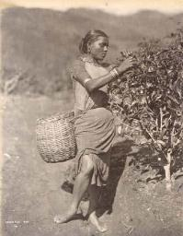


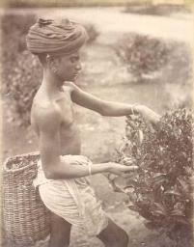
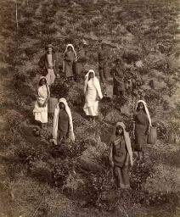
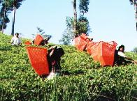
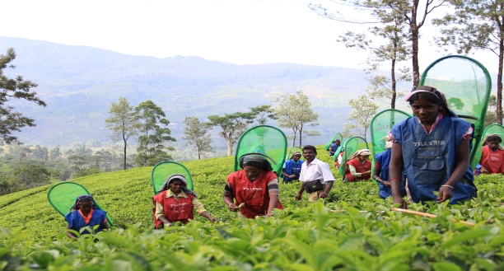
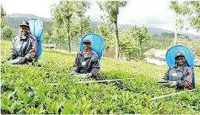
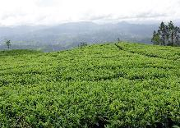

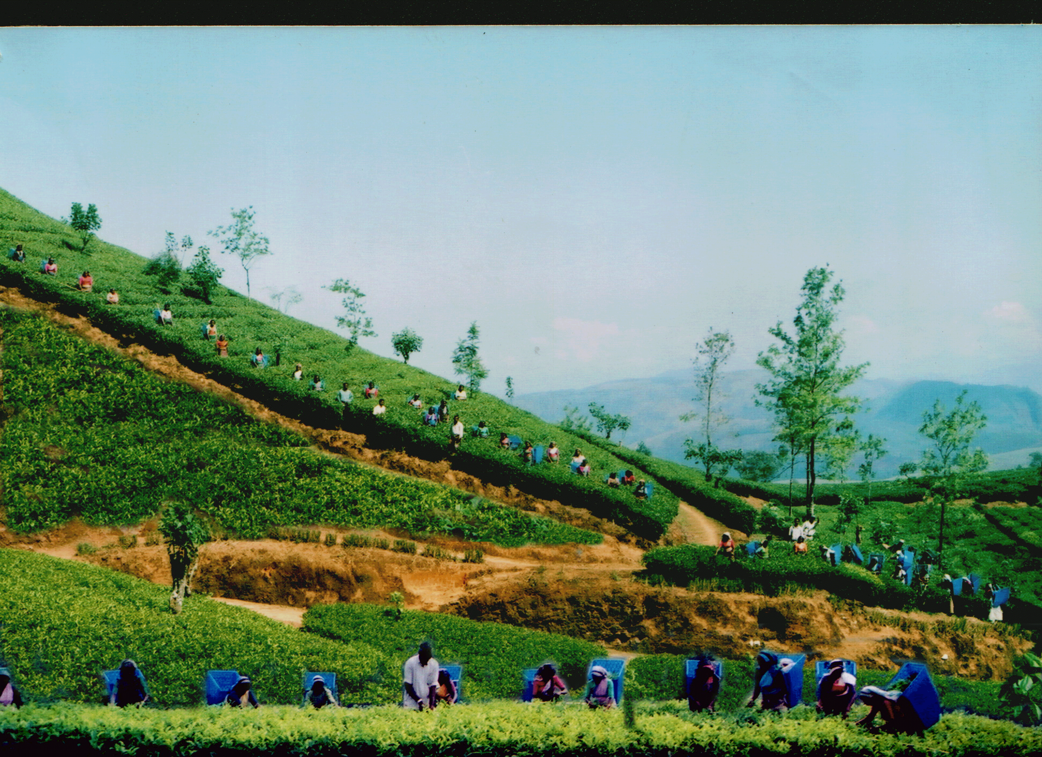
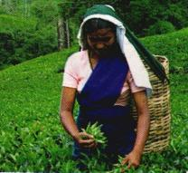

Slide 63


Slide 64
















THE WORLD’S FINEST TEA

