Slide 1

Shifting Dynamics in the Tea Smallholder Sub-Sector and Implications for the Future of Work
Prof. M. Esham
Dr. Rohitha Rosairo
Dr. A. W. Wijeratne
Sabaragamuwa University of Sri Lanka.

Slide 2
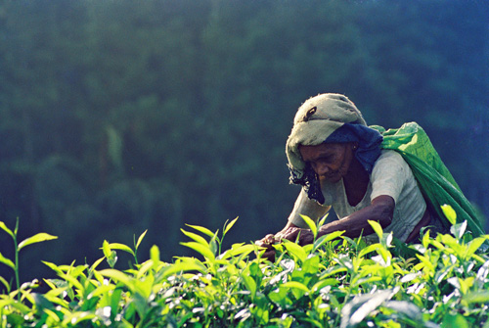
Background
Tea smallholders are playing an increasingly important role in the tea industry in Sri Lanka by contributing to 71% of national production.
Tea smallholders are ahead of RPCs in terms of productivity (TSHs: 1,974 kg/ha, RPCs: 1,483 kg/ha).
However, land and labor productivity of tea in Sri Lanka is low compared to our competitors.
The sustainability of the tea smallholder sub-sector is plagued by high cost of production, informal nature, lack of labor and climate change.

Slide 3

Objectives of the rapid assessment
Identify the role and operations of tea smallholders in the supply chain.
Access the current state of decent work in the tea smallholding sub-sector.
Identify drivers affecting future of work in the tea smallholder sub-sector
Provide recommendations on what needs to be done to ensure the competitiveness and the growth of the tea smallholding sub-sector.

Slide 4
Research Method
Focus group discussions
Tea Smallholders groups
Workers of tea smallholdings
Leaf collectors
Factory officers
Key informant interviews
TSHDA officials
SH Societies office bearers
TU representatives
Factory owners association reps.
Labor officers
Officers of financial institutions

Slide 5
The current state of decent work in the tea smallholder sub-sector
Employment opportunity
Own account work, unpaid family work and casual work
Majority are fulltime farmers
Adequate earnings and productive work
Wage not sufficient for a decent living
Labour cost not factored into COP thus, it becomes irrelevant as a decision parameter
Child labour
Child labor was not an issue as children less than 16 years did not involve in farming
Limited efforts to generate new jobs
Safety at work
Safety at work was a serious concern since the majority of the smallholders neither they use nor provide safety gear for their workers

Slide 6
The current state of decent work in the tea smallholder sub-sector
Social dialogue
No union membership
Not eligible for membership
Access to technical and vocational training
Low participation in vocational training
Social security
Not covered by any form of social security schemes.
Casual workers are not eligible to hold membership in societies
Not participating in any voluntary pension or insurance schemes.
Equal opportunity and treatment in employment
Discrimination in ownership of smallholdings
The majority of own account workers were male while the majority of unpaid family workers were female
No preparation of youth for future jobs
Lack of entrepreneurship development opportunities

Slide 7
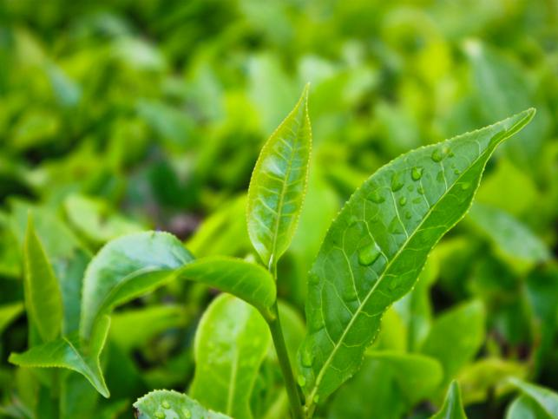
Drivers affecting future of work in the tea smallholder subsector
Productivity; Profitability & Sustainability
Future of Work
Demographic change
Food safety & quality standards
Integration with global value chains
Youth for succession
Climate change & extremes
Sustainable farming
Mechanization
Labour shortage
Land fragmentation & shortage

Slide 8
Nature of smallholder supply chain
Majority of green leaves by smallholders is channeled to the factories through private collectors while small proportion is handled by societies.
There is a value added supply chain existing.
RA Certified Small Holders
Collectors
Collecting Agents
RA Certified Factories of RPCs
Exporters

Slide 9

Business Model Within Existing Supply Chain
Non-member Smallholders
Collecting agents
Exports
RPCs
and
Private Factories
Private Collectors
Member Smallholders
Tea Smallholder Cooperative
Smallholders' society
Local sales

Slide 10
Outcomes of the model
A road map for farmer collectives should be developed with the participation of all stakeholders.
Create enabling environment in terms of policies, infrastructure and support services to promote farmer cooperatives & other business models.
Paradigm shift of the sub-sector into formality.
Potential business opportunities should be exploited (tea-tourism/home-stay, sustainable/organic farming & input supply, integrated farming, skilled labour pooling, farm mechanization etc).
Promote rural business incubators.

