Slide 1
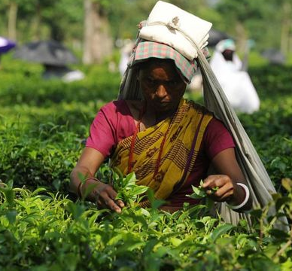
Shifting Dynamics of World of Work and Role of Women in Tea Plantations Sector – The smallholders’ Perspective
Dr Rohitha Rosairo
Faculty of Agricultural Sciences
Sabaragamuwa University of Sri Lanka

Slide 2
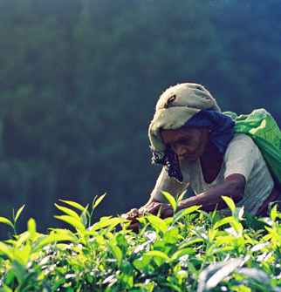
Key objectives of the presentation
Share insights on the role played by women in the tea smallholding sector.
Opportunities and challenges for women in the smallholding sector
Promotion of women smallholders in the value chain as workers , employers , farmers , land owners

Slide 3
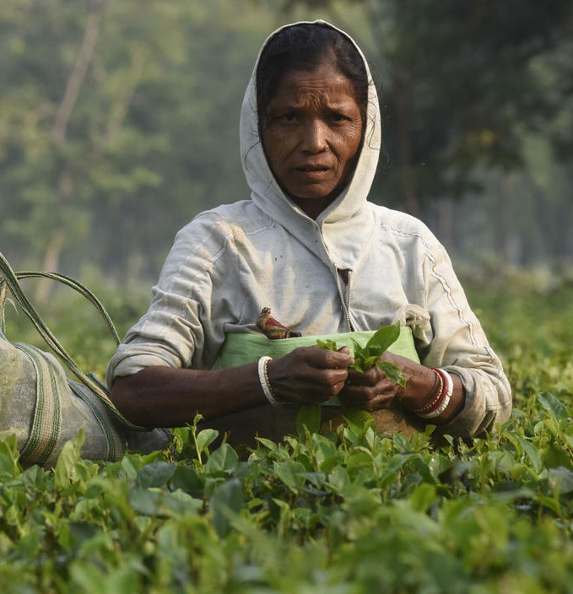
Role played by women
Woman land owner : own account worker, land as collateral.
Unpaid family worker : Undefined status, no salary, supports income to family.
Paid workers : Informal, working conditions, not much benefits, place in labour regulations.

Slide 4

Opportunities and challenges for women in the smallholding sector
Woman land owner : Land as collateral, return does not factor to cost of production.
Unpaid family worker : Undefined status, free and hidden labour (unaccounted), no salary, supports income to family.
Paid workers : Informal, unsatisfactory working conditions, not much benefits, not in the purview of labour regulations, pregnancy/childbirth conflict with work.
Youth leaving the sector : Brings greater pressure.

Slide 5

Promotion of women smallholders in the value chain
Human capital : Skill development of women/youth.
Women farmer collectives : Bargaining power, enhanced access to capital/finance,
Shift of approach : Conversion of farmer to business unit, decision-maker,
Potential business opportunities : tea tourism and homestay

