Slide 1

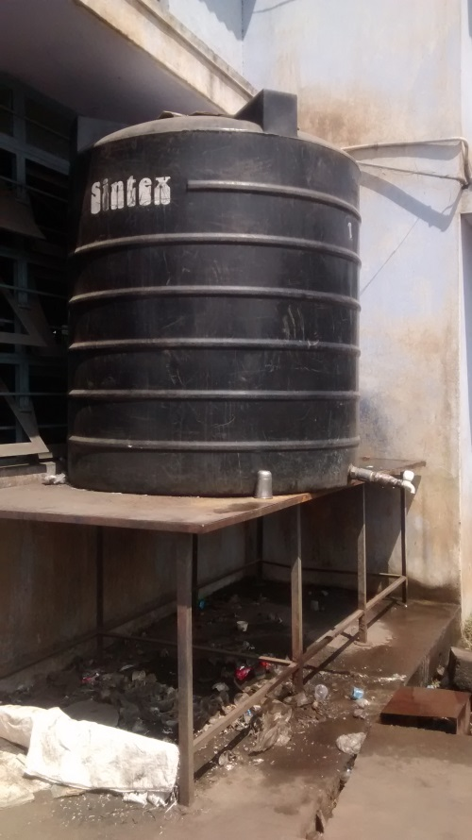
Identifying and Reducing Water Wastages in RK Enterprises, Coimbatore, Tamil Nadu, India
Environmental wastages analysis in RK Enterprise gave an eye opener. It was found that lot of drinking water was wasted and not used effectively. People used to walk up to the tank to get drinking water. Enterprise Improvement Team decided to provide small tanks at various places. Leakages in the drinking water supply were also corrected.
Water Leakage Ignored

Slide 2
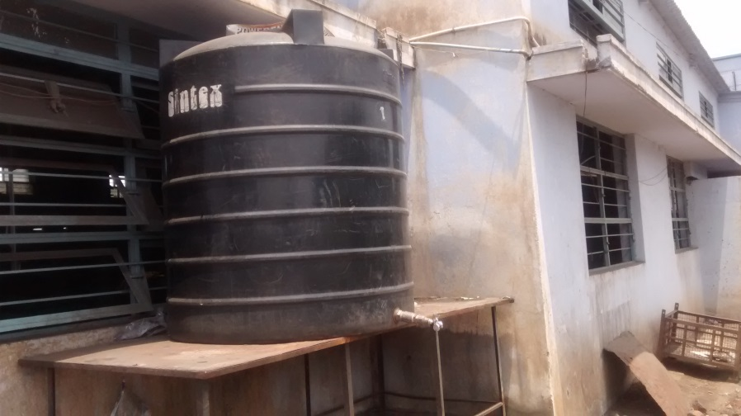
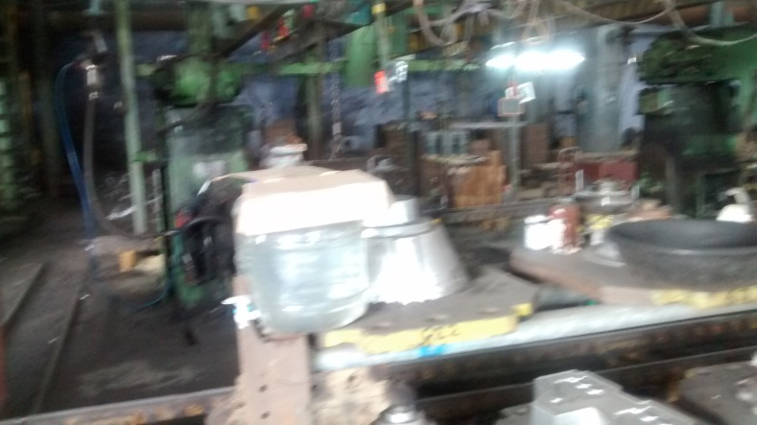
Water Consumption Reduction in RK Enterprises, Coimbatore, Tamil Nadu, India
Water Leakage arrested by replacing the tap. A lock was provided so that during non usage time, water is preserved for usage
Water provided at various sections in small cans which also reduced movement of people
Company used to buy 4 tanks of drinking water every month costing about Rs. 2400/- per month. After this small improvement, company started buying only 2 tanks which cost about Rs. 1200/- per month. The initial investment of Rs. 1800/- for small cans + Rs. 100/- for lock and key recovered within 24 days. This led to cost saving of Rs. 1200/- every month

Slide 3
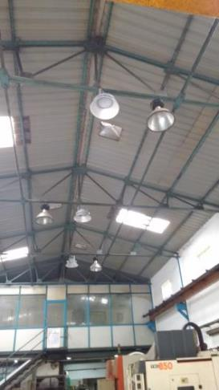
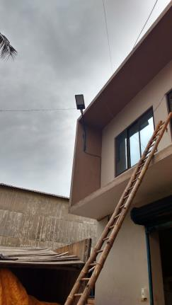
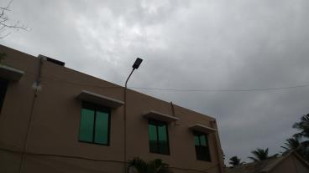
Replacing Sodium Vapour Lamps with LED Bulbs in Microfine Bushings, Chennai, Tamil Nadu, India
Microfine Bushings, Chennai, replaced Sodium vapour lamps with LED bulbs producing same amount of light. Energy consumption reduced to Three KwH per day against the original consumption of Nine KwH

