Slide 1



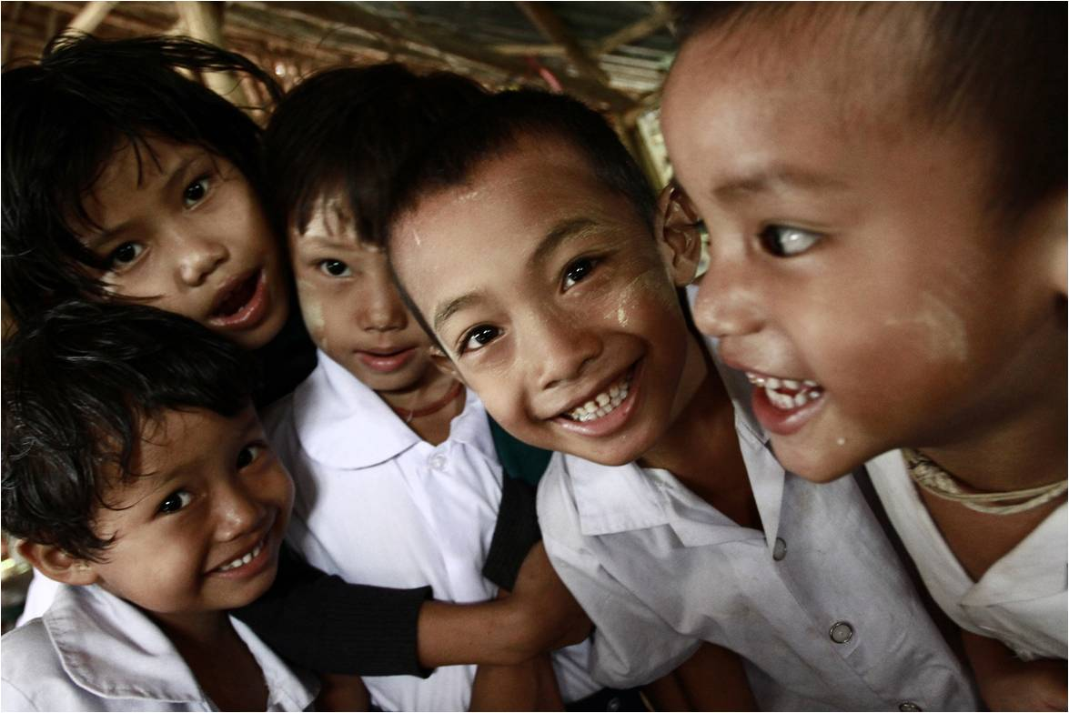
Decent employment and employment policymaking: International context
Ulaanbaatar, 7 October 2016
Makiko Matsumoto
Employment Specialist
Decent Work Technical Support Team for
East and South-East Asia and the Pacific

Slide 2
OVERVIEW
Progress made and remaining challenges
Employment policy for poverty reduction
The gap between policies and the capacity to deliver
Current issues

Slide 3
Progress made and remaining challenges

Slide 4
Achievement in reducing extreme poverty (UNDP)
47% in 1990 to 14% in 2015 (estimate, UNDP)
  Number of extreme poor more than halved: 1.9 billion in 1990 to 0.8 billion in 2015
Achievements not uniform across regions and countries
  South Asia and sub-Saharan Africa, challenges remain
Achievements not uniform across women and men
  In majority of developing countries, women are more likely than men to live in poor households
Notes:
UNDP: The Millennium Development Goals Report 2015.

Slide 5
Working poor in extreme poverty has reduced, though still very high in some countries/regions
In 3 regions, less than 10% of employed people are in extreme poverty
Progress in Asia and the Pacific and in Africa, but considerable differences across countries
  More than 50% chances of being extremely poor when in employment (2 in AP, 6 in Africa)
Share of extreme poor (<US$1.90, PPP) in total employment (%), 2010s
Note: Data for the latest available year in 2010s are presented.
Source: ILO World Employment and Social outlook, Trends 2016, table 17B

Slide 6
... a lot of people still remain vulnerable to poverty…
Share of moderate and near poor is still quite large
Susceptible to set backs in times of economic, natural or political shocks
Combined with incidence of extreme poverty, more than 4 in 5 employed persons are vulnerable to poverty in 25 of the 72 countries presented
Share of moderate and near poor (US$1.90-US$5, PPP) in total employment (%), 2010s
Note: Data for the latest available year in 2010s are presented.
Source: ILO World Employment and Social outlook, Trends 2016, table 17B
Notes:
It is approximately a third of the countries presented, concentrated in AP and Africa. They include:
Africa: Ethiopia (93%), Uganda (85%), Guinea (93%), Senegal (84%), Chad (87%), Niger (96%), Benin (82%), Tanzania (89%), Togo (82%), Lesotho (80%), Mali (94%), Sierra Leone (93%), Nigeria (87%), Rwanda (92%), Guinea-Bissau (89%), Zambia (90%), Malawi (96%), Congo, DR (92%), Madagascar (97%).
AP: Pakistan (80%), India (83%), Cambodia (90%), PNG (86%), Lao PDR (93%), Bangladesh (93%).

Slide 7
Higher incidence of poverty is also associated with higher income inequality
Some positive association between higher incidence of poverty and income inequality
Reducing poverty may also contribute to reduction in inequality
Income Gini index and incidence of poverty (national poverty line), 2010s
Note: Data for the latest available year in 2010s are presented.
Source: ILO World Employment and Social outlook, Trends 2016, table 17A

Slide 8
Employment policy for poverty reduction

Slide 9
The economic activities people do for a living (employment) importantly determines their likelihood of being poor

Slide 10
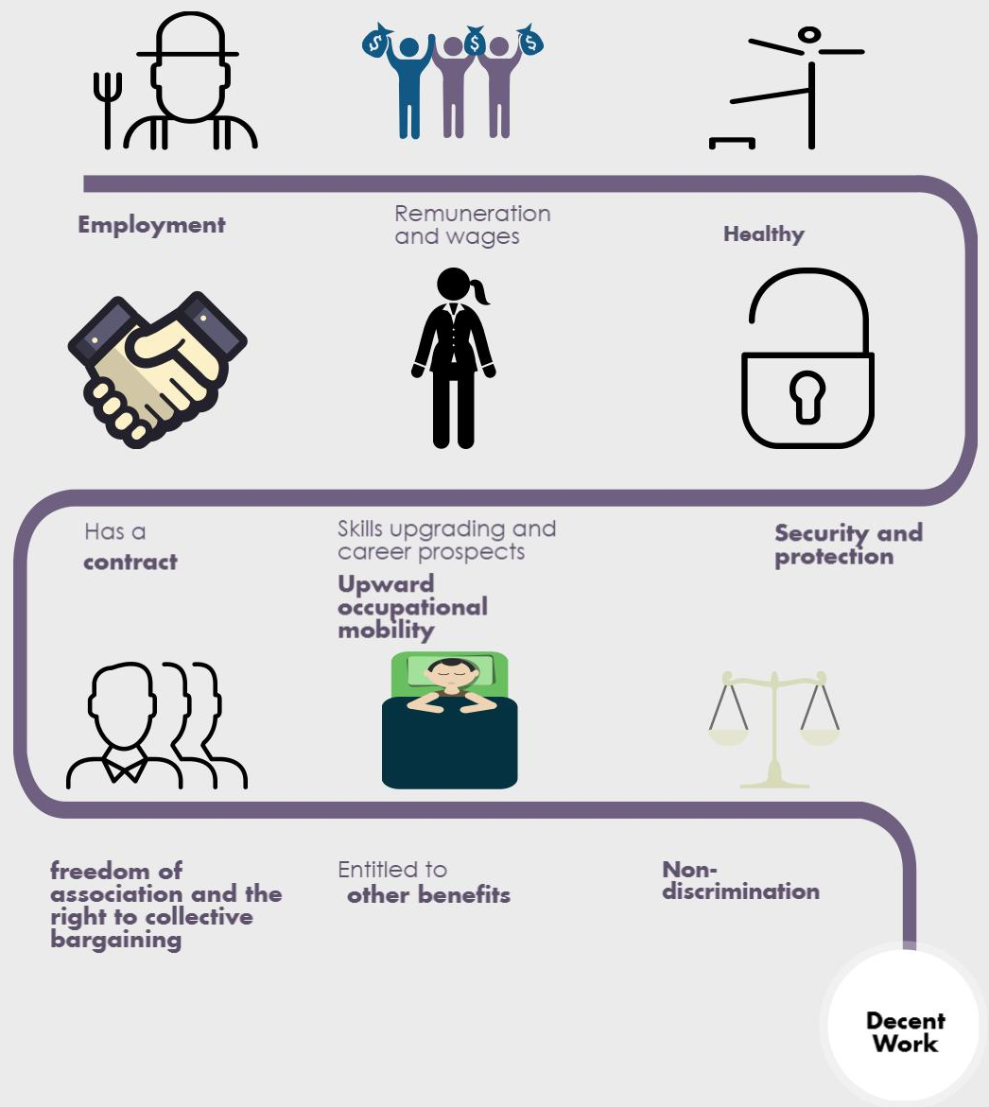
Obvious, but not so easy…

Slide 11
Continued engagement in primary or subsistence activities
Households continue to engage in less productive primary or subsistence activities
  Particularly in low-income countries
Household income diversification strategies
  Rural-urban migration by some members
Some connections established between rural and urban, agricultural and non-agricultural labour markets
  Linkages could be stronger
Share of employment in agriculture (%), 1991-2019
Source: ILO: World Employment and Social outlook, Trends 2016, table R04

Slide 12
Accelerate structural change and enhance rural-urban and inter-sectoral linkages…
In urban labour markets:
  Improve earnings
  Enhance security or protection, in event of job losses
  Increase skills development opportunities
In rural labour markets:
  Increase off-farm, non-agricultural employment opportunities
  Increase provision and quality of public services (skills, information, infrastructure)

Slide 13
Employment policy framework for poverty reduction needs to go beyond a narrow set of labour market policies and institutions

Slide 14
The Employment Policy Convention, 1964 (No. 122) ratified by 110 member States of the ILO.
As of 2014, approximately 60 countries developing, reviewing or implementing national employment policies with ILO support.

Slide 15
Countries in AP that has an employment policy framework
[Insert a map: NEP - KHM, LKA, FJI, PHL, MNG; EL – CHN, VNM; NDF – IDN]

Slide 16
Example of structure of NEP - Cambodia
Goal 1
Increase productive employment opportunities
Goal 2
Enhance skills and human resource development
Goal 3
Enhance labour market governance
Promote decent & productive employment opportunities in macroeconomic policy framework
Promote decent & productive employment opportunities in sectoral development
Enable transition of workers & economic units from informal to the formal economy
Enhance & expand development of soft skills
Improve the quality of & access to education & technical & vocational education & training
Improve the relevance of education & TVET to labour market needs
Strengthen informal system & database of labour market
Strengthen employment service effectiveness & expand outreach
Improve conditions of work & protection of workers
Harmonize IR & strengthen wage-setting mechanisms
Conduct a feasibility study to establish unemployment scheme
Oversee & protect migrant workers

Slide 17
Planning implementation in the policy cycle
A. Preparation
B. Issue identification
C. Formulation
D. Adoption
E. Programming
F. Implementation
G. Evaluation
A shorter-cycle of:
Planning/prioritizing
Action
Assessment/evaluation
Identification of gaps
Planning/prioritizing
Etc.

Slide 18
Institutional structure for implementing, monitoring and evaluating employment policy
An inter-ministerial or inter-agency platform
  MoL
  Workers, Employers
  Planning (including NSO) and finance
  Economic and sectoral ministries
  Research institutions
Working groups or sub-committees under the broad stakeholder platform to concretely implement and monitor the policy

Slide 19
Institutional structure for implementing, monitoring and evaluating employment policy
Such structures can:
  Identify target groups:
  Set priorities and targets
  Coordinate and monitor implementation, reporting, adjust policies
Youth
Women
Rural
Informal

Slide 20
An example of planning - Cambodia
Short-term prioritization + gradual build up of institutional and delivery capacity, for example
2016
Baseline
2018
Annual target: progress review, assessments, adjustments
2025
Long-term target:
Outcome + programmatic
2021
Mid-term target:
Outcome + programmatic
2017
Annual target: progress review, assessments, adjustments

Slide 21
An example of planning - Cambodia
Short-term prioritization + gradual build up of institutional and delivery capacity, for example:
2016
Baseline
2017
Annual target: progress review, assessments, adjustments
2025
Long-term target
2021
Mid-term target
Gaps: resource (people, finance), technical, institutional, legal
What works, what doesn’t work
Implementation
plan
Implementation
plan
Implementation
plan
Review
Review
Review

Slide 22
Targets and indicators: Examples
Outcome
Decent work indicators
SDG indicators
Programmatic
Number of programme beneficiaries
Number of teachers trained
Other labour market indicators
TVET course on specific skills in demand designed and implemented

Slide 23
The gap between policies and the capacity to deliver

Slide 24
Having an employment policy framework
Explicitly commits the government to improving employment outcomes (and poverty, in turn)
Provides platform for stakeholder assessment of policy measures that work
Commitments to regularly collect statistics for national M&E purposes
Improves the political economy context in favour of decent employment objectives

Slide 25
An enabling condition…
Macroeconomic policy framework that is connected to the core concerns of socio-economic development
Identifying and pulling together existing policy frameworks
  E.G.: Skills and trade & investment policies
Continuous investment in human resources and capacity development
Investment in information, management and analyses
  E.G.: LMIS

Slide 26
Employment policy as a repository of experiences and lessons learned from past labour market policies, programmes and projects…
… and to realistically coordinate across a set of key socio-economic policies, given capacity constraints.

Slide 27
Current issues

Slide 28
‘New normal’ of slower expected growth…
Balance between inward- and outward-looking growth path
Balance between investment- and consumption-led growth path
Ageing population and the young entrants
Many developing countries still have a considerable room to gain from further structural changes by having decent employment as a core objective of national development frameworks

Slide 29
Thank you
matsumoto@ilo.org

