Slide 1
Amendments Processing & SAMM

Slide 2
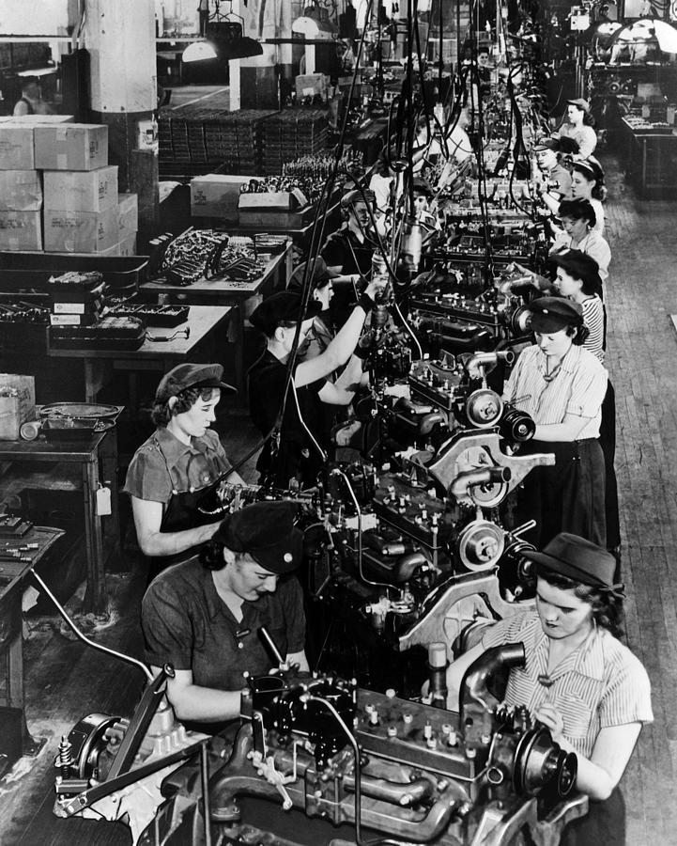
Amendments processing application: an assembly line for amendments

Slide 3
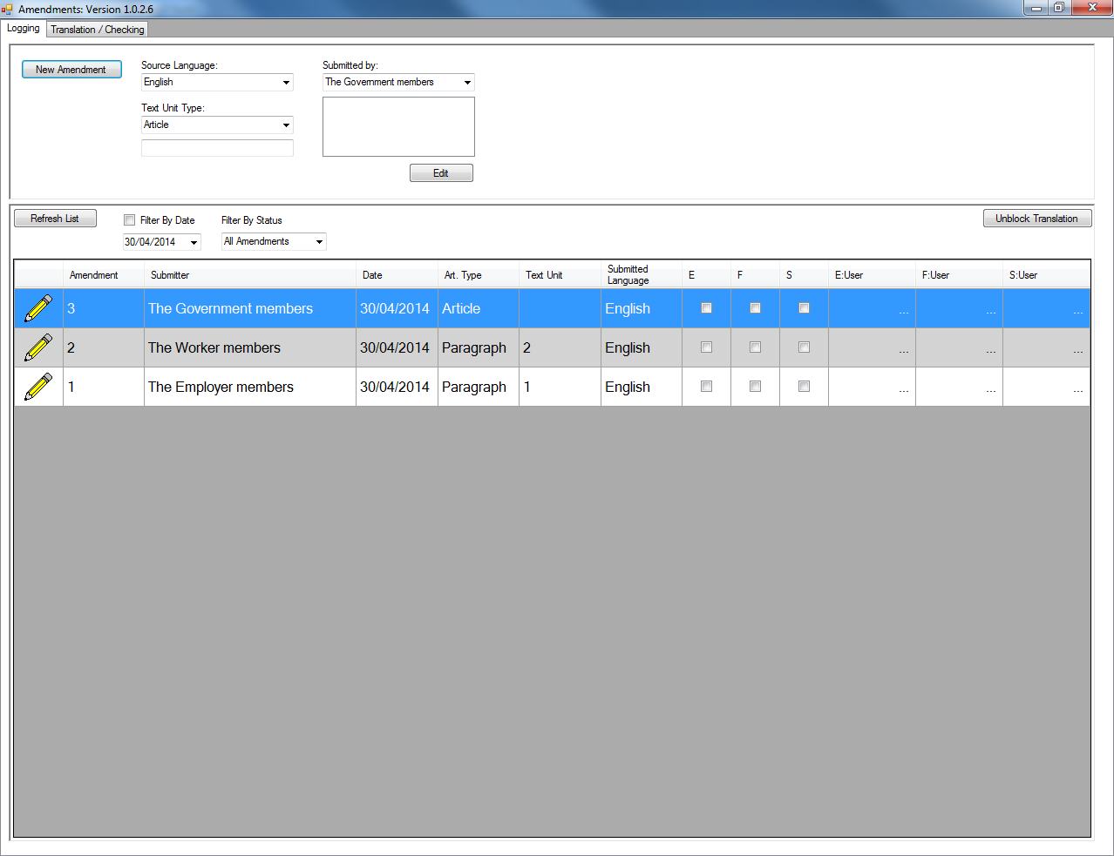
Step 1: Log Amendment

Slide 4
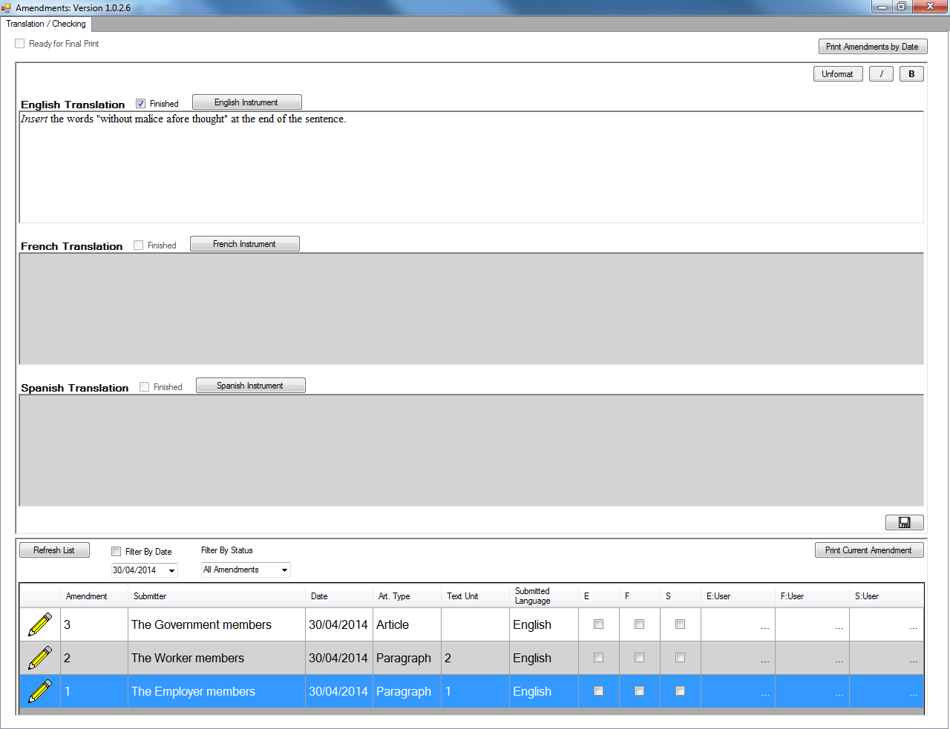
Step 2: Type in Original Amendment Wording

Slide 5
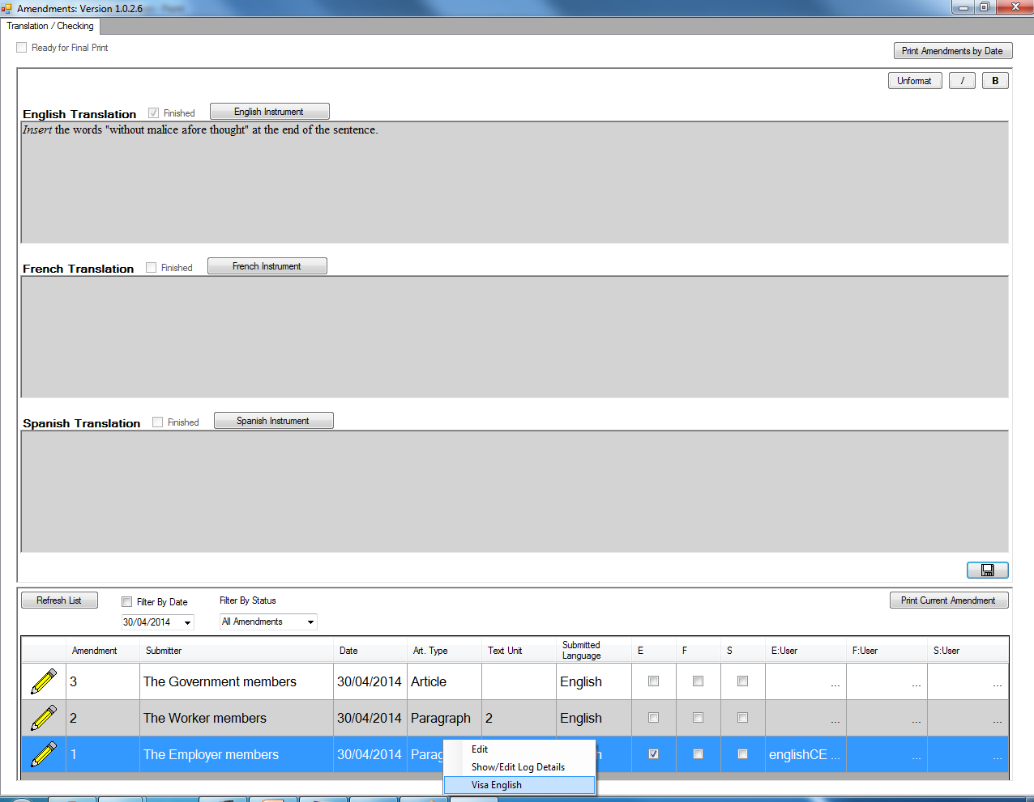
Step 3: Edit Original Wording

Slide 6
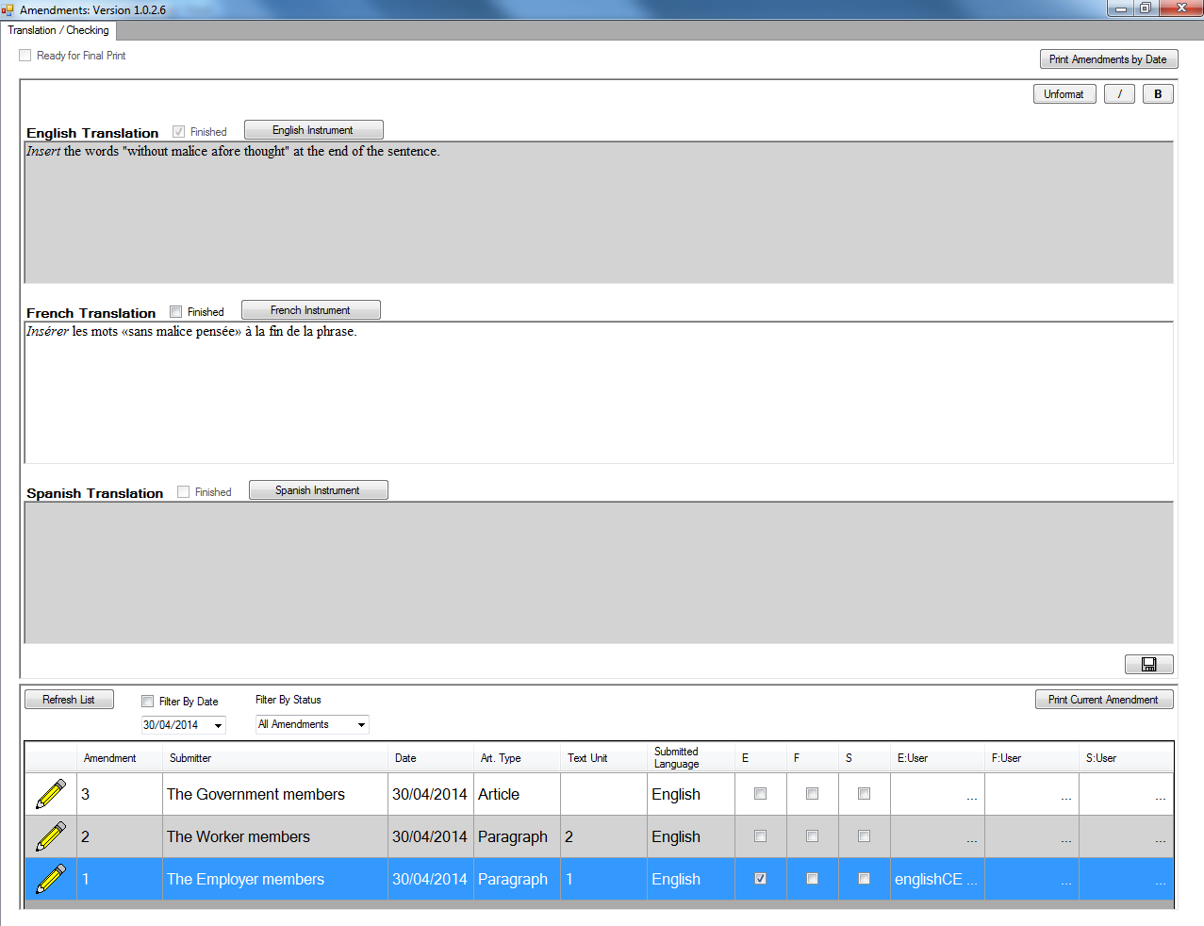
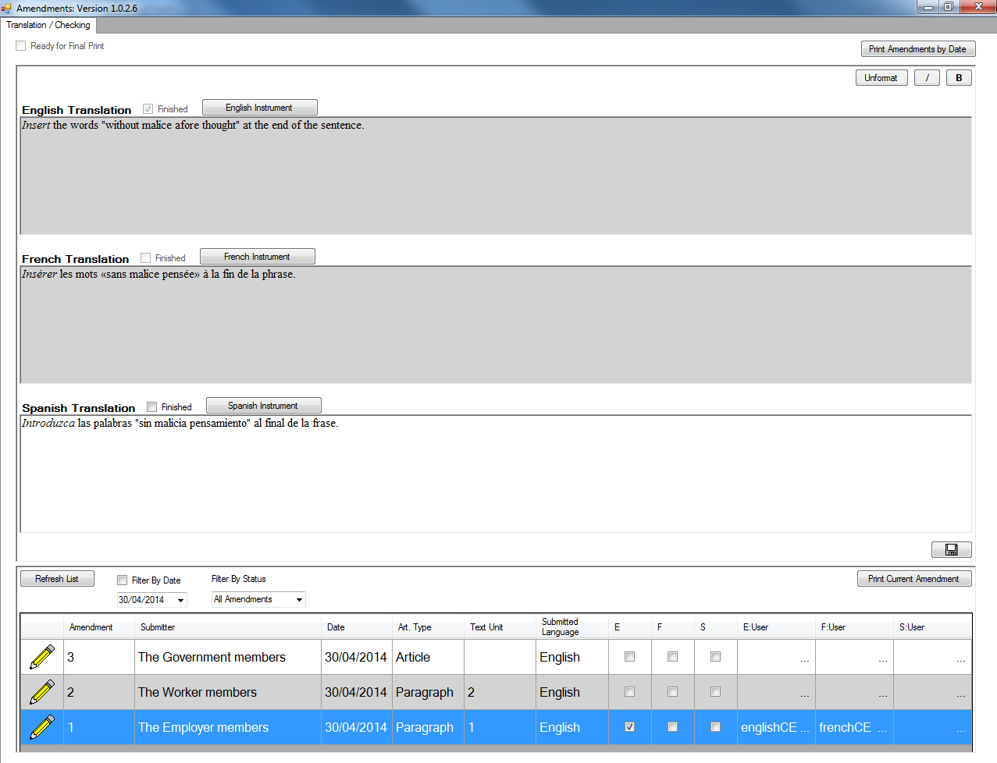
Step 4: Translation

Slide 7
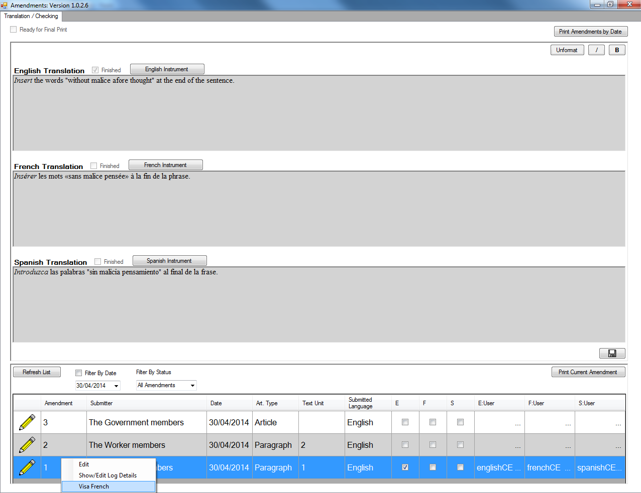
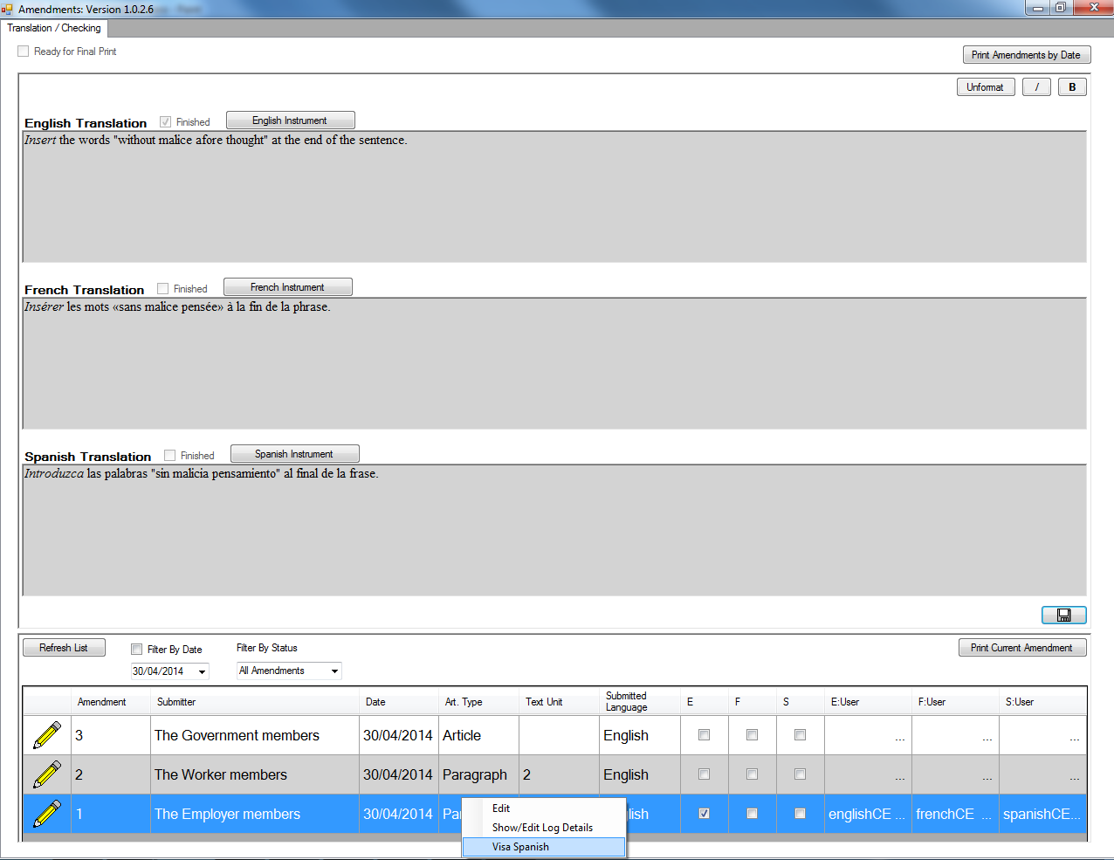
Step 5: Edit Translations

Slide 8
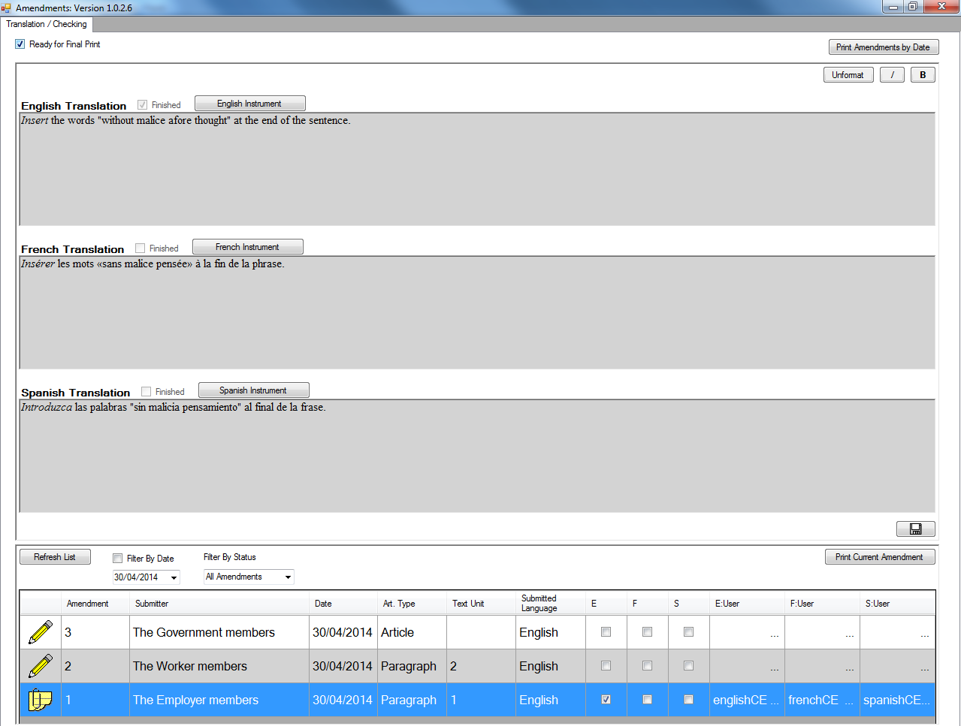
Step 6: Tri-Lingual Check

Slide 9
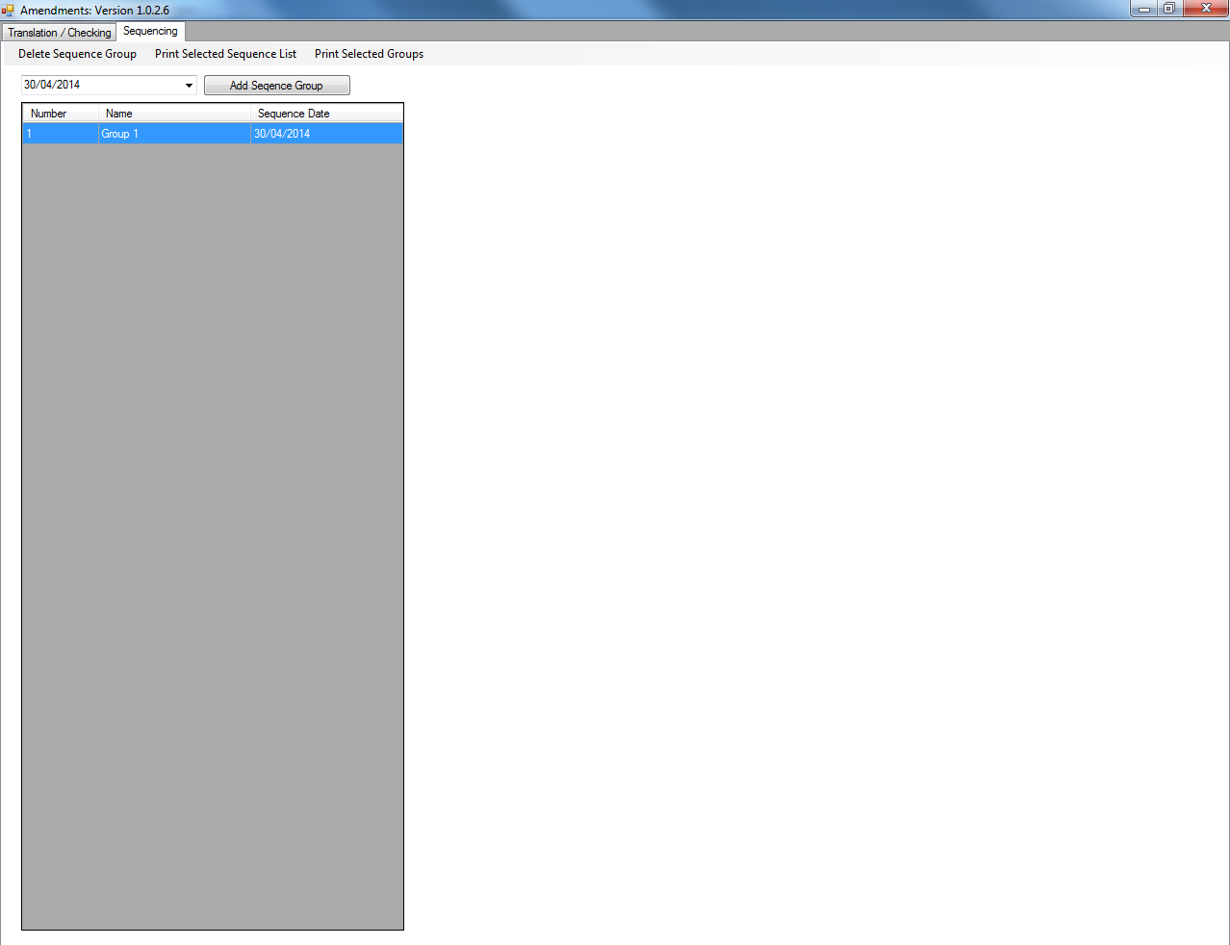
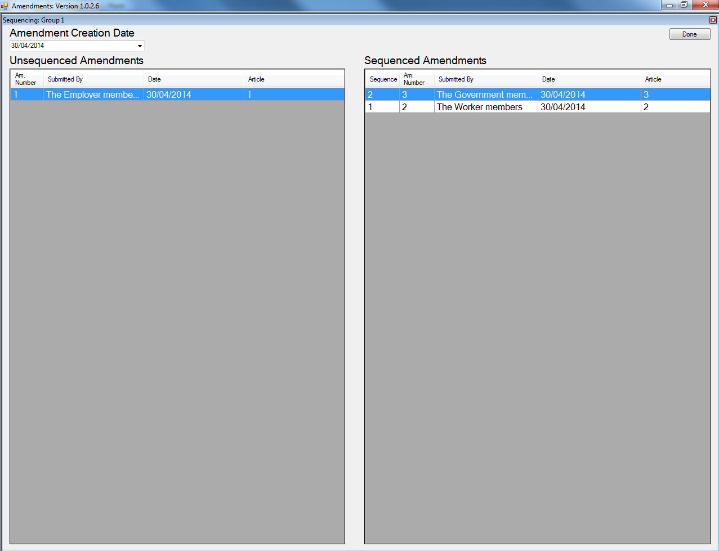
Step 7: Sequencing

Slide 10
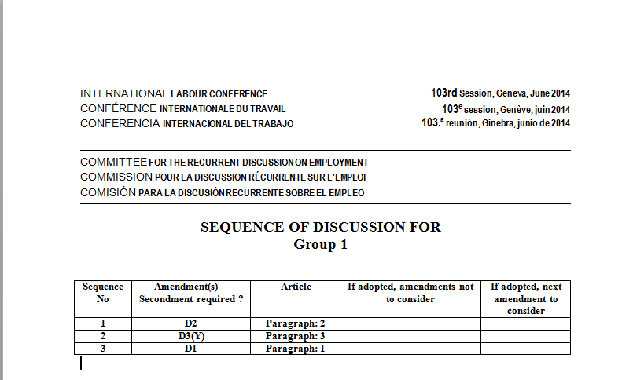
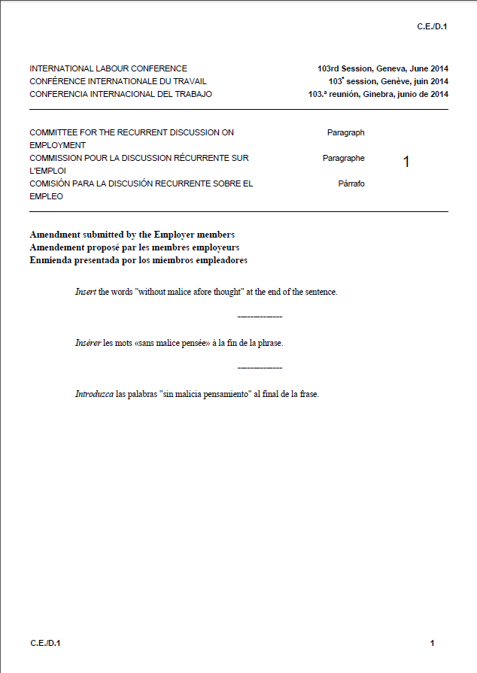
Outputs: Sequence List and Amendments

Slide 11
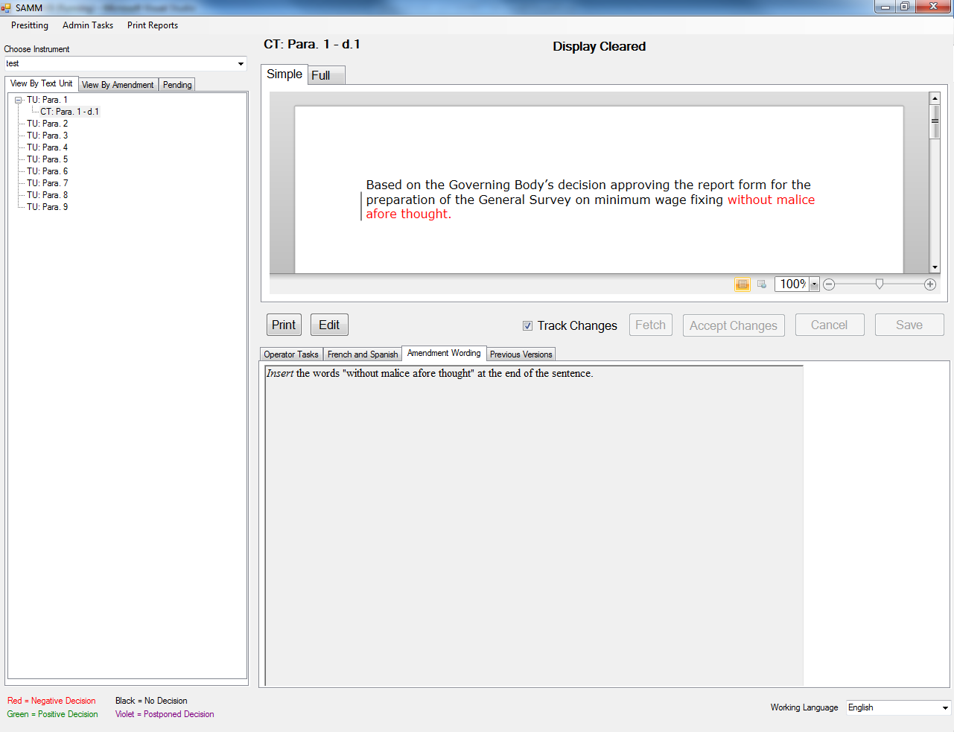
From Amendments to SAMM
Amendments linked in SAMM to create consequent text

Slide 12
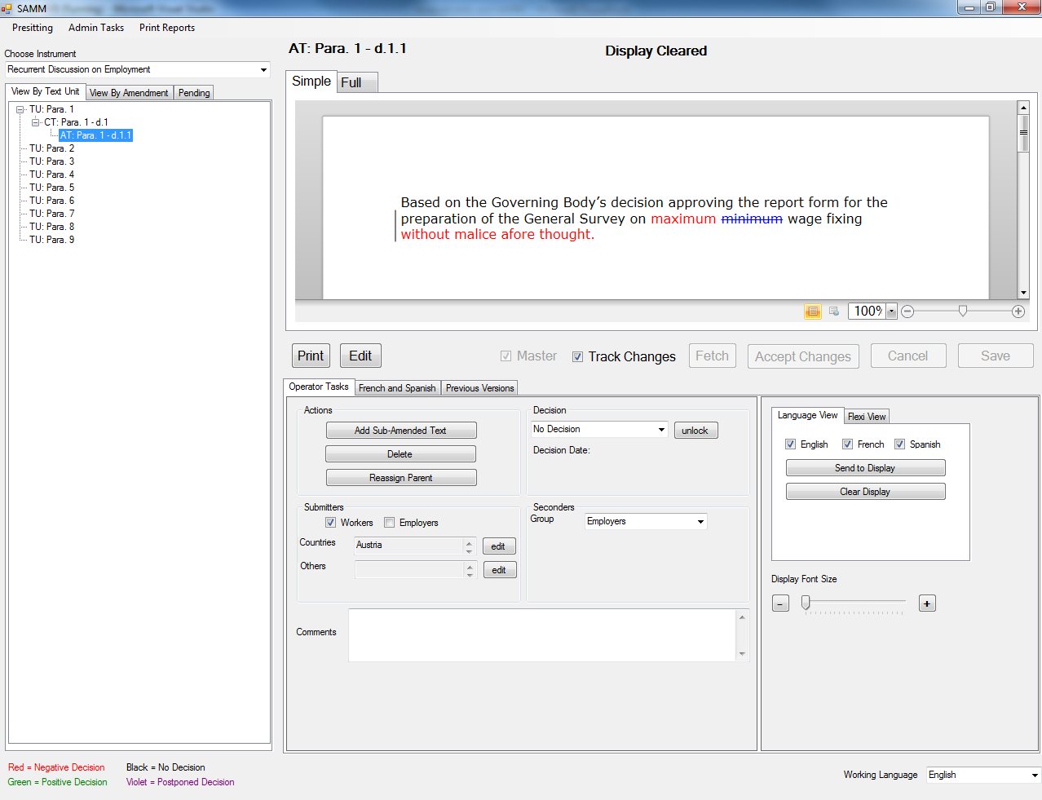
SAMM is used for Sub-Amendments in the committee discussion

Slide 13
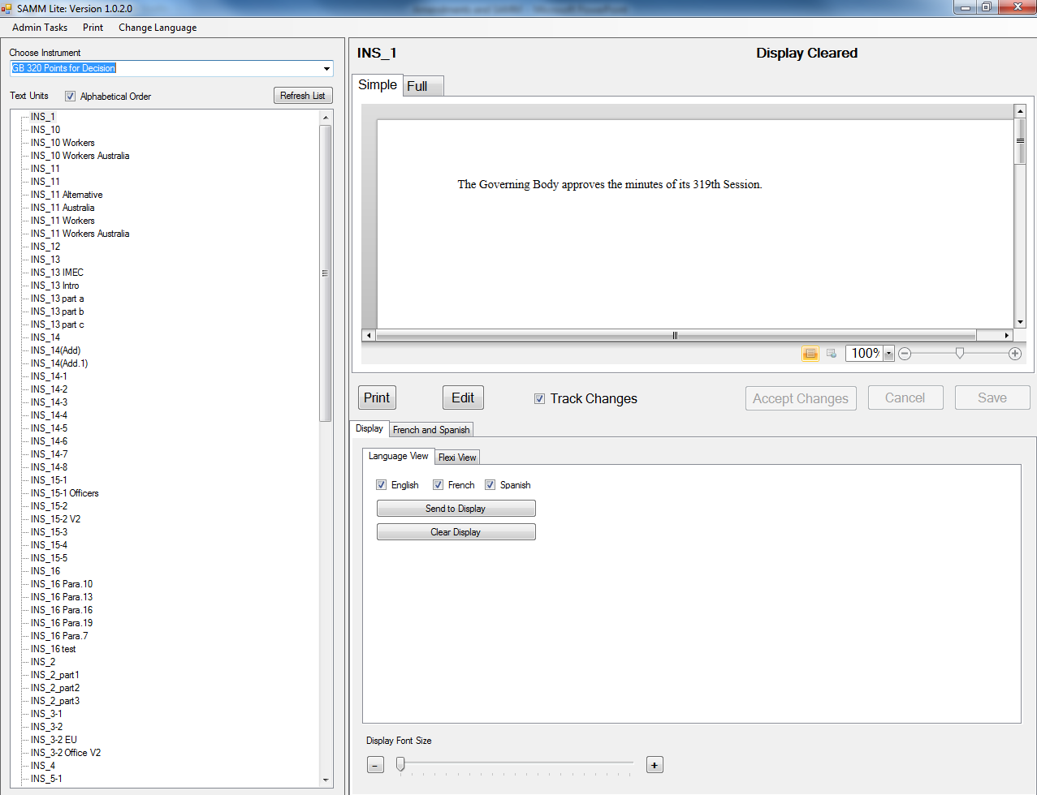
SAMM for Drafting Groups
SAMM can also be used for drafting groups who do not have ‘formal’ amendments.

