Slide 1

Common mistakes relating to
writing & editing
  Chanitda Wiwatchanon
  ILO Regional Office for Asia and the Pacific, Bangkok, Thailand

Slide 2

This presentation is based on:
    ILO house style manual, sixth edition
    ILO Director-General announcements
    Other relevant guides and manuals
    Download: pdf - 1.2 MB

Slide 3
Office names
Short name
    RO-Asia and the Pacific ILO Regional Office for Asia and the Pacific
    DWT/CO-Bangkok ILO DWT for East and South-East Asia and the Pacific and Country Office for Thailand, Cambodia and Lao People’s Democratic Republic
    DWT/CO-New Delhi ILO DWT for South Asia and Country Office for India
    CO-Bangkok ILO Country Office for Thailand, Cambodia and Lao People’s Democratic Republic
Full name

Slide 4
Office names
Short name
    CO-Beijing
    CO-Colombo
    CO-Dhaka
    CO-Hanoi
    CO-Islamabad
    CO-Jakarta
    CO-Kathmandu
    CO-Manila
    CO-Suva
Full name
    ILO Country Office for China and Mongolia
    ILO Country Office for Sri Lanka and the Maldives
    ILO Country Office for Bangladesh
    ILO Country Office for Viet Nam
    ILO Country Office for Pakistan
    ILO Country Office for Indonesia and Timor-Leste
    ILO Country Office for Nepal
    ILO Country Office for the Philippines
    ILO Country Office for Pacific Island Countries

Slide 5
Office names
Short name
    ILO-Kabul
    ILO-Tokyo
    ILO-Yangon
    NC-Phnom Penh
    NC-Vientiane
    NC-Ulaanbaatar
    NC-Port Moresby
    NC-Apia
Full name
    ILO Senior Coordinator for Afghanistan
    ILO Office for Japan
    ILO Liaison Officer for Myanmar
    ILO National Coordinator for Cambodia
    ILO National Coordinator for Lao People’s Democratic Republic
    ILO National Coordinator for Mongolia
    ILO National Coordinator for Papua New Guinea
    ILO National Coordinator for Samoa
In case of need to spell out DWT in text, use Decent Work Technical Support Team (not Decent Work Team).

Slide 6
Country names
Long-form names
    Islamic Republic of Iran or Iran (Islamic Republic of) Islamic Republic of Iran or Iran (Islamic Republic of)
    Lao People’s Democratic Republic Lao People’s Democratic Republic (not Laos or Lao PDR)
    Republic of Korea Republic of Korea
    the People’s Republic of China China
    Hong Kong Special Administrative Region, China Hong Kong, China or Hong Kong (China)
    Macau Special Administrative Region, China Macau, China or Macau (China)
    Taiwan, China or Taiwan Province of China Taiwan, China or Taiwan (China)
Short-form names
    Timor-Leste (not Timor Leste)
    Viet Nam (not Vietnam)
Use in lists already separated by commas.

Slide 7
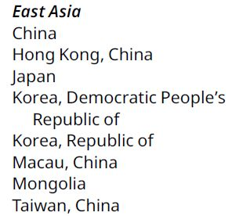
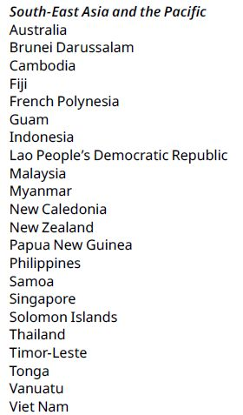
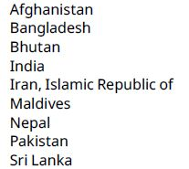
Asia-Pacific country groupings
East Asia
South-East Asia and the Pacific
South Asia

Slide 8
Capitalization
On the cover, title page, head of an article/chapter/table/graph/figure/box and in subtitle, only the first letter of the title and subtitle are capitalized as well as other words that ordinarily be capitalized.
    Cover - -> Labour migration policy in Thailand: Towards long-term competitiveness
    Chapter heading - -> Chapter 2. Capacity-building needs: Economy observations
    Figure - -> Figure 6. Youth employment rate in Philippines: Ranked by gender
    In general, upper case for the specific, lower case for the generic.

Slide 9
Capitalization – Geographical, political, administrative designations
Initial capitals for specific geographical, political, administrative and similar designations but not for general descriptions.
    New York City, Greater London, City of Dublin
    but village of Hale, town of Flint, municipality of Livingstone
General area within a country are in lower case
    In the east of the country, northern Thailand
Initial capital for a major region in a continent
    East Asia, South Asia, South-East Asia

Slide 10
Capitalization – Subdivisions of texts
Initial capitals if followed by a number or letter for major subdivisions of a book / text
    Chapter 1 Volume I Book 2 Part A Appendix VI Annex 2
    but in this chapter
Lower case for minor subdivisions, whether followed by a number or letter or not
    section 2 subsection (3) clause (a) item (i) regulation 4
    category B group I table 2 figure 6 point 6

Slide 11
Capitalization - ILO Conventions & Recommendations
Check for ILO Conventions & Recommendations titles at: http://www.ilo.org/dyn/normlex/en/f?p=NORMLEXPUB:1:0::NO:::
Short titles for the first mention
    the Home Work Convention, 1996 (No. 177)
    the Home Work Recommendation, 1996 (No. 184)
    the Home Work Convention (No. 177) and Recommendation (No. 184), 1996
Shortened form for the next mention (in the text)
    Convention No. 177
    Recommendation No. 184
    Conventions Nos 177 and 184
Abbreviated forms for tables, graphs, and footnotes
    C.177, R.184

Slide 12
Capitalization - ILO Conventions & Recommendations
Before adoption, the title is in lower case, except for the word “Convention” and “Recommendation”.
    proposed Convention concerning the elimination of violence and harassment in the world of work
The word “Article” in ILO Conventions, treaties and other instruments take an initial capital.
    Article 4 (of a treaty)
    This Article (of a Convention)
The word “article” in the ILO Constitution and in national constitutions and legislation is in lower case.
    article 19 of the Constitution
    article 15(a)(i) of the Act

Slide 13
Italics
Use for specific cases
    foreign words & expressions not listed in the Oxford English Dictionary
    titles of publications (in text)
    titles of court cases and decisions
    scientific notations, but not chemical formulas
    minimally for emphasis
    Example:
    amparo [protection of constitutional rights]
Italics within italics are set in non-italic type
    Example: Clause (a), dealing with amparo, was adopted unanimously.

Slide 14
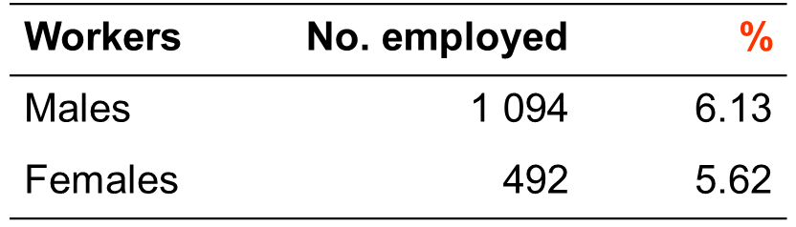
Per cent sign
% is used only in tables and figures.
In text, “per cent” is spell out.
    Example: Employment grew at an average annual rate of 6 per cent between 2008 and 2011.

Slide 15
Spacing
Add only one space after punctuation
    Example: What is decent work? It is the aspirations of all people for their working lives. The overall
    goal is …

Slide 16
Round brackets
    Enclose supplementary information, variants, digressions and explanations
    Expand abbreviations
    Enclose author-date style references
Full sentence, it begins with a capital and ends in a full stop.
    Example:
    Output grew by 7.7 per cent in 2016. (In 2015, it grew by 6.1 per cent.)
    Output grew by 7.7 per cent in 2016 (compared with 6.1 per cent in 2015).
    article 3(1)(i), rule 53(4)(a)
Not a full sentence, it begins with a lower case and the full stop is outside the closing bracket.
Subdivisions of legal instruments.

Slide 17
Square brackets
The text between square brackets in quotation is not part of the original.
    Example: The spokesperson said that “[r]epercussions are to be anticipated”.
The text between square brackets indicates a comment, clarification or translation inserted by an author, editor or translator.
    Example: He [the Employers’ delegate] said that …

Slide 18
Comma
No comma before the last “and” or “or”
Example: the Ministry of Foreign Affairs, Education and Labour
Add a final comma only for clarity if “and” or “or” appears multiple times
Example: the Ministry of Foreign Affairs, Education, and Labour and Social Affairs

Slide 19
Hyphen (-), en dash (–), and em dash (—)
Hyphen (-)
    Compound adjectival expression before a noun
    Last-minute changes, first-class results, part-time worker, basic-needs strategy, higher-value-added activities, on-the-job training, upper-middle-income countries
    Suspended hyphen is retained where part of a compound expression is omitted.
    Low- and middle-income countries, long- and short-term policies
    More rules are on ILO house style manual, pages 10–11.

Slide 20
Hyphen (-), en dash (–), and em dash (—)
En dash (–)
    Use in pairs to draw more attention than round brackets, with spaces
    There is inherent danger to a policy objective – however commendable – that one believes to be unattainable or does not actively prioritize and pursue in practice.
    Use for ranges, without space
    2019–20, June–July
    Use to join two words, without space
    work–life balance
3-Em dash (———)
    In reference, use for repeated name(s) in the same order as the previous entry.
    International Labour Organization (ILO). 2015a.
    ——— 2015b.

Slide 21
Quotations
Quotation marks – should be curly, not straight.
Double quotation marks
    To quote words, sentences and paragraphs
Single quotation marks
    To enclose quotations within quotations

Slide 22
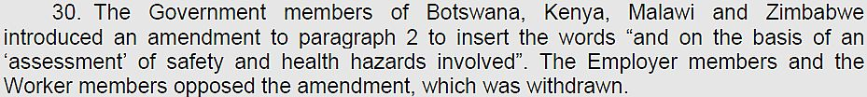
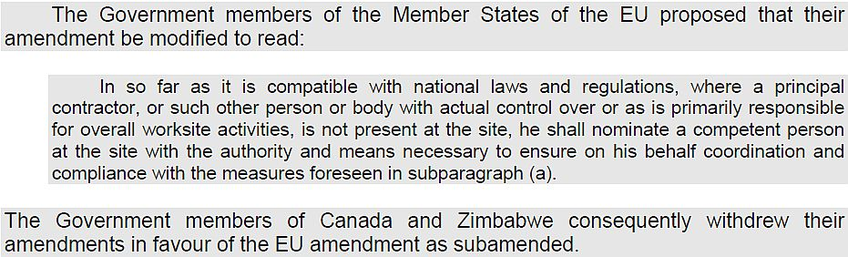
Quotations
Incorporated in the text with double quotation marks.
Short quotations (fewer than five lines)
Long quotations (five lines or more)
Smaller font
- Start on a new new line
- Indent from left

Slide 23
Quotations
Quotation marks are placed after a full stop if it is a complete sentence in itself.
Quotation marks are placed before the full stop if it is not a full sentence.

Slide 24
Quotations
To define a short form of term
To indicate an informal term that may be unfamiliar to the reader.

Slide 25
Abbreviations / acronyms
Spell out the abbreviations/acronyms, followed by the abbreviations/acronyms in brackets when first appear in the text, and use abbreviations/acronyms thereafter.
    Asian Decent Work Decade (ADWD)
    ADWD
    vocational education and training (VET)
    VET

Slide 26
Abbreviations / acronyms
No full stop
    Ms, Mr (avoid using Mrs)
    Dr (used only for a qualified medical doctor)
    PhD (place after the name for non qualified medical doctor)
    Jr, St
    Ltd, Dept, eds (but ed.), paras (but para.)
    arts, Nos, Vols (but art., No., Vol., pp., a.m., p.m.)

Slide 27
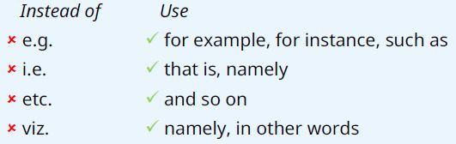
Abbreviations / acronyms
Latin abbreviations should not be used in running text, use English equivalent instead.
In tables and figures, months are abbreviated to the first three letters, followed by a full stop, except May, June, July.
    Example: Jan. Feb. Mar. Apr. May June July Aug. Sep. Oct. Nov. Dec.

Slide 28
Currencies
Written out the currencies when first used. Thereafter, a shorter form is used.
    Example: A budget of 550,000 Indian rupees in which 5,000 rupees are for …
Use ISO code where space is limited (in tables and graphs) but not be used systematically as not all readers will be familiar with the codes. The exception is the Swiss franc which “CHF” should always be used in combination with amounts.
    Example: CHF500
Neither full currency name nor ISO code is used for US$, €, £ and CHF
    Example: US$500, €500, £500 and CHF500
Always spell out currencies when not coupled with a figure.
    Example: Contributions received in Swiss francs and US dollars.

Slide 29
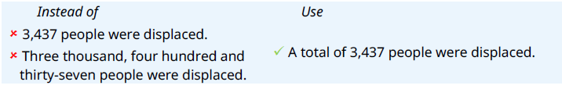
Numbers
Spell out one to ten inclusive and use figures thereafter.
Example: There are three cases of malaria, 11 of enteritis and eight of dysentery.
Apply the highest number rule if there are two or more numbers with different rules.
Example: Representatives from 12 African, 8 Asian and 5 Latin America countries attended the meeting.
Numbers are in words at the beginning of a sentence or redrafted.
Example: Fifteen staff members attended the seminar.

Slide 30
Numbers
Numbers expressed in numerals
    percentage 5 per cent, an increase of 5 percentage points
    compound fractions and decimals 3½ hours, 2.5 full-time equivalents
    with the word “million”, “billion” or “trillion” a population of 3 million
    sums of money 5 rupees, €5
    measurements, weight and temperatures 3 cm, 2 kg, 9ºC
    ages 6 years old
    reference of parts of text page 7, example 2, paragraph 9, section (ii), figure 3, table 8
    results of votes It is rejected by 7 votes

Slide 31
Numbers
Four or more figures should take a comma, except in tables (leave a space instead)
Example: In text - 10,500
In table - 10 500
No space or comma for references, serial numbers of laws/decrees and periodicals
Example: See page 1231
Decree No. 1277
No apostrophe for decades
Example: In the early 1980s, in the late 1920s

Slide 32
Numbers
Number ranges
Example: 1–10 May (but from 1 to 10 May)
2010–20 (but from 2010 to 2020)
1999–2020
Dates & times
Example: Date: 2 April 2020 (not 2nd April or April 2)
Time: 9 a.m., 1.30 p.m. (not 9.00 a.m.)
At 12 a.m. and 12 p.m. midday, noon or midnight
In timetable, daily bulletin, schedules 09.00, 16.45, 12.00 (not 09:00)

Slide 33
Numbers
Spell out ordinal numbers up to and including “tenth”
Example: Eighth Session
Use numerals from 11th onwards (not superscript)
Example: 103rd Session (not 103rd)
21st Asian Regional Meeting (not 21st)
Spell out ordinal numbers of centuries
Example: nineteenth century
twenty-first century

Slide 34
Tables
Commas are replaced by spaces.
    Example: 1 405 724 not 1,405,724
Figures are rights aligned or aligned on decimal point.
    Example: 1 235
    -
    104.5
    0.75
    36

Slide 35
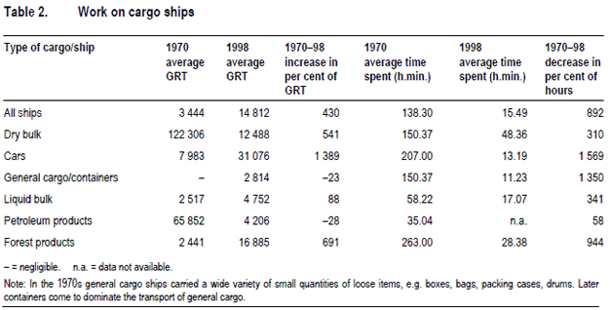
Tables
Table title - left aligned
Header - left aligned
Figures - right aligned by decimal point
Spaces are used instead of commas
n.a. and Note are inside the table
No horizontal or vertical lines in the table except at the header and at the bottom of the table

Slide 36
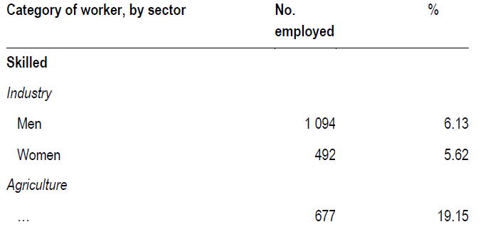
Tables
The left-hand column should be clearly subdivided by indenting, italics and bold where necessary.

Slide 37
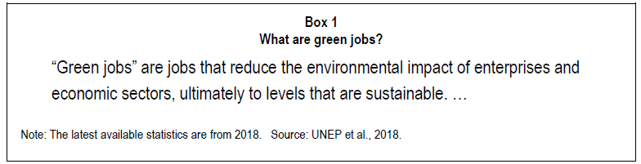
Text boxes
Numbering of boxes as 1, 2, 3. No full stop at the end.
Text box heading is inside box,
centre aligned, on two separate lines.
More than one note and source, they should be numbered and presented horizontally, separated by three spaces, rather than beginning on a new line for each.
Note and Source are placed at the bottom, inside box, smaller font size than text, with a full reference provided in the bibliography.

Slide 38
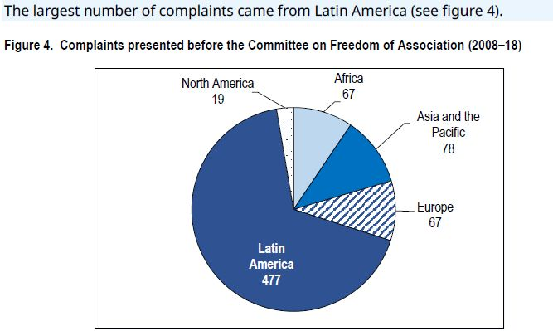
Figures
Note and Source are placed outside of the border, directly below the figure.
    Note: ... Source: …

Slide 39
Lists in running text
Omit numbering or lettering for a list with a few short items
With numbering or lettering, separate by commas or semicolons
The list with a colon + semicolons

Slide 40
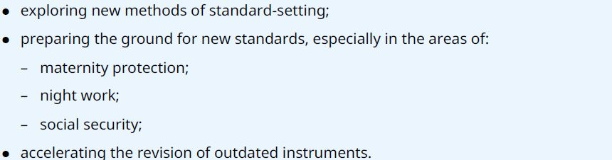
Numbered / bullet lists
Full stop for the first level, lower-case letters in round brackets for second level, and lower-case Roman numerals in round brackets for the third level
Bullet for the first level, and a dash for the second level

Slide 41
Numbered / bullet lists
Incomplete sentence items begin with lower-case letters and end with a semicolon, except for the last item which ends with a full stop.
    A successful Asia-Pacific youth employment requires:
    effective action starting at the national level;
    active involvement on the part of young women and men.
Complete sentence items begin with capital letters and end with full stops.
    The speaker made two points:
    Aboriginal peoples across the world have been persecuted in the name of civilization.
    Even enlightened governments have broken treaties made in good faith with aboriginals.

Slide 42
Numbered / bullet lists
Sentence fragments do not require a semicolon or a full stop.
    A successful Asia-Pacific youth employment requires:
    equality of treatment
    contracts of employment
Omit punctuation at the end of items in an agenda.
    1. Preview of the Programme and Budget
    (a) Strategy for the improvement
    (b) Preview of Programme and Budget
    2. Evaluations
    (a) Annual evaluation report
    (b) Country programme evaluation

Slide 43
Numbered / bullet lists
Each item in numbered / bullet list should:
    be a grammatically consistent;
    begin with the same grammatical form (for example, all verbs or all nouns).

Slide 44
ILO usage list
    adviser (not advisor)
    analyse (not analyze)
    Asia-Pacific region, Asia and the Pacific
    Association of Southeast Asian Nations (ASEAN) (not South-East)
    box (lower case in running text, “see box 1”)
    chapter (lower case when not followed by a number, initial capital when followed by a number, “in Chapter 3”)
    country office (initial capitals for a specific country office, otherwise lower case)
    decent work, Decent Work Agenda, Decent Work Country Programme(s)
    decision-maker, decision-making
    Director-General of the International Labour Organization
    e-commerce, e-business, but email
    Member State(s) of the International Labour Organization

Slide 45
ILO usage list
    micro, small and medium-sized enterprises
    small and medium-sized enterprises
    non-governmental organization
    part-time, a part-time job
    policy making, policymaker
    programme and budget, Programme and Budget proposals for 2020–21
    short-term
    socio-economic
    More words are in the ILO house style manual, sixth edition, pages 66–80,
    otherwise check at Oxford English Dictionary.

Slide 46
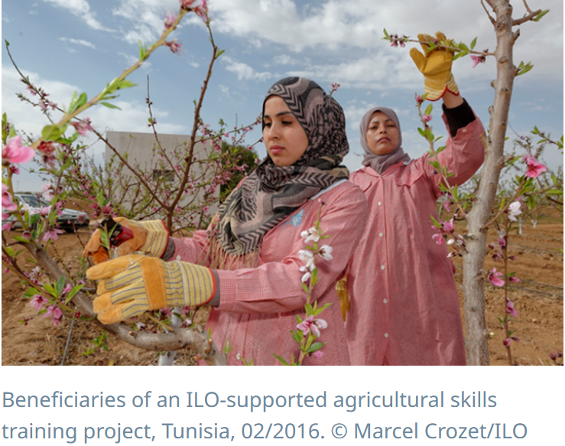
Photo credit
    Each photo is permission granted by the owner if not ILO photo copyright.
    Under each photo add photo caption and credit (Noto Sans, Regular, 7.5 pt.)
Comma
Comma
Dot
© sign
/
No dot
Photo caption.
Photo country
Photographer full name/ owner organization
Photo taken month/year

Slide 47
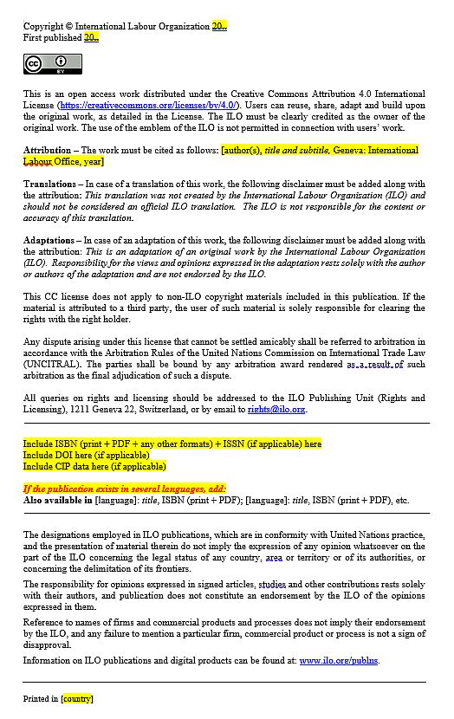
Creative Commons copyright page
Add photo credit above ‘Printed in …’ if it does not specify under each photo as in the following format:
Cover photo: © Marcel Crozet/ILO
All cover photos: © Marcel Crozet/ILO
Cover photo: (Top) © Marcel Crozet/ILO
(Bottom) © Shutterstock
All photos: © Marcel Crozet/ILO
Illustration: © Marcel Crozet/ILO
Page 10: © Shutterstock
Chapter 1: © Shutterstock
Chapters 5 and 6: © Kritanut Unsombut/iStock

Slide 48
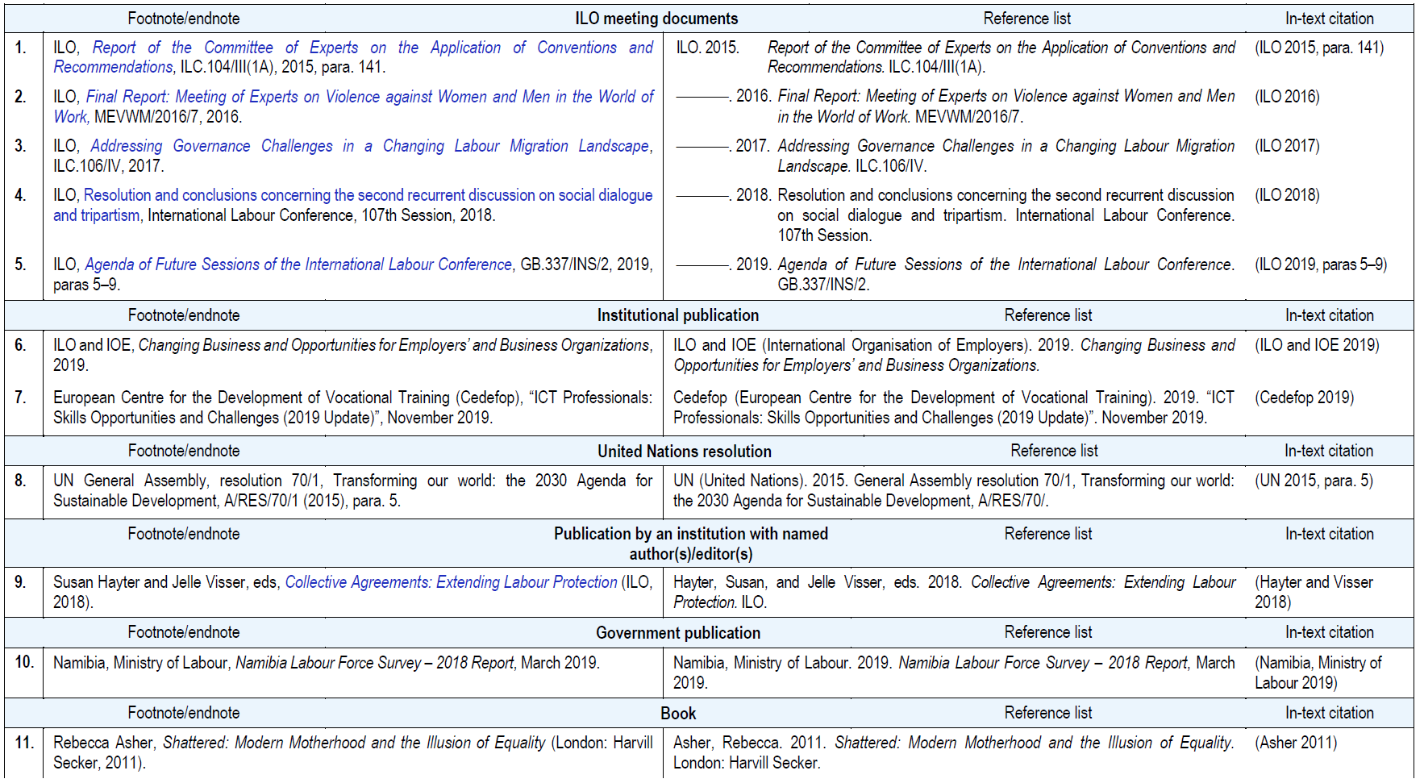
Footnotes & References

Slide 49
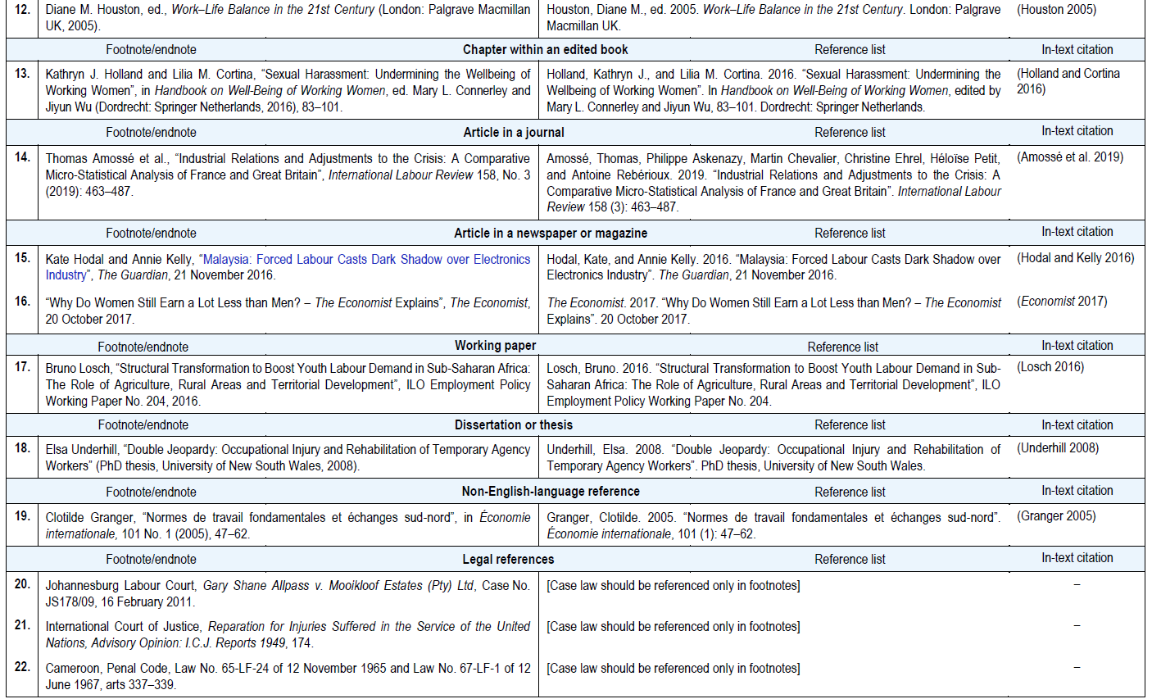
Footnotes & References

Slide 50
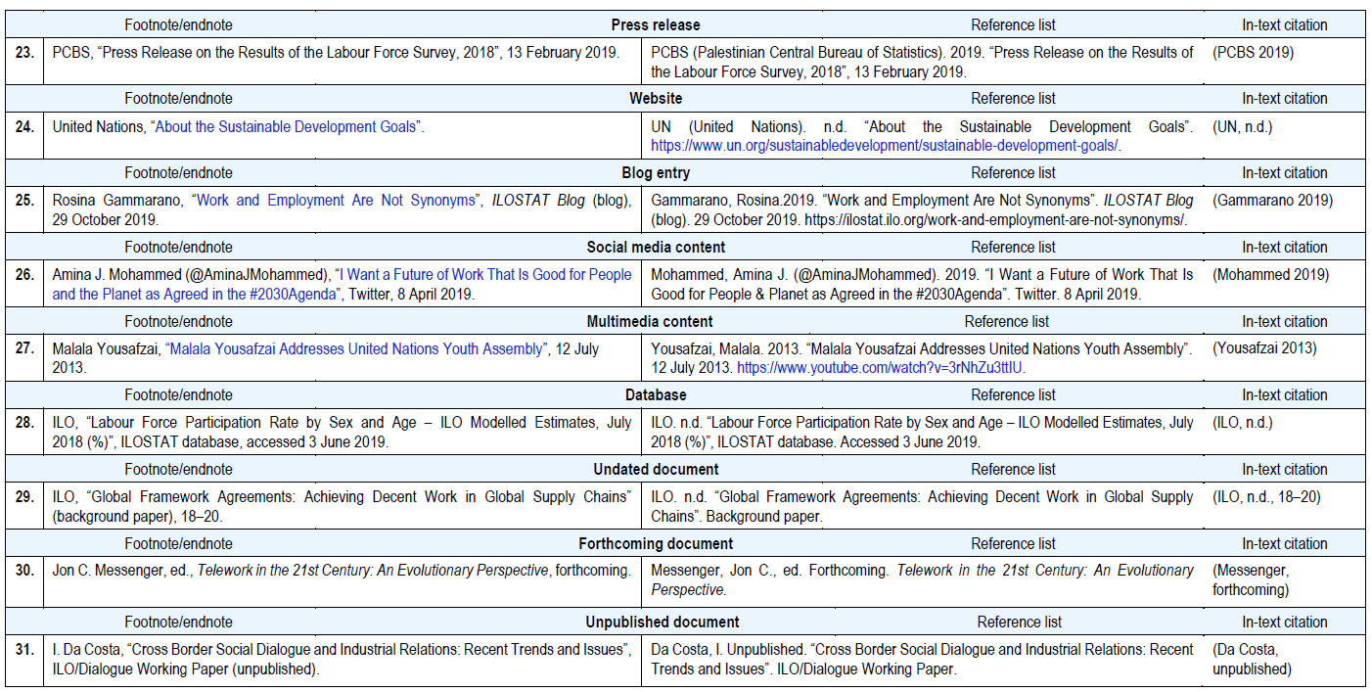
Footnotes & References

Slide 51
Useful links
    ILO publications portal
    ILO house style manual, sixth edition.
    ISBN and DOI online request form
    ILO standard Creative Commons copyright page
    ILO Conventions and Recommendations titles
    ILO Member States
    ILOTERM (ILO terminology)
    ILO publishing
    Online version of the Oxford English Dictionary (for ILO staff)
    Public version of the Oxford English Dictionary
    ISO 4217 currency codes

Slide 52
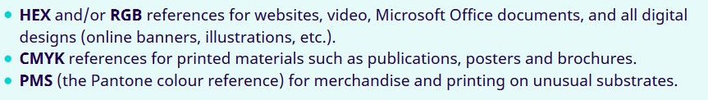
Useful links
Layout and design
    ILO brand hub
    ILO logo
    Typography hierarchy
    Colour palette
    Colour combinations
    Photo caption and crediting
    Sample of ILO standard reports
    Downloads templates, logos, …
    ISBN barcode generator
    Important note

Slide 53
Useful links
ILO Working Papers
    Use a specific design and layout which can only be formatted using PublishOne programme.
    Please contact: p1support@ilo.org for a training.
    Coordinator video tutorial
    More video tutorials on YouTube channel

Slide 54
Useful links
ILO website
    WCMS instructional materials for Asia and the Pacific
    E-learning: Quick WCMS guide
    Useful script

Slide 55
Thank you
For further information please contact:
    Chanitda Wiwatchanon
    ILO Regional Office for Asia and the Pacific
    T: +662 288 1769
    E: chanitda@ilo.org
    W: ilo.org/asia

