Slide 1
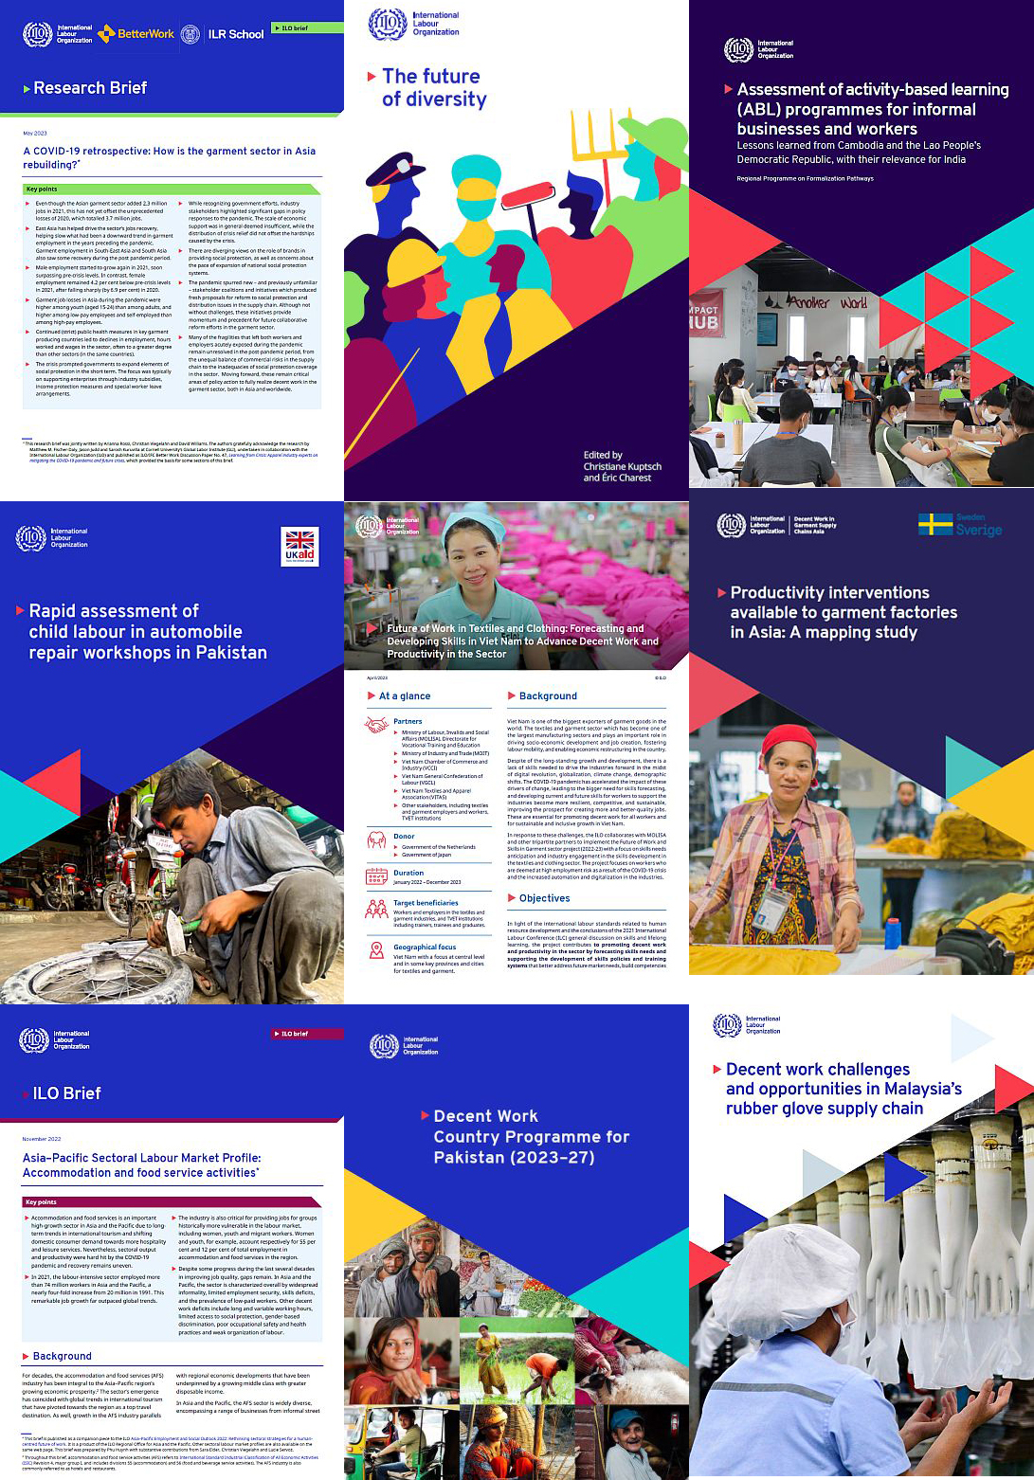
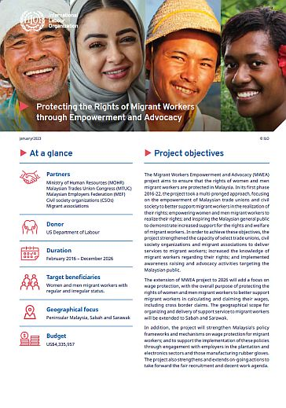

Publishing process
& ILO branding
Chanitda Wiwatchanon
Regional Communications Unit
ILO Regional Office for Asia and the Pacific
Thursday / 20 / July / 2023

Slide 2
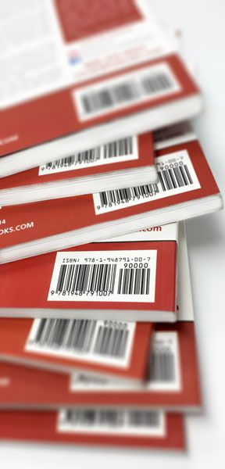
What is the publishing process?
    It covers the production of any materials with ILO ISBN.
    It helps the author to successfully publish materials in
    high quality following the ILO branding and house style.
The complete guide is here.

Slide 3
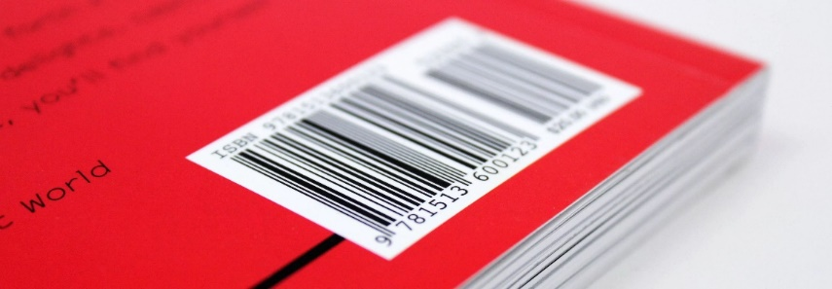
What types of materials require an ISBN & publishing process?
With ISBN
Flagship reports | Guides/Guidelines
Major publications | Manuals/Handbooks
Standard publications/ reports | Working Papers
Codes of practice | ILC documents
Good practice
Without ISBN
Concept paper | Briefs
Discussion paper | Fact sheets
Background papers/ general meeting documents | Flyers/brochures/ booklets (lesser than 16 pages)
Animation | Executive summary
Infostories

Slide 4

Publishing process steps
Distribution
Peer review
Web upload
Edit
Steps for
publishing process
Print
Request for ISBN
Director’s approval
Proofreading
Layout design
Submit publishing process form
and final draft to publication focal point

Slide 5
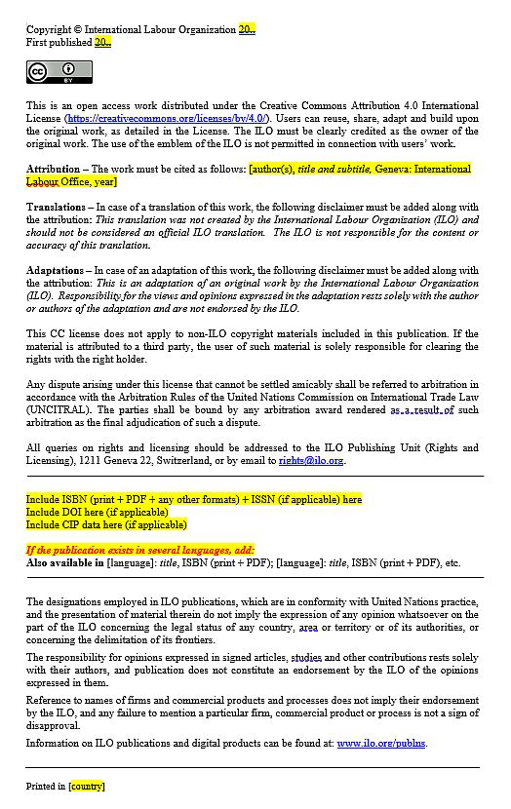

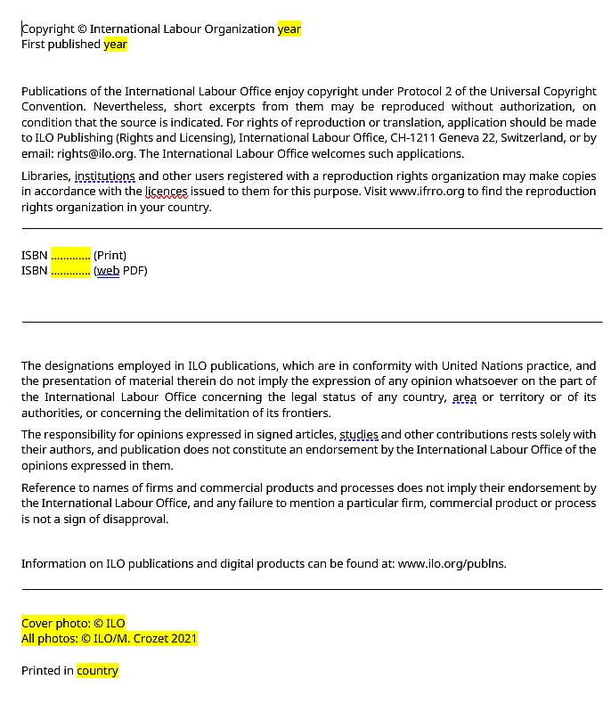

    New ILO standard Creative Commons
    copyright page
New change on copyright page
    Formal copyright page
Downloadable here

Slide 6

Useful links for publishing process
    ILO publications portal
    ILO Asia-Pacific publishing process guide
    ILO Asia-Pacific publishing process form
    ILO house style manual, sixth edition
    Common mistakes related to writing and editing
    Resources for authors and editors
    Handover checklist for editors
    ISBN and DOI online request form
    ILO standard Creative Commons copyright page
    TOR for editor

Slide 7


ILO Branding
Regional Communications Unit
ILO Regional Office for Asia and the Pacific
Thursday / 20 / July / 2023

Slide 8
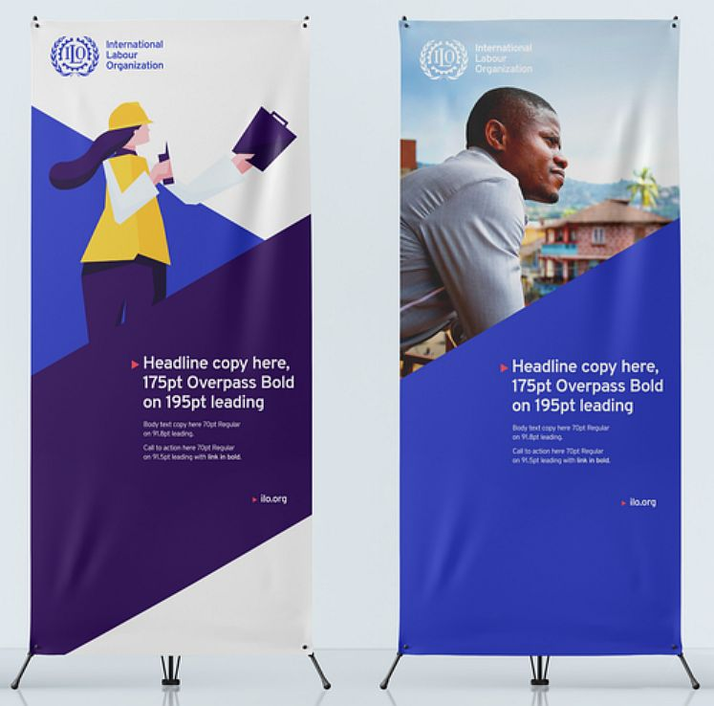

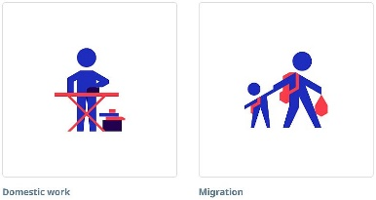

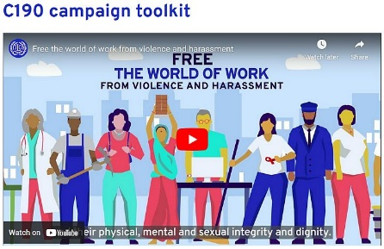
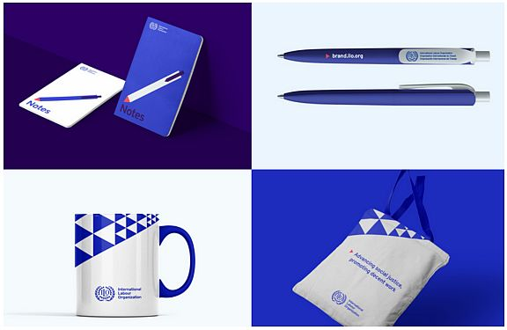

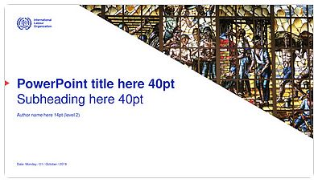
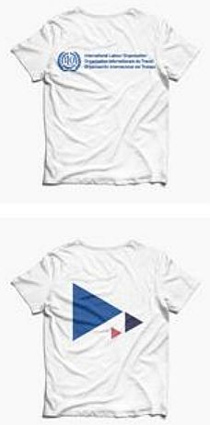

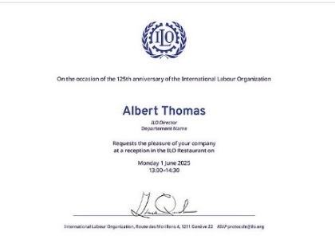

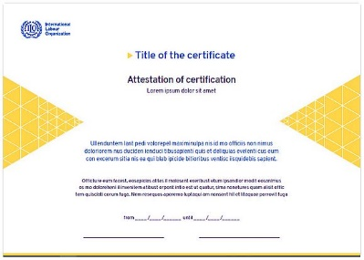
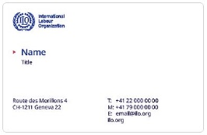

Slide 9






ILO logo
    Standard version
    Use in all public communication, including
    publications and websites.
    Secondary version
    Use only when there is limited horizontal space or
    in co-branding with various partners in which
    the vertical logo version is more suitable.
    Local language version in Asia-Pacific region
    Logos in other languages should always be requested
    from brand@ilo.org. No new language versions should
    be created without authorization.
    Media platform
    Such as Twitter, Facebook.

Slide 10
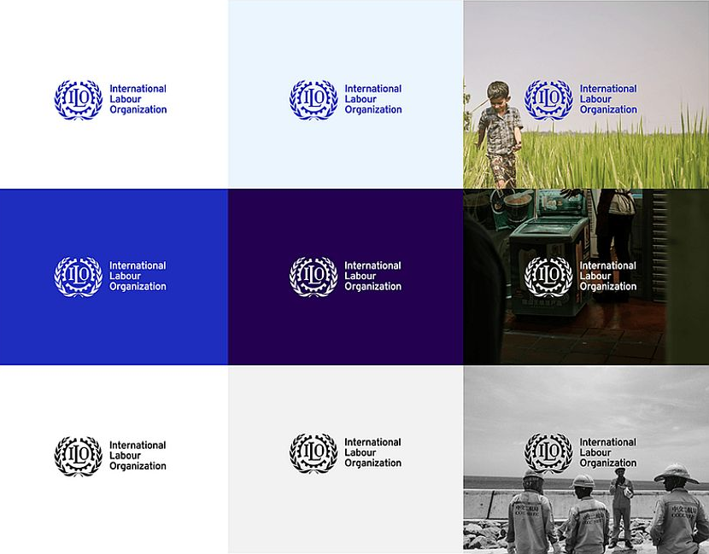
ILO logo
    The logo is only in blue, white, or black.
    When the logo is blue, the background can be white, light blue, or a light image.
    When the logo is white, the background can be blue, dark blue, or a dark image.
    The black logo is reserved for use on applications where only mono colour reproduction is possible.

Slide 11


Triangle grid
    ILO brand look and feel
    The triangle grid is a core element of our visual identity, representing tripartism and the progressive nature of our organization.

Slide 12
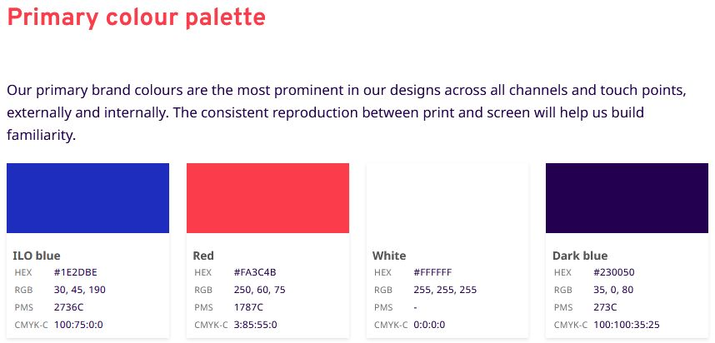
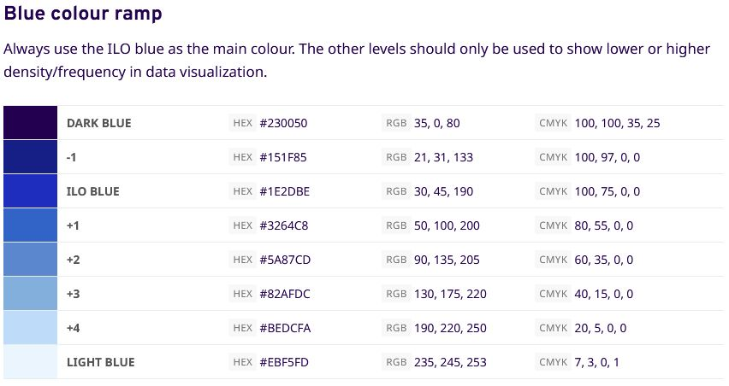
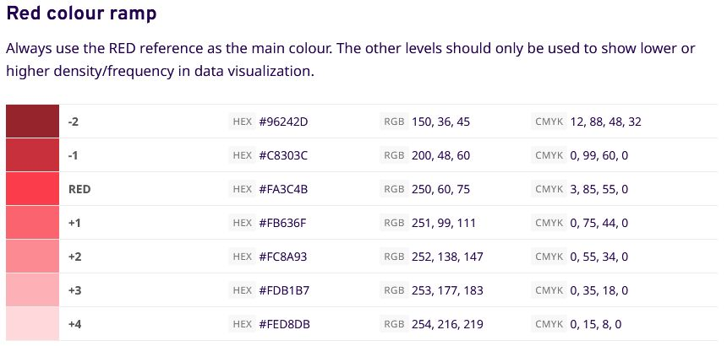
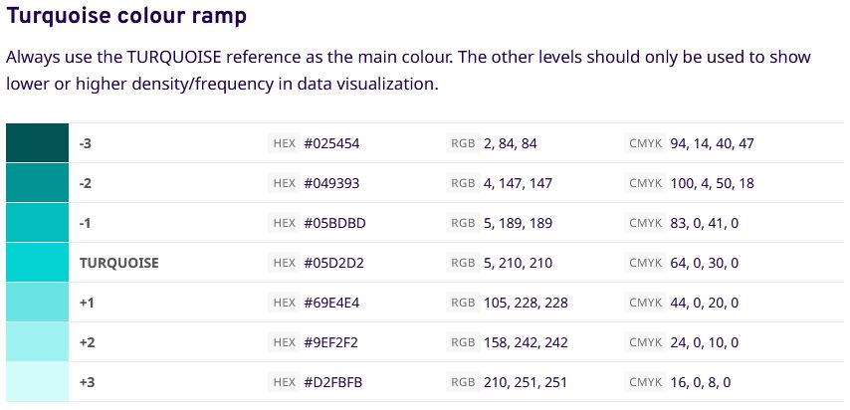
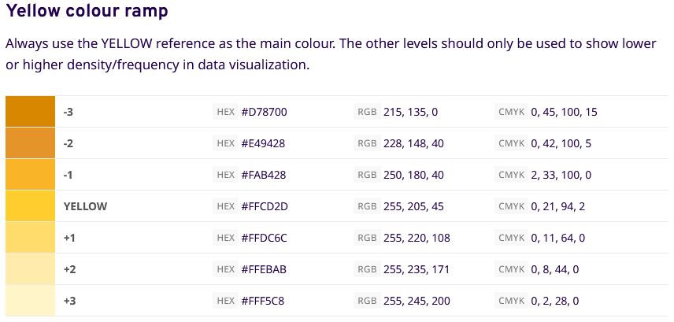
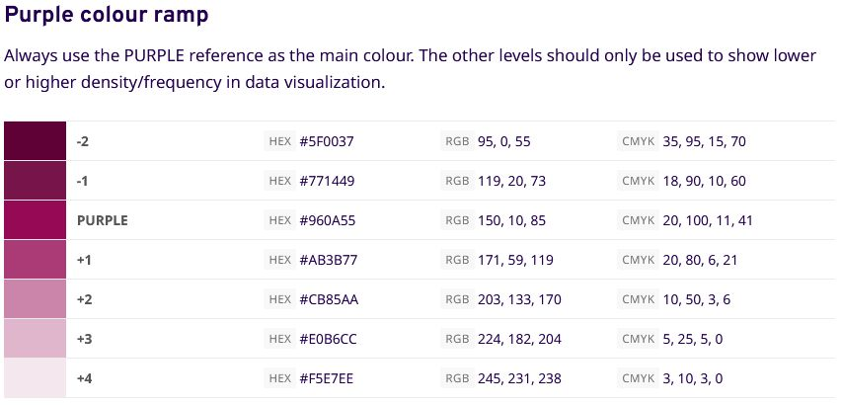
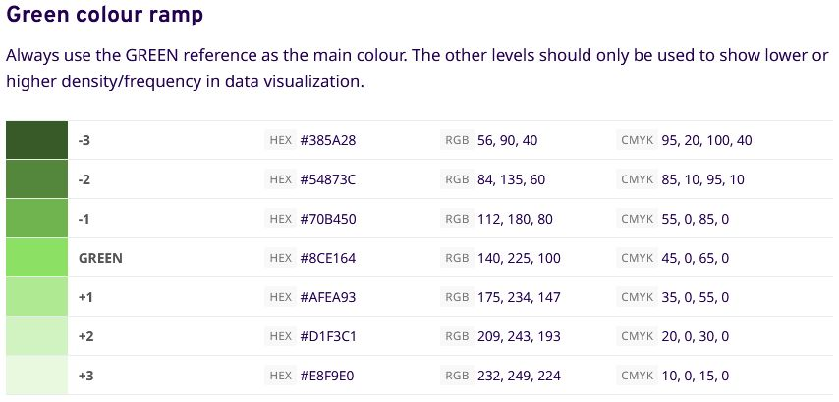
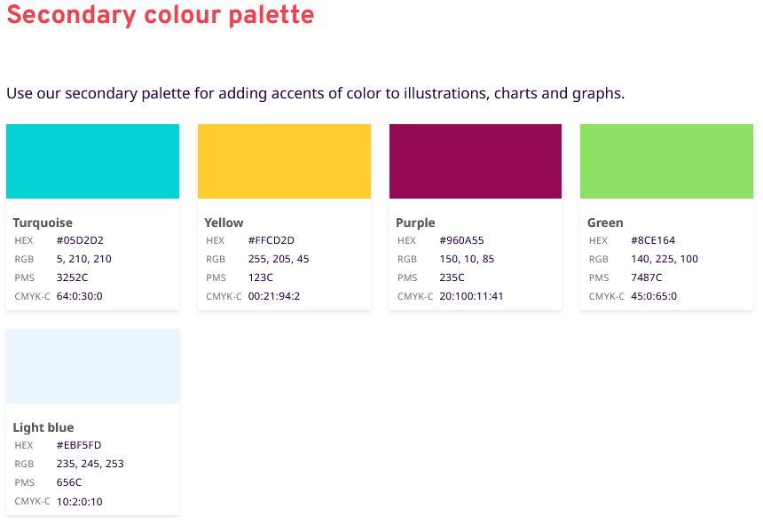
Colour

Slide 13
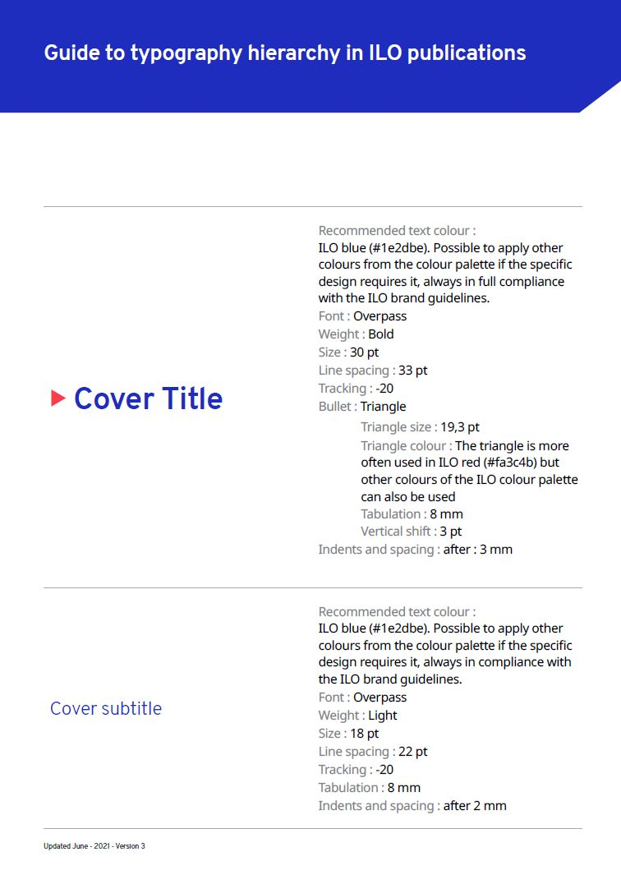
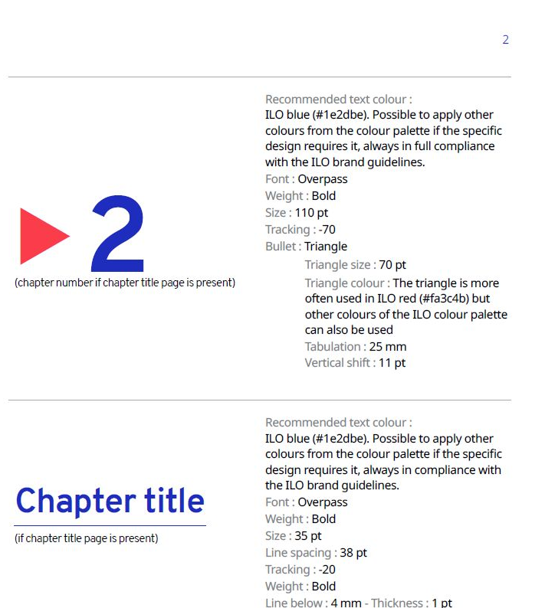
Typography
Fonts
    Headings font: Overpass
    Body font: Noto Sans
    With specific sizes
    The complete typography hierarchy is here.

Slide 14
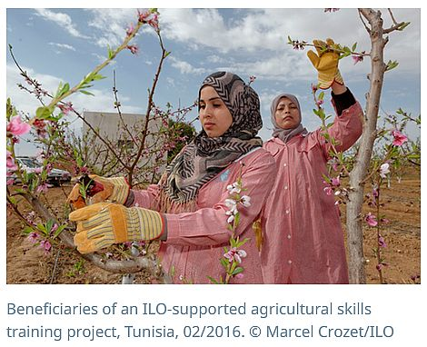
Photography & Photo credit
    Human-centred
    Give clarity to the ILO message and show the ILO engaging in concrete activities
    Capturing the moments of real people, grounded in everyday situations
    Reflecting the diversity of the world of work
    Showing the positive impact of ILO’s work in people’s lives
    Copyright & permission
    All details on taking good photos, selecting and using proper photos are here.
Photo credit format:
Meaningful caption, Town, Country, mm/yyyy. © First and last full name/organization

Slide 15
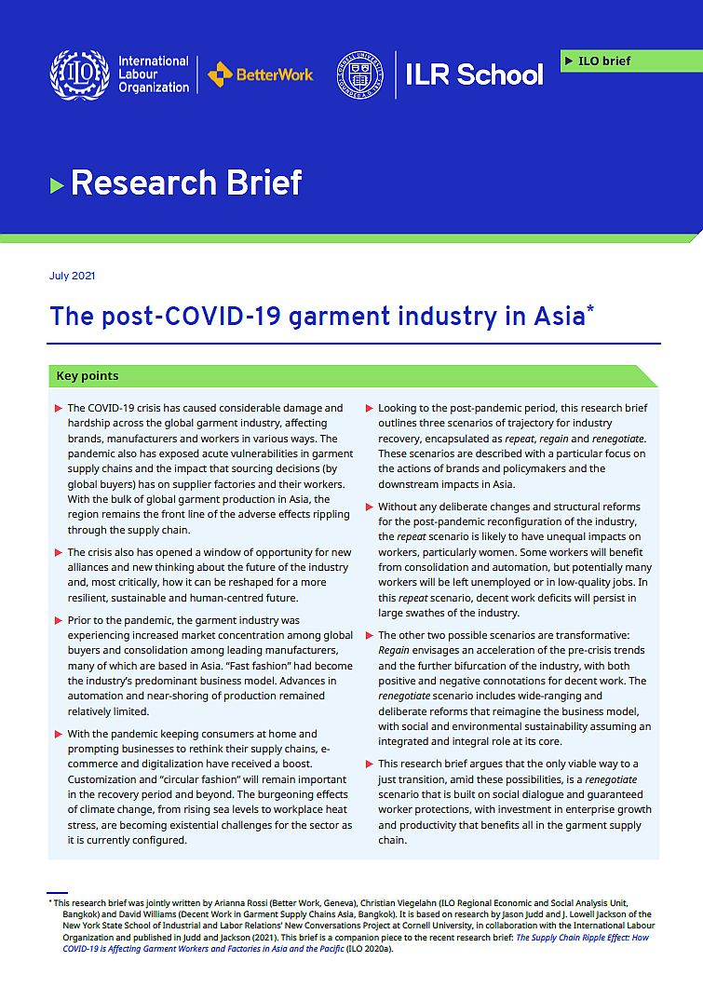



Sub-branding logo
    An ILO sub-brand is always shown
    to the right of the ILO logo separated
    by the vertical hairline.

Slide 16
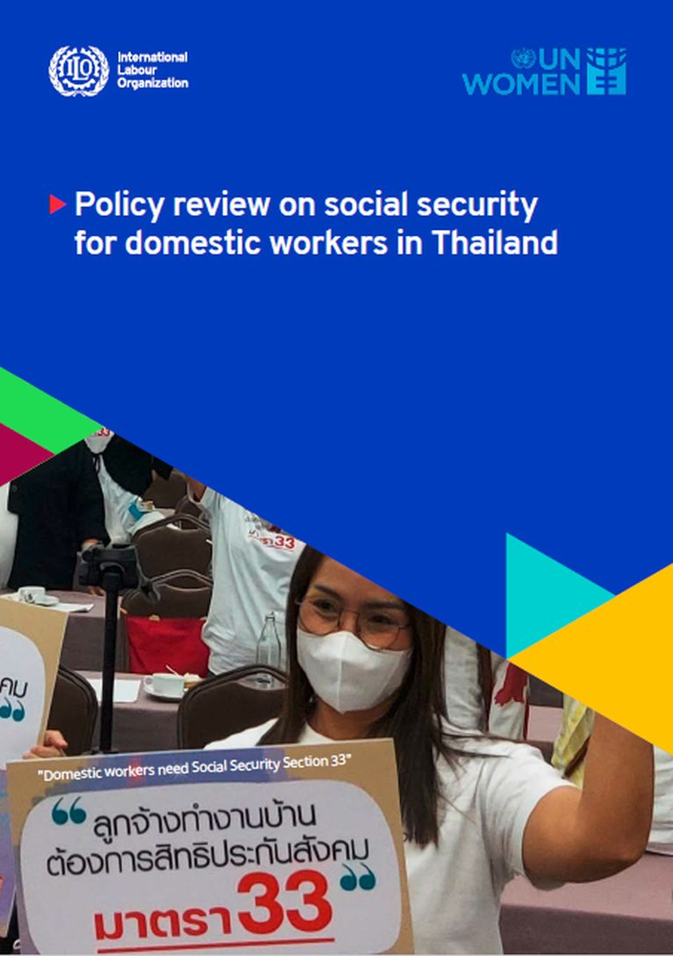

Co-branding logo
    Co-branding with
    other agency
    Co-branding in a multistakeholder
    partnership

Slide 17

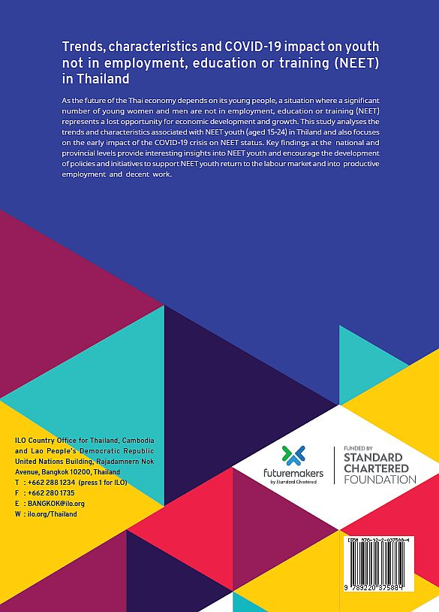
Where to put the donor’s logo?
    Put on the back cover
    Except there is a strong requirement from the donors to have their logos on the front cover, then put at the bottom with the text “Funded by” or “Financial support by” on top of their logos.

Slide 18



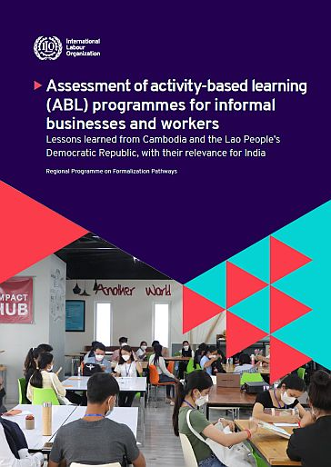









Cover design by publication types
Flagship reports
Major publications
Standard publications/reports
    In Design publication templates are downloadable here.

Slide 19
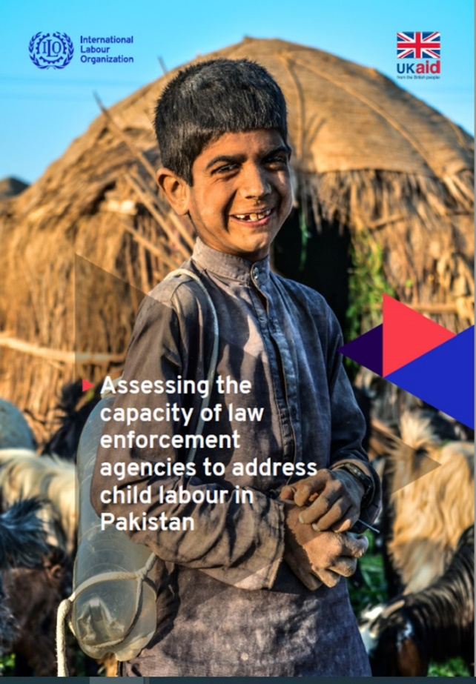
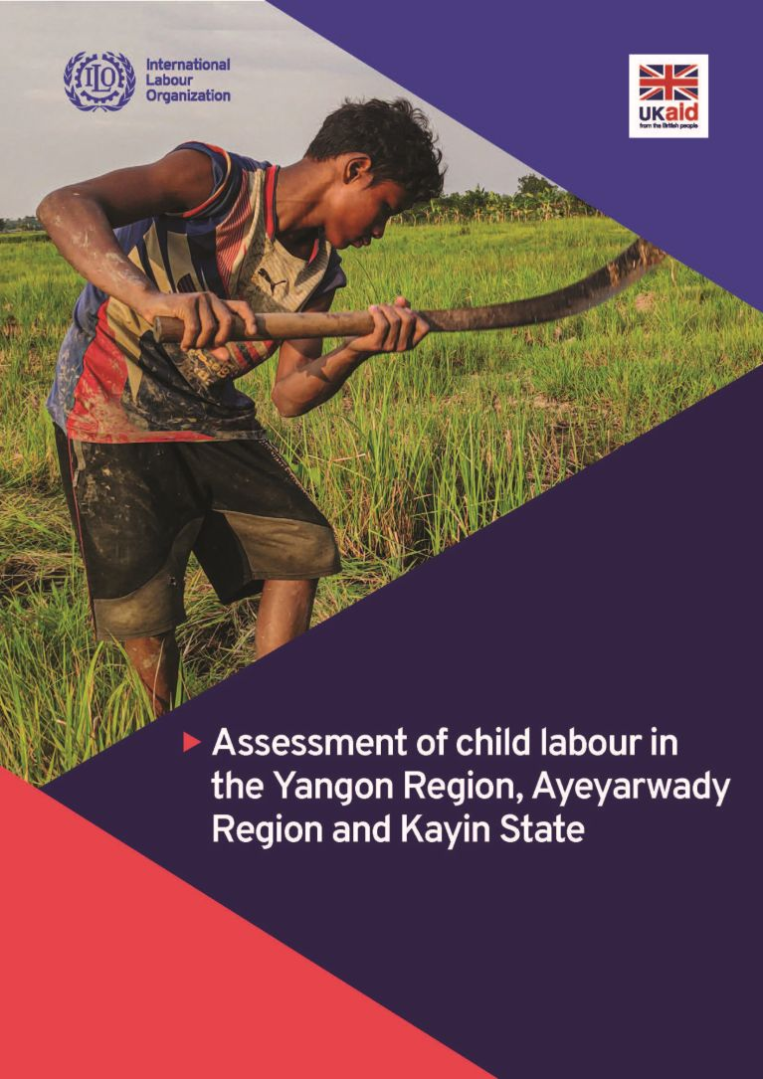
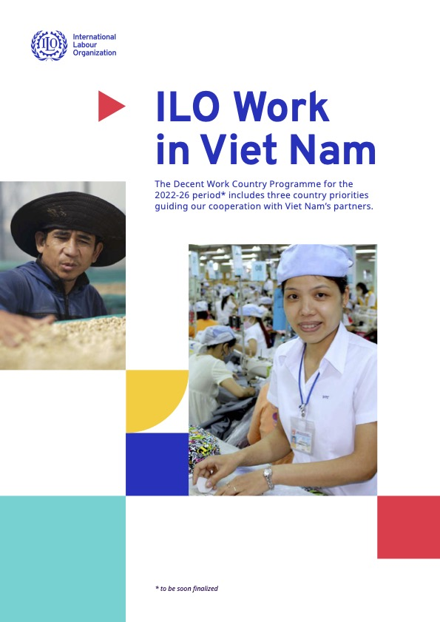
Wrong design samples
Standard publication/report
but was designed as
flagship report type.
Standard publication/report
but was designed as
major publication type.
Not in line with the ILO branding.

Slide 20
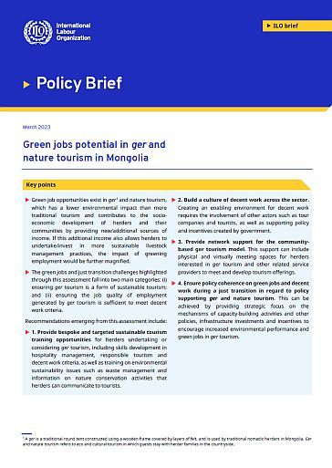
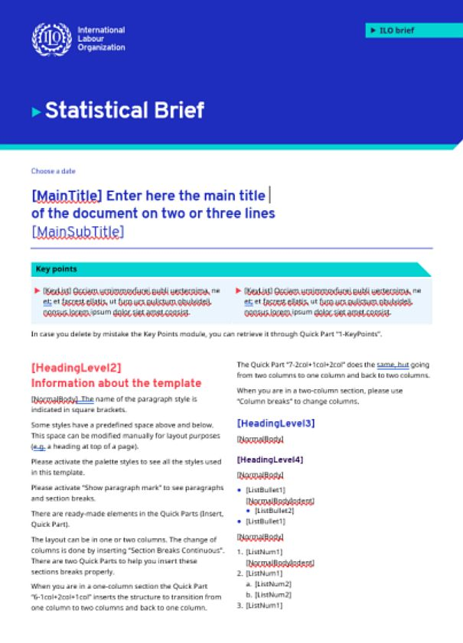
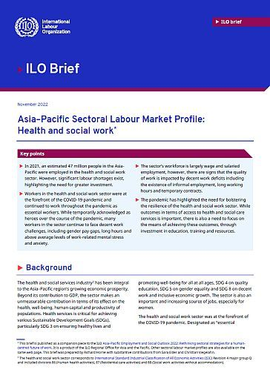
Briefs templates
    Word templates are downloadable here.

Slide 21
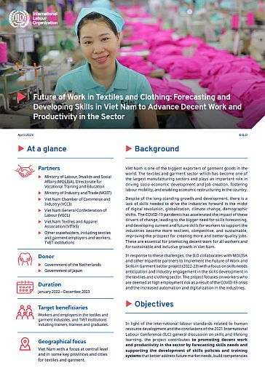

Project factsheet
    In Design templates are downloadable here.

Slide 22
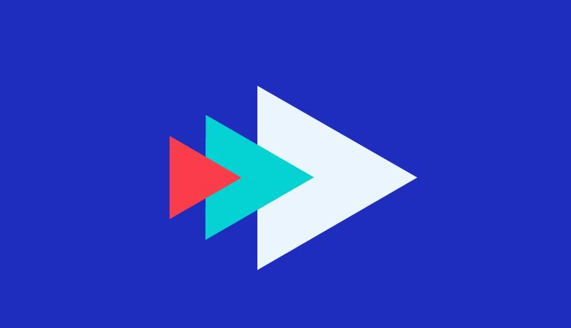
Useful links for ILO branding
    ILO branding
    Standard publication design and template
    Standard font types and sizes and Typography hierarchy
    ILO colour palettes
    Photo crediting
    ISBN barcode generator
    Graphic designer list
    TOR for graphic designer
Any questions: Contact brand@ilo.org or chanitda@ilo.org

Slide 23
Thank you

